Slide 1



Fairness-Aware Graph Filter Design
O. Deniz Kose¹, Yanning Shen¹, Gonzalo Mateos²
¹ EECS, University of California Irvine
² ECE, University of Rochester
2023 Asilomar Conference on Signals, Systems, and Computers
Acknowledgement: NSF awards CCF-1750428,
CCF-1934962, and ECCS 2207457

Slide 2
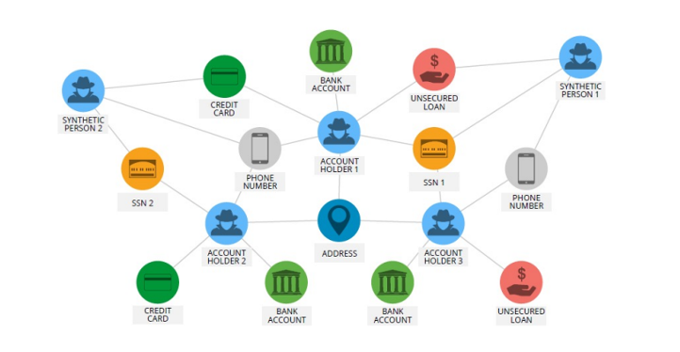

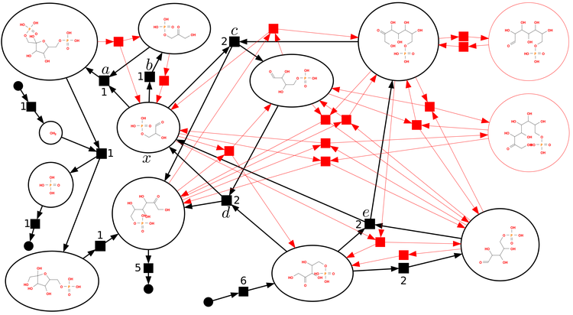
Graphs Everywhere
Social Networks
Chemical Networks
Financial Networks
The era of connectivity: Increasing data describing interconnected systems
Graphs : mathematical structures to model complex relations in such systems
  Nodes: users in social networks, accounts holding money in financial networks
  Edges: friendships between users, transactions between accounts
  Nodal features: location of users, size of money in accounts
1

Slide 3
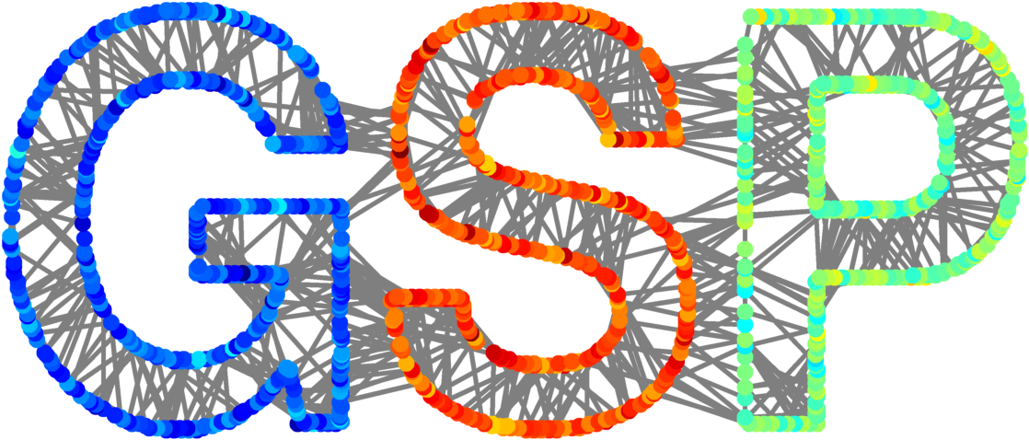
Learning over Graphs
Tools for Graph Data
Increasing amount of graph data → Processing & Learning from such data can facilitate various interconnected systems
Machine learning (ML) over graphs has attracted increasing attention
Use of graph signal processing (GSP) tools become widespread
  Extends signal processing tools to graph data
  Sampling, frequency-domain analysis, filtering
GSP and ML over graphs are closely intertwined
  ML algorithms can be improved by leveraging GSP tools [1]
Possible advancements by cross-pollinating the findings in both domains
[1] F. Gama, J. Bruna, and A. Ribeiro, “Stability properties of graph neural networks,” IEEE Transactions on Signal Processing, vol. 68, pp. 5680–5695, 2020.

Slide 4
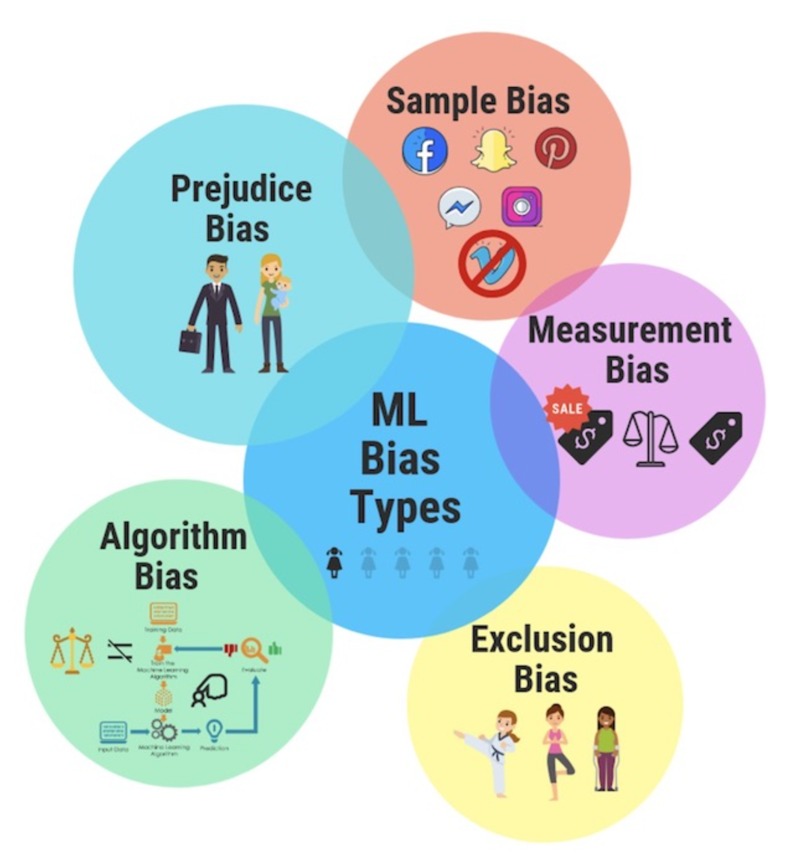
Learning over Graphs
Fairness & Bias in Machine Learning
Fairness: performance gap incurred by ML models with respect to certain sensitive attributes
  Gender or ethnicity
Algorithmic bias: stereotypical correlations ML models encode and propagate wrt sensitive attributes
ML algorithms may lead to biased results
  Different error rates on women/men faces in face recognition
  Different crime prediction rates based on ethnicity
  Different credit approval rates based on gender
Critical for various applications and policy making

Slide 5
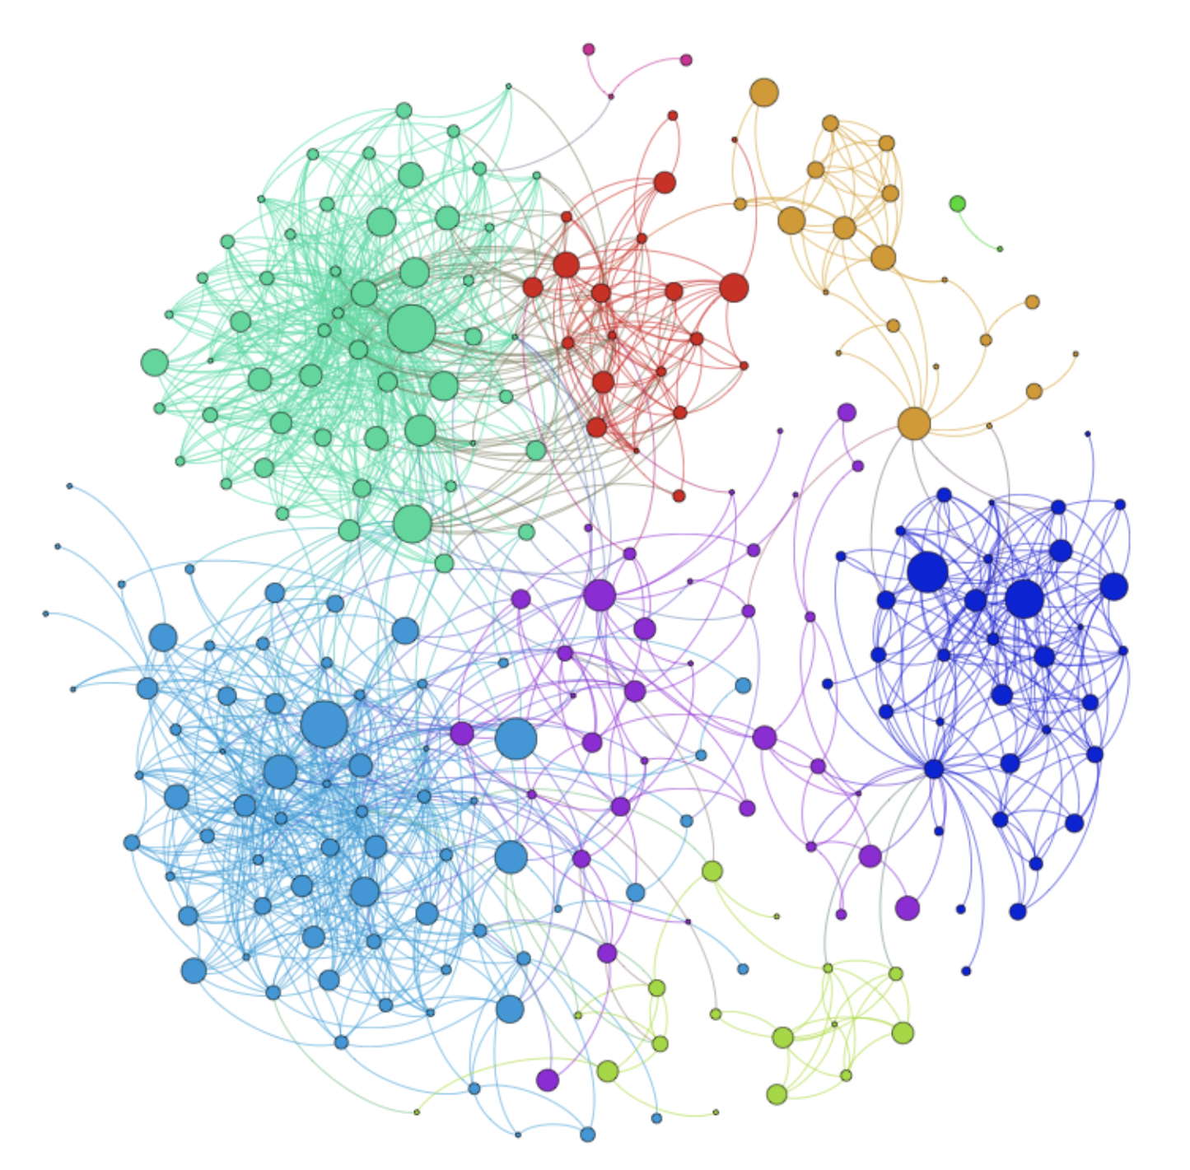
Bias in ML over Graphs
Learning over graphs amplifies already existing bias [1]
Relations between nodes based on sensitive attributes.
  Homophily: Higher probability for the connections between similar users (religion, ethnicity)
Indirect use of sensitive attributes in training!
Information aggregation over neighbors in graphs
[1] E. Dai and S. Wang, “Say no to the discrimination: Learning fair graph neural networks with limited sensitive attribute information,” in Proc. ACM Int. Conf. on Web Search and Data Mining (WSDM), March 2021, pp. 680–688.
4

Slide 6
Related Works & Contributions
Main strategies for fairness-aware learning over graphs
  Adversarial regularization: [Bose et. al., 2019], [Masrour et. al., 2020]
  Fairness constraints: [Buyl et. al., 2020]
  Fairness-aware pre-processing: [Kose et. al., 2022]
Algorithm-specific, task-specific, no theoretical justification
A novel, unsupervised bias metric for graphs
  Facilitate fairness-aware unsupervised learning from network data
We show filtering node representations can be used to manipulate bias metric
Via theoretical analysis, we design a surrogate cost leading to an LP problem
Optimal, closed-form solution
Novel filter design is versatile, can be employed in different stages of learning, and for various graph-based learning frameworks

Slide 7
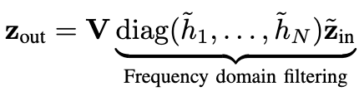
Preliminaries & Problem Statement
Focus on undirected graphs
Topology information: and
Sensitive attribute signal, , node labels, y
Nodal features,
Graph Fourier Transform: , where
Filtering: for a filter with frequency response
Problem Statement: Given and s, design a graph filter so that algorithmic bias sourced from graph topology can be attenuated

Slide 8
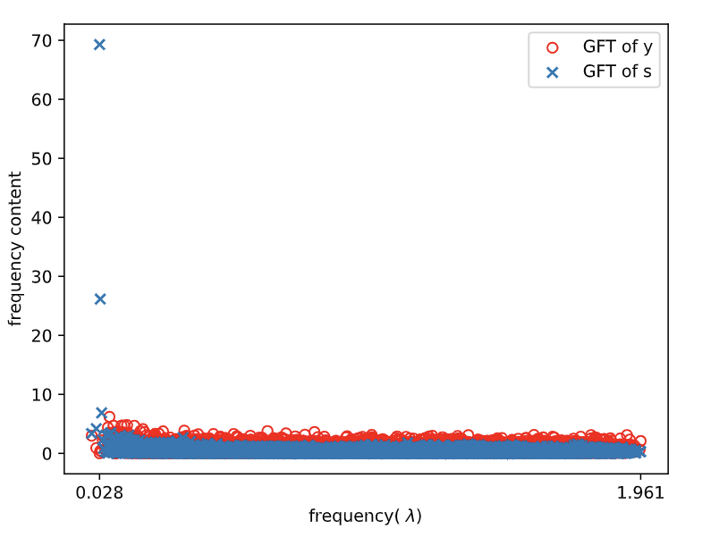
Preliminary Spectrum Analysis
Both sensitive attributes and node labels are smooth signals over graphs
  Expected higher energy concentration over lower frequencies
Design a filter preserving information for downstream task, while filtering-out sensitive information
Extent of overlap between the spectra of and
Subtle but important discordance

Slide 9
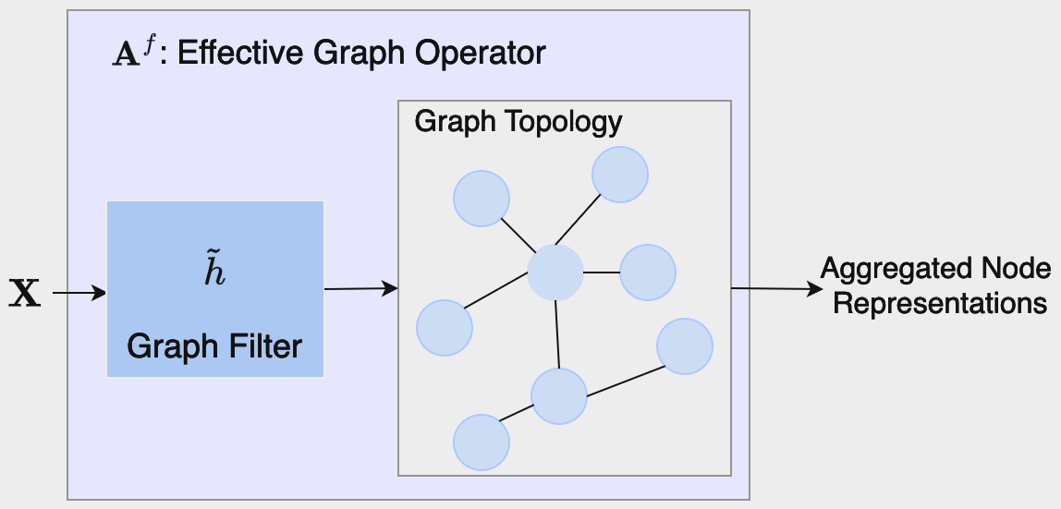
Bias Metric
Homophily principle → A graph structure highly correlated with s
Correlation between graph topology and sensitive attribute signal s
Graph-based ML relies on representations created via local aggregation
Case: A filter is applied to input graph signal before aggregation
Effective graph operator
Can be manipulated via filter design!
Proposed bias metric:

Slide 10
Bias Analysis and Filter Design
Proposition:
A surrogate cost allowing efficient minimization
Define , where
Utility/fairness trade-off
Protect information in frequencies not propagating bias
Closed-form solution:
where

Slide 11
Versatile Use of Proposed Design
Proposed filter applies to graph signals that are input to/output from learning algorithms
Filter is pre-computed, no modification in training
  Can be used as pre-trained bias mitigation operators before GNN layers
  Analogy to batch normalization layers

Slide 12
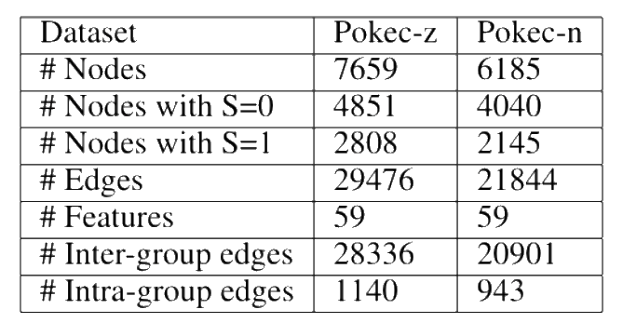
Experimental Settings
Datasets: Real-world Facebook-like networks Pokec-z and Pokec-n
  Sensitive attribute: location of users
  Label: binarized working fields
Task: Node classification
Utility: Classification accuracy
Fairness metrics:
Model: 2-layer GNN with ReLU activation

Slide 13
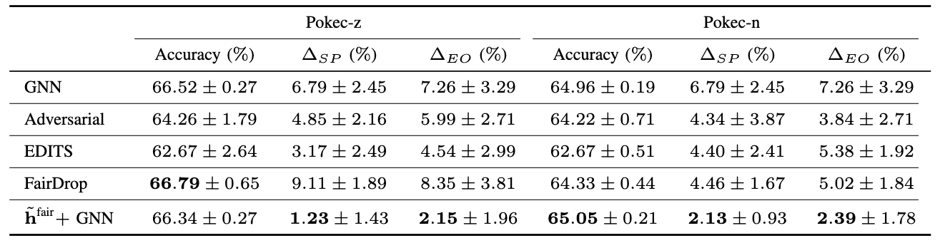
Experimental Results
Similar utility compared to fairness-agnostic baseline, GNN
Enhanced stability for both utility and fairness metrics
Better fairness compared to SOTA, fairness-aware baselines

Slide 14
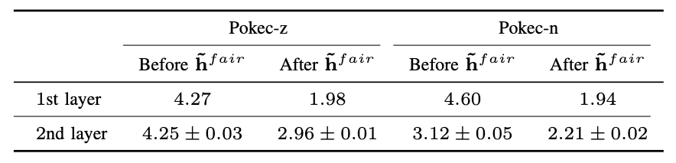
Correlation Analysis
Reduced correlation between s and aggregated representations → Better fairness
Learning over graphs amplifies bias
Proposed filter effectively reduces correlation
Reduction is observed for both layers

Slide 15
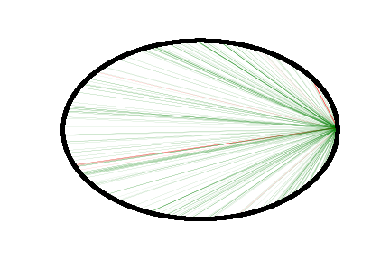
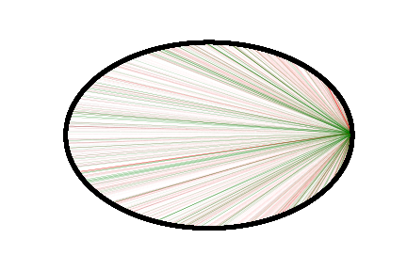
Explanation for Bias Mitigation
Unbalanced intra- and inter-edges leads to bias amplification [1]
Application of fair filter
A subgraph obtained from Pokec-z, intra-edges and inter-edges
Balancing effect is an explanation for bias mitigation
[1] O. D. Kose and Y. Shen, ”Demystifying and Mitigating Bias for Node Representation Learning", accepted to IEEE Transactions on Neural Networks and Learning Systems (TNNLS), 2023.

Slide 16
Conclusions
A novel bias metric, applicable to unsupervised settings
Theory-based surrogate loss allowing efficient, LP-based design
Closed-form solution, leading to optimal and efficient filter design
Versatile use, pre-trained computation
Future work: eigendecomposition-free, vertex domain designs

Slide 17
Thank you!

