Slide 1

GRAPH FREQUENCY ANALYSIS OF COVID-19 INCIDENCE TO IDENTIFY COUNTY-LEVEL CONTAGION PATTERNS
IN THE UNITED STATES
Yang Li and Gonzalo Mateos
Dept. of Electrical and Computer Engineering
University of Rochester
IEEE ICASSP 2021

Slide 2
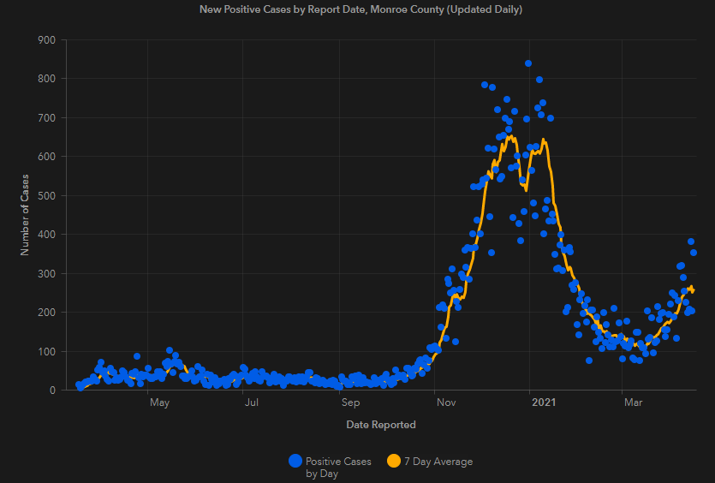
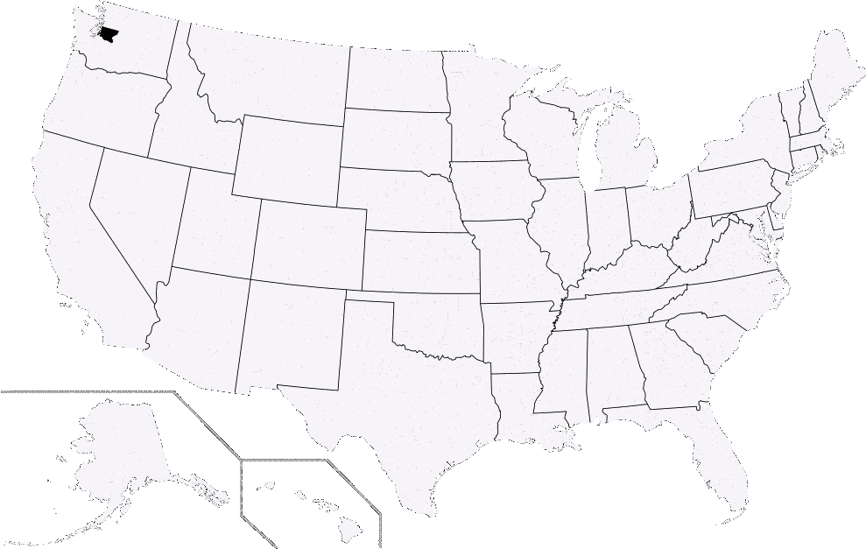
COVID-19 pandemic on US soil
Early scattered regional outbreaks to country-wide spread
Diverse patterns at various timescales and locations
Vital to understand spread patterns of the epidemic
In this work, we focus on:
Spatio-temporal study
  Case data from 3142 US counties
  Daily confirmed cases from Jan 22 to Aug 31, 2020
Graph frequency analysis
  Graph of commute flows between counties
  Graph signals and Graph Fourier Transform
  Identify spatial contagion patterns from frequency analysis
    Within/across counties ⬄ low/high-pass components
Contagion pattern transformation
  Study nature of contagion patterns within counties
  Investigate contagion pattern transformation
    From localized outbreaks to regional spread

Slide 3
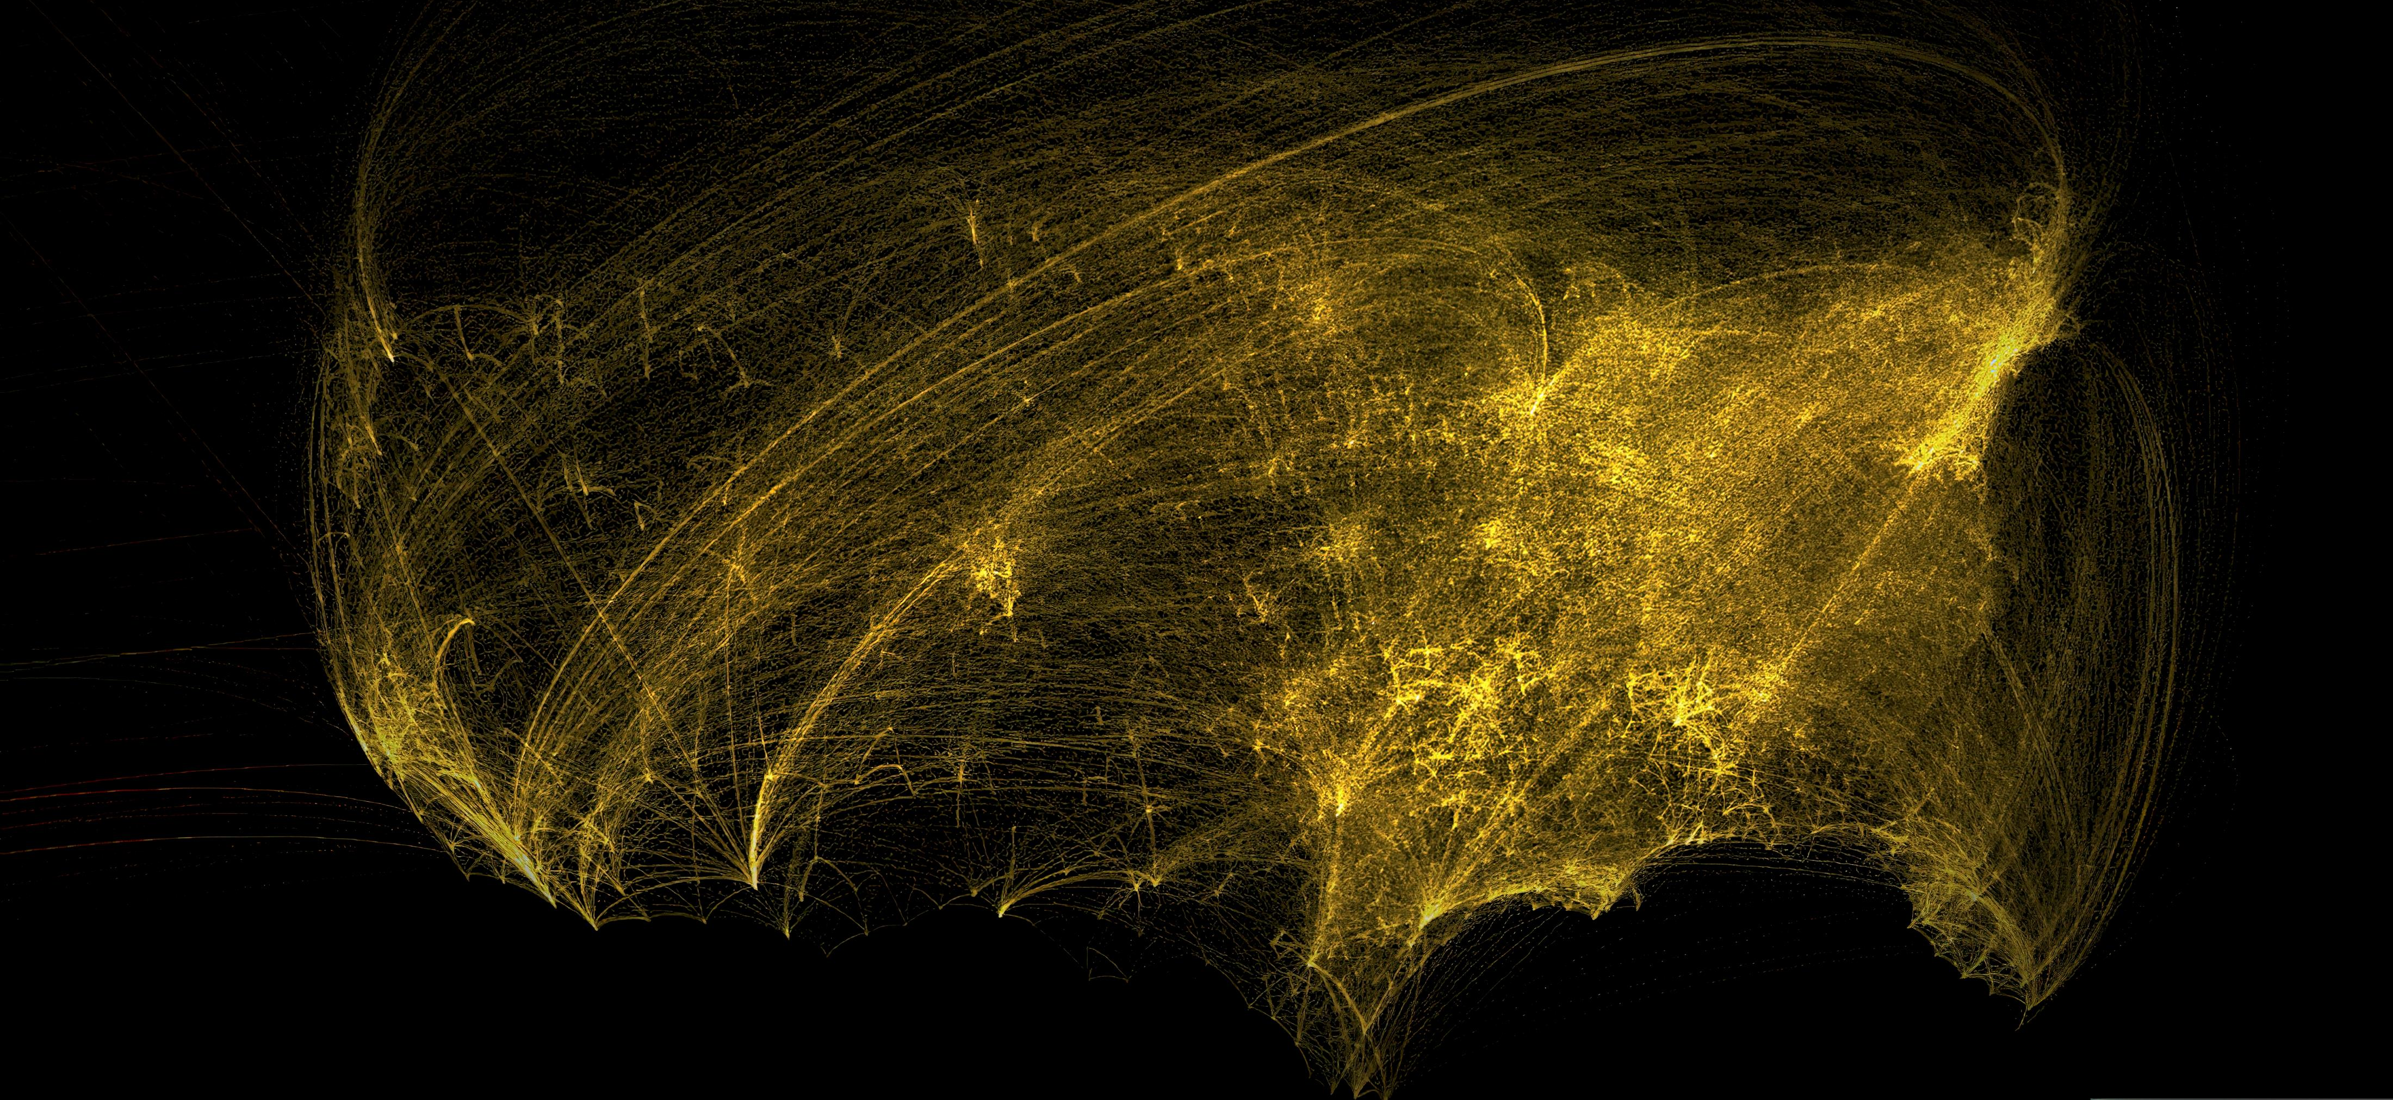
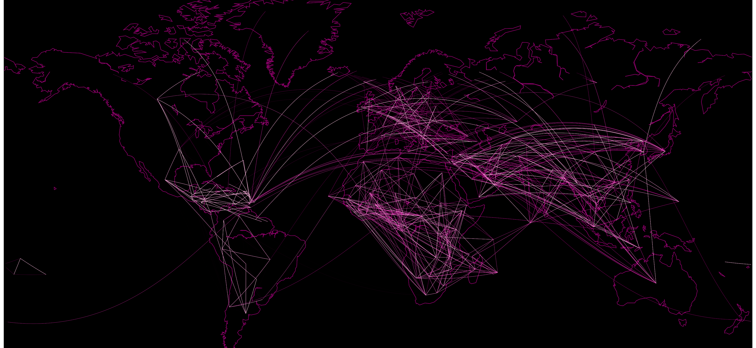
Graph-theoretic preliminaries
Graphs enable modeling complex interactions within data
  Nodes as data entities
  Edges as relations between nodes
  Nodal attributes of features of the elements of interest
Graph topology provides prior information about the graph signals
Graph signals determine and update pairwise node relationships
Graph Signal Processing (GSP)
  Leverage relational structure encoded in the graph
  Carry out information processing tasks
GSP advances in various applications
  Social networks, biological networks, etc.

Slide 4





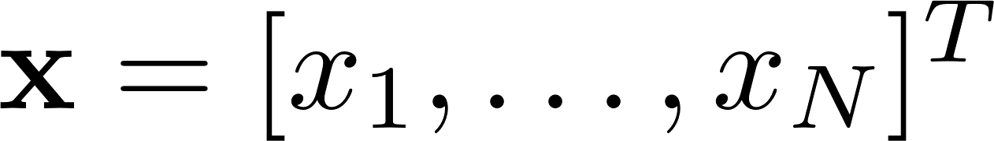
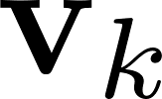






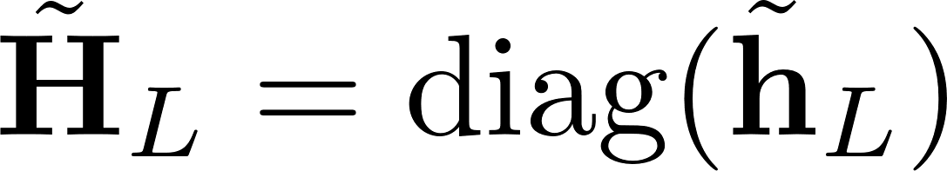
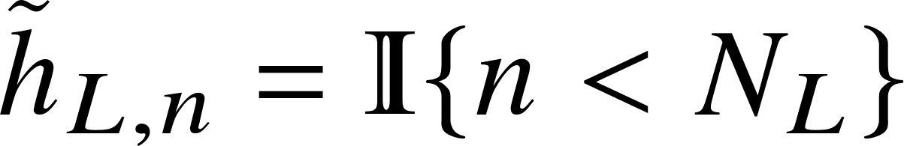

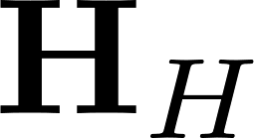
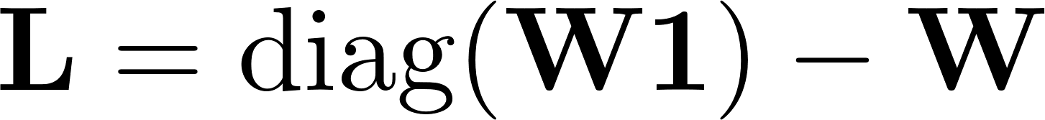
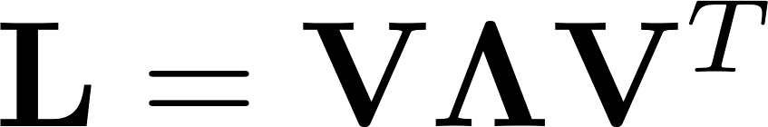
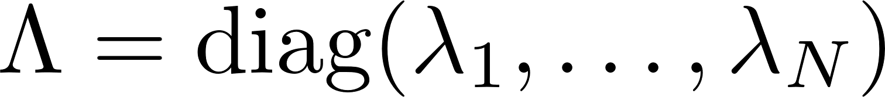


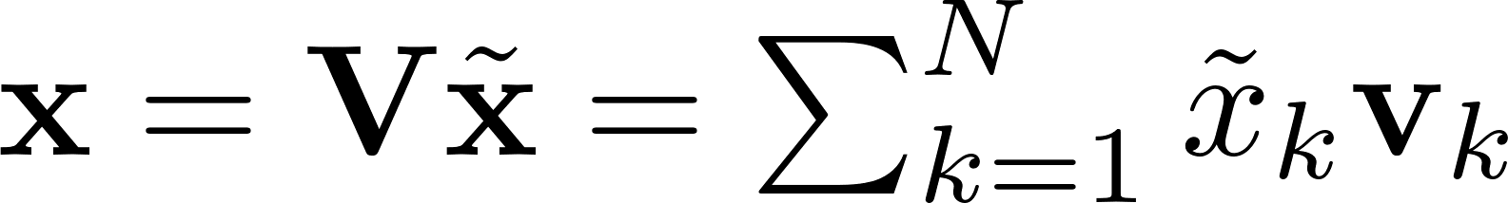
Weighted, undirected, and connected graph
  set of nodes and set of edges
Nonnegative reals
  Strength of connections (similarity or influence)
  Counties as nodes and amount of population commuting as edge weights
Signals associated with the graph nodes
  Daily confirmed cases per county
  Large ⬄ signal values and tend to be similar
  Spread of virus highly depends on commuting flows
Edge weights establish link between signal values and graph topology
  GSP approach within this work
Graph signal fundamentals
Graph filtering
Total variation of graph signal
  Quantify how much signal changes w.r.t weights in graph
Total variation of eigenvectors
  Eigenvalues viewed as graph frequency
  Indicate how eigenvectors vary over the graph
Isolate the lowest eigenvalues and corresponding eigenvectors
Graph filtering operation in the vertex domain
  Graph band-pass filter and high-pass filter
Map each frequency component back to vertex domain
Graph Fourier Transform
Decompose graph signal into orthonormal components
  Different modes of variation w.r.t graph topology
Represent graph signals in vertex domain and frequency domain
Laplacian eigenvalues
Orthonormal matrix of eigenvectors
GFT encodes a notion of signal variability over the graph
  Akin to the frequency in Fourier analysis of temporal signals

Slide 5
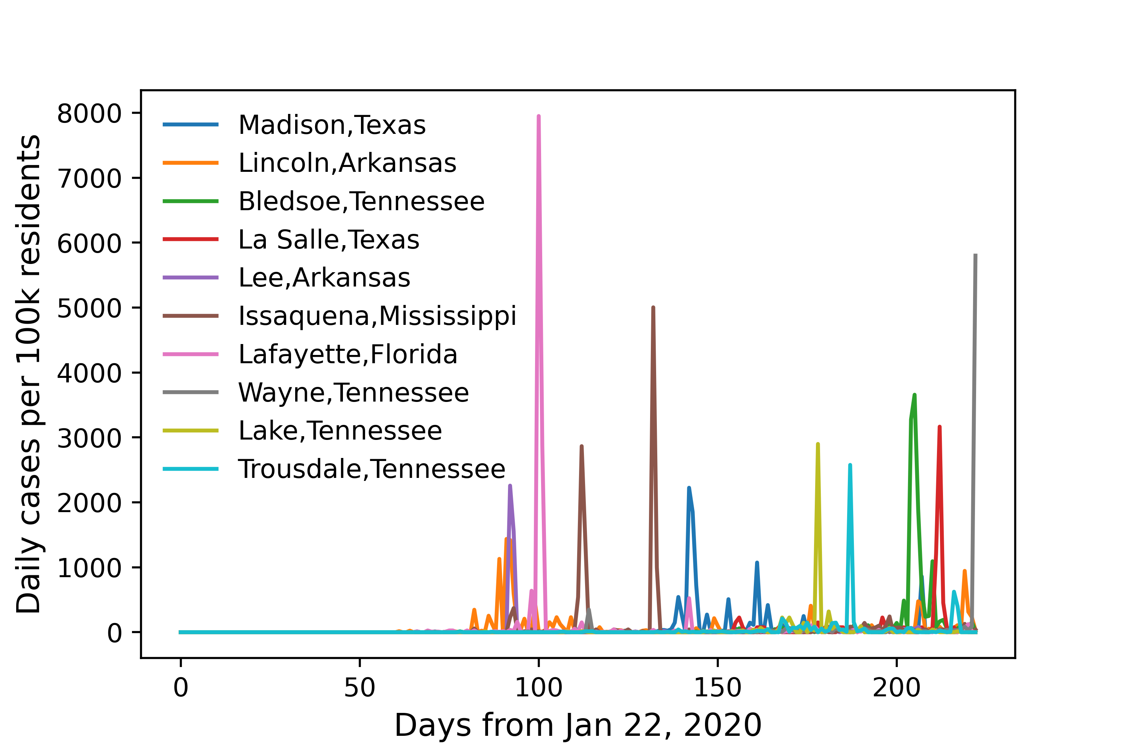
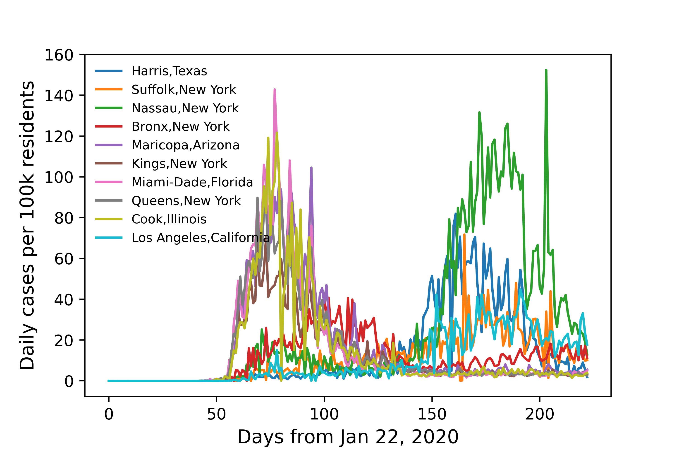
COVID-19 data as graph signals
Daily number of confirmed COVID-19 cases per 100k residents for
  3142 counties in US
  Jan 22 to Aug 31, 2021 (223 days in total)

Slide 6
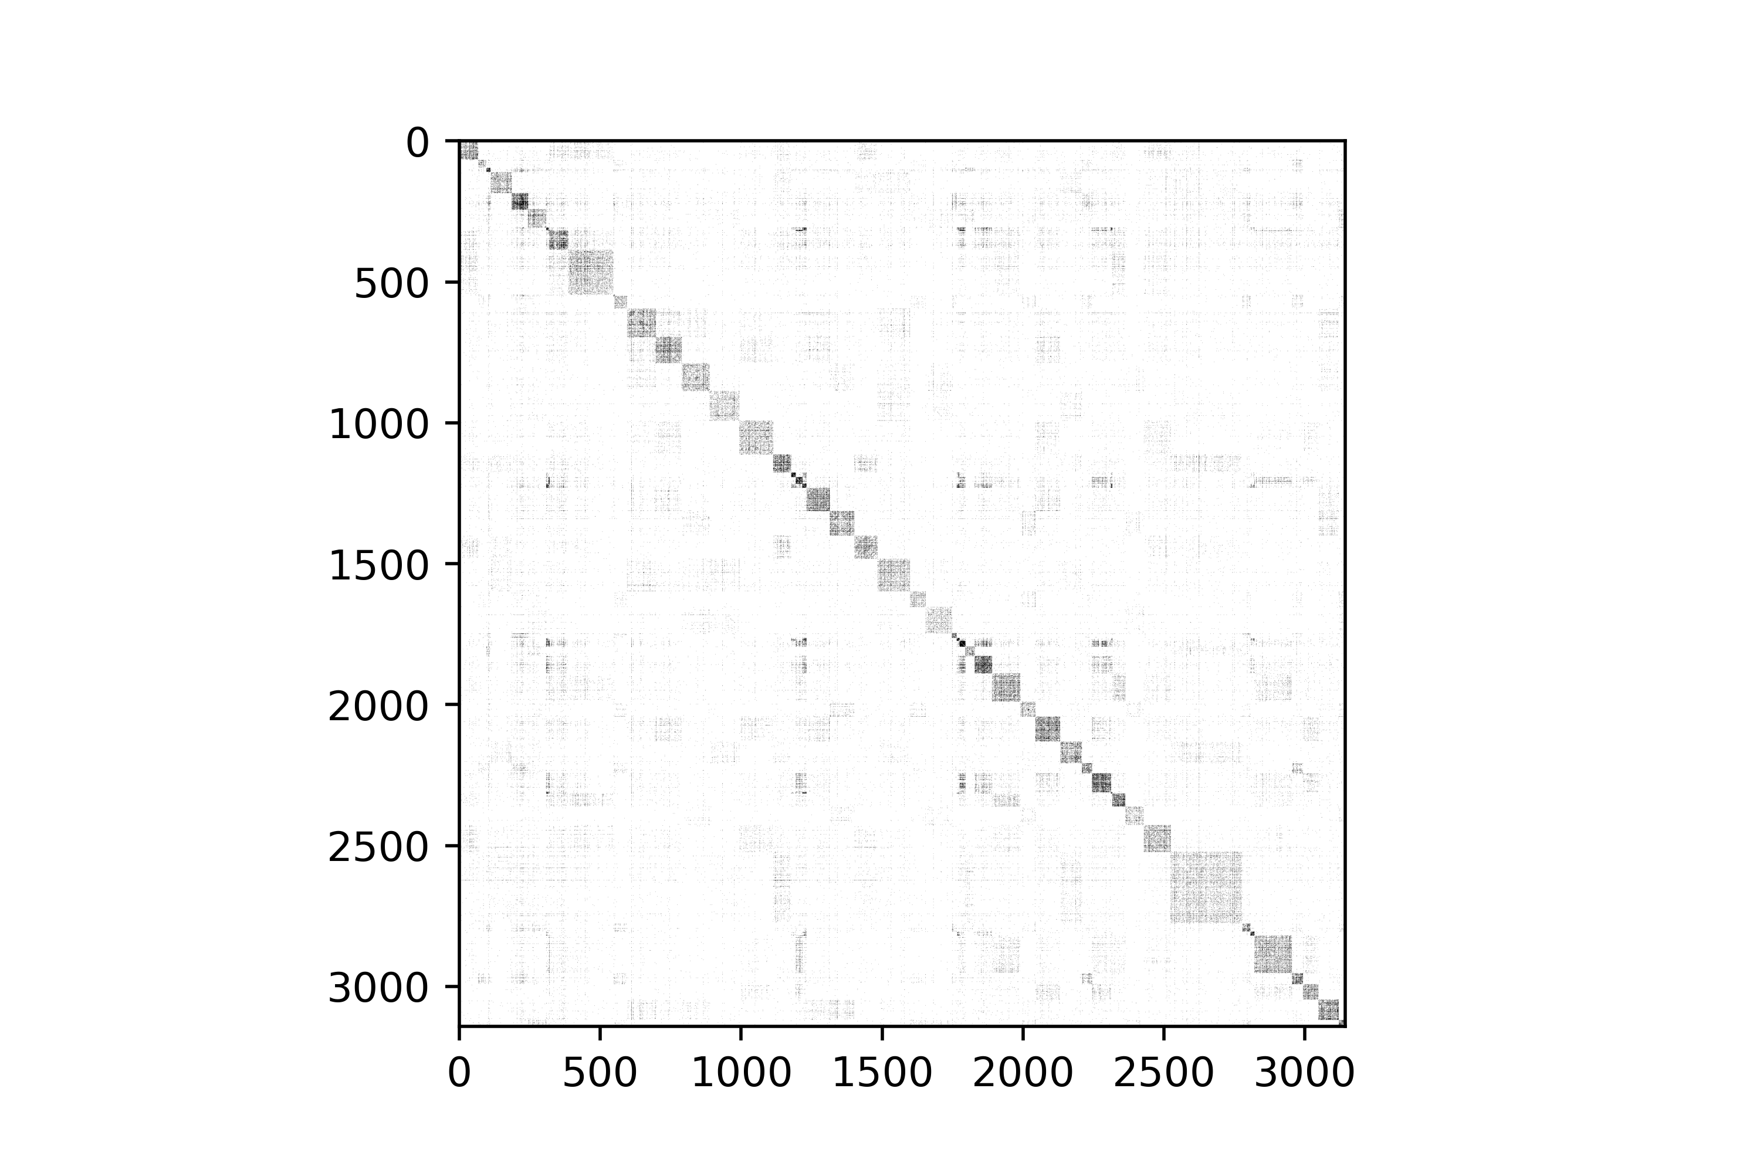
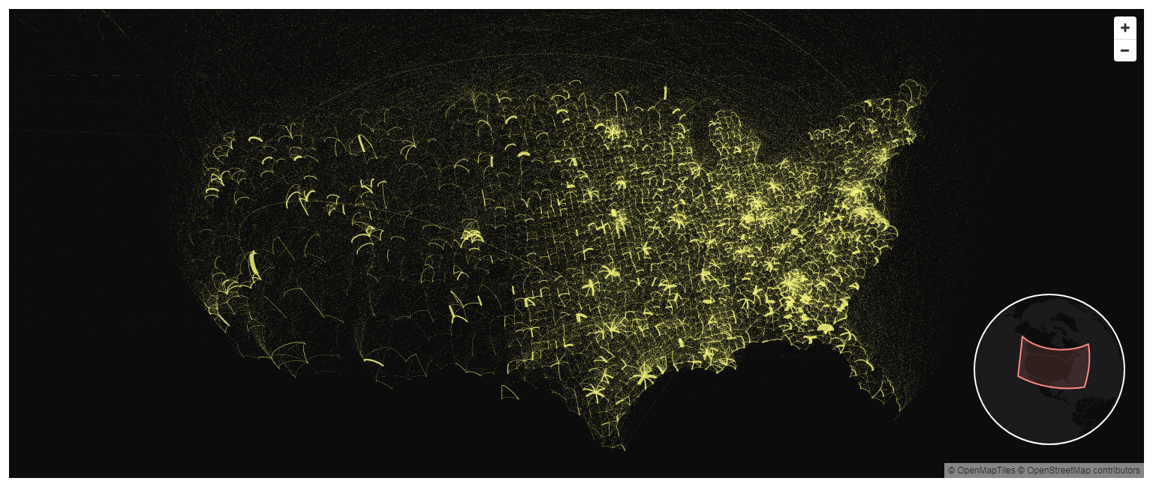
Graph construction
Commute flow data from 2011 to 2015 (US Census Bureau)
  Population mobility between US counties
  Capture nominal flows trend
Weighted undirected graph constructed
  One node for each county
  Edge weights of average population flow between counties
    Normalized by the intra-flows (mobility within each county)

Slide 7
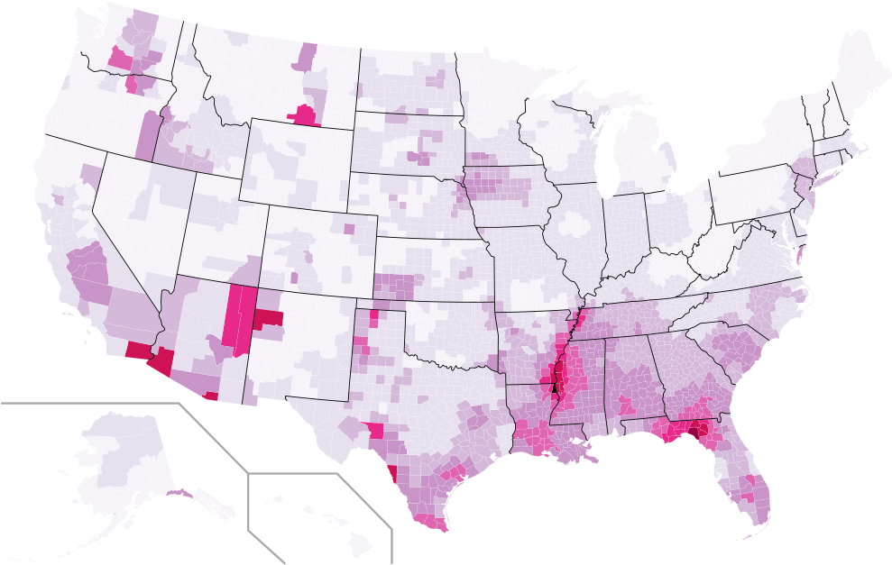


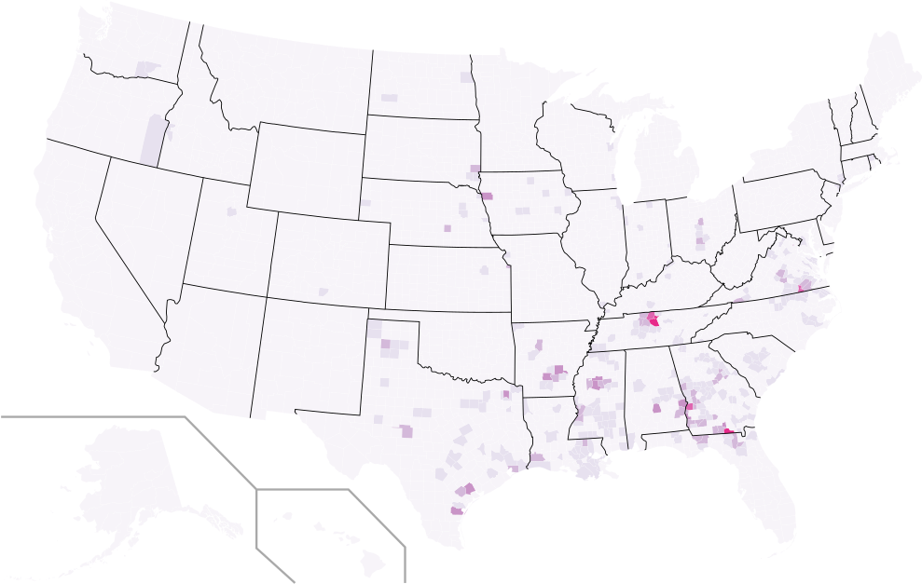



Frequency decomposition of graph signals
Graph signals and graph , carry out graph signal decomposition
Compute eigenvalues and eigenvectors of the Laplacian matrix of
Constructed low/high-pass filter by
  Taking the lowest/highest 1/5 of the eigenvalues
Original decomposed into
Components that change slowly/mildly/rapidly w.r.t graph
Take the row-wise average of absolute values of and to
  Quantify signal magnitude per county
  Energy occupancy in low/high-pass spectral band
  HP regions, LP regions

Slide 8
Frequency decomposition of graph signals
LP regions have similar number of daily confirmed cases
  Normalized by population size with neighboring counties
  Aligned with the commute flows in between
  Smooth signals on graph
HP regions present distinct and abnormal signals
  Against nearby counties
  Despite of the population mobility between them
  High-variability signals

Slide 9
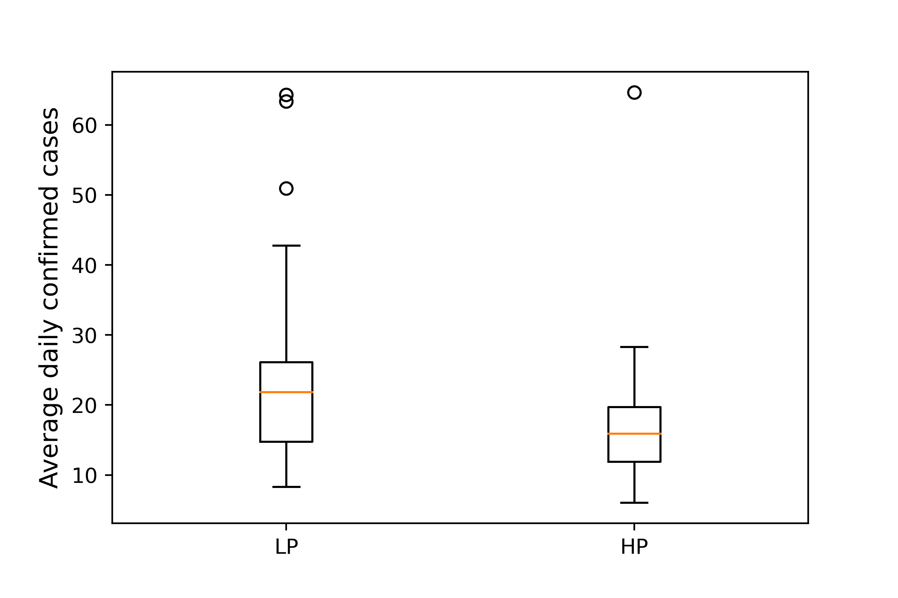
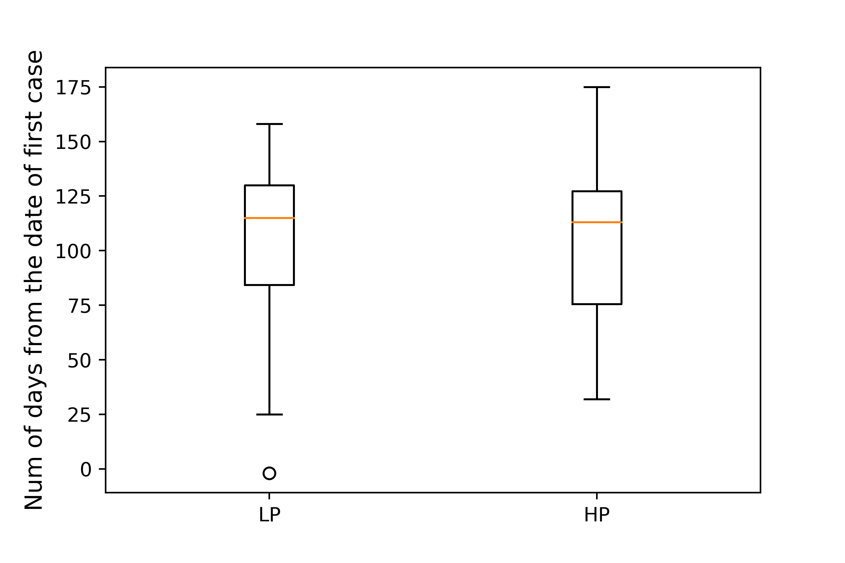
Frequency analysis w.r.t contagion patterns
LP regions have more daily cases and take longer to reach peak
LP regions are more densely gathered on map
LP regions suffer from across-county spread with
  Continuous increasing rate
  Longer contagion period
HP regions located distributively in isolated areas
HP regions suffer more from within-county outbreak with
  Fast increase rate
  High magnitude of high-pass signals

Slide 10
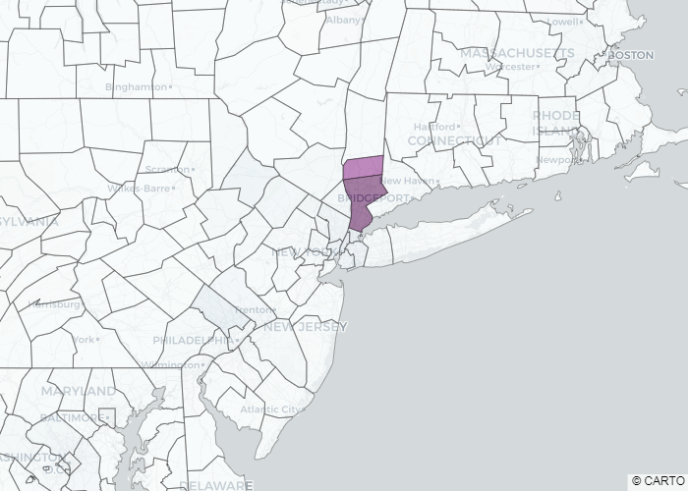
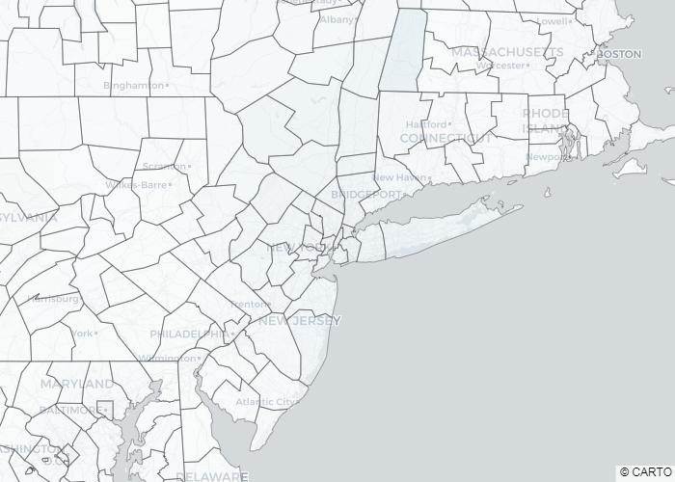
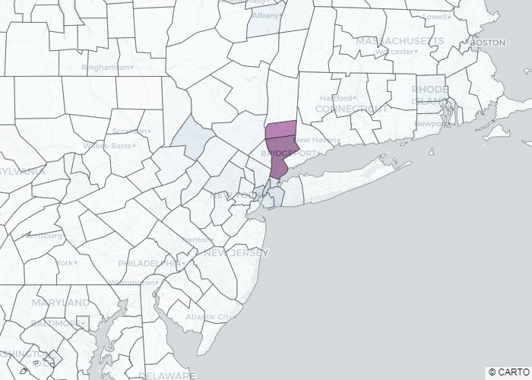
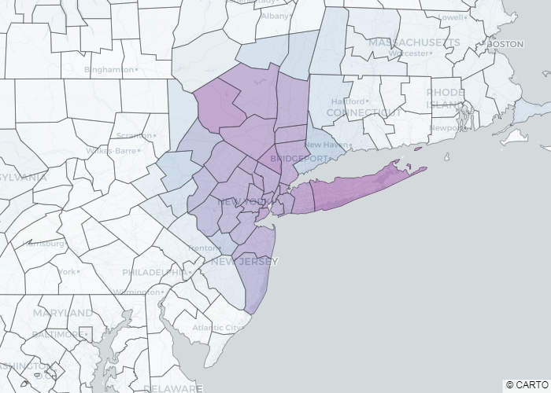
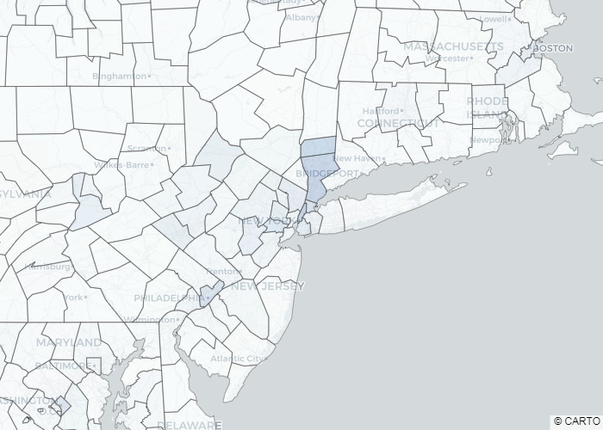
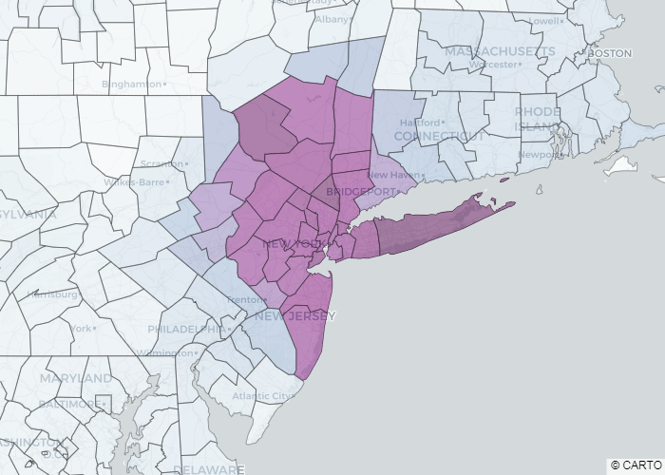
Temporal analysis of signals
Lose rich temporal information by
  Taking average of decomposed signals
Partition complete signals into temporal windows
  The row-wise average of each window was taken
  Focus on New York city area
Localized outbreak identified as a high-pass signal first
  Started in the Westchester county at week 6
Magnitudes of high-pass signals decreased
Low-pass signals started gaining dominance
Transformation of localized outbreak to widely spread
  Reflected in the graph frequency analysis
  Transition between frequency bands
HP week 6
LP week 7
HP week 8
LP week 9
HP week 10
LP week 11

Slide 11
Conclusions and Future work
Investigated the tool of Graph Signal Processing
Applied it for analysis of COVID-19 contagion patterns
Information extracted from graph frequency domain
  Graph low/high frequency ⬄ across/within-county contagion spread
GSP provides novel insights for mining and learning vital information from graphs.
Future work shall be devoted to
  Consider dynamic population mobility to construct graphs
  Focus more on spatio-temporal analysis on finer scales

