Slide 1



Parallelizable Algorithms for the Selection of Grouped Variables
Gonzalo Mateos, Juan A. Bazerque, and Georgios B. Giannakis
January 6, 2011
NSF grants CCF-0830480, 1016605 and ECCS-0824007
Acknowledgement:
Notes:
Thank you for attending this talk. I will present this joint work with Gonzalo Mateos and our advisor Prof. Giannakis. The paper presents an algorithm to obtain the Lasso estimator in a distributed fashion.

Slide 2
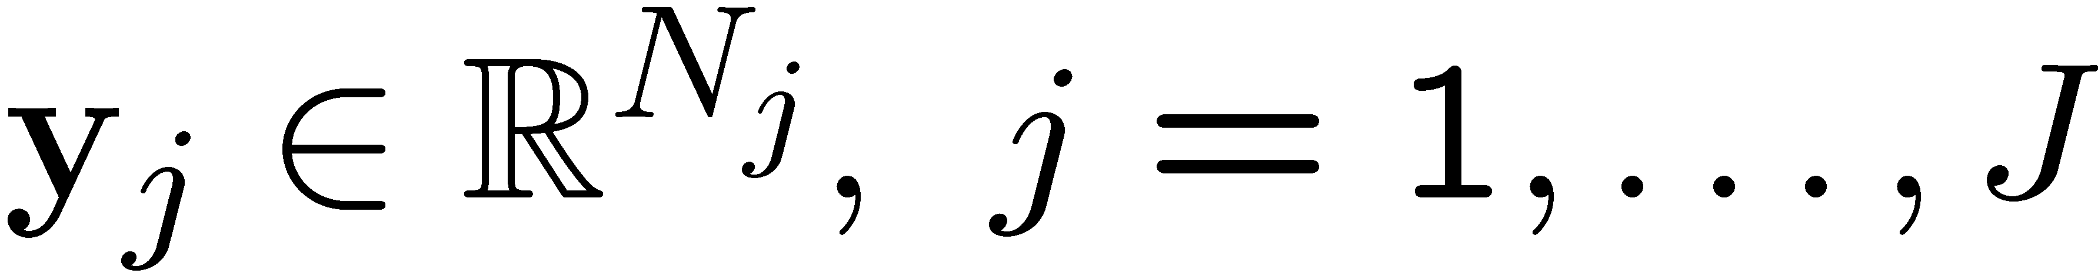

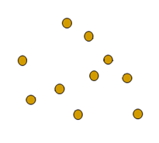
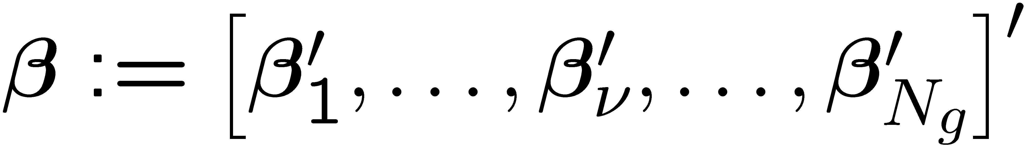

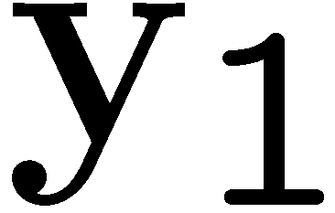

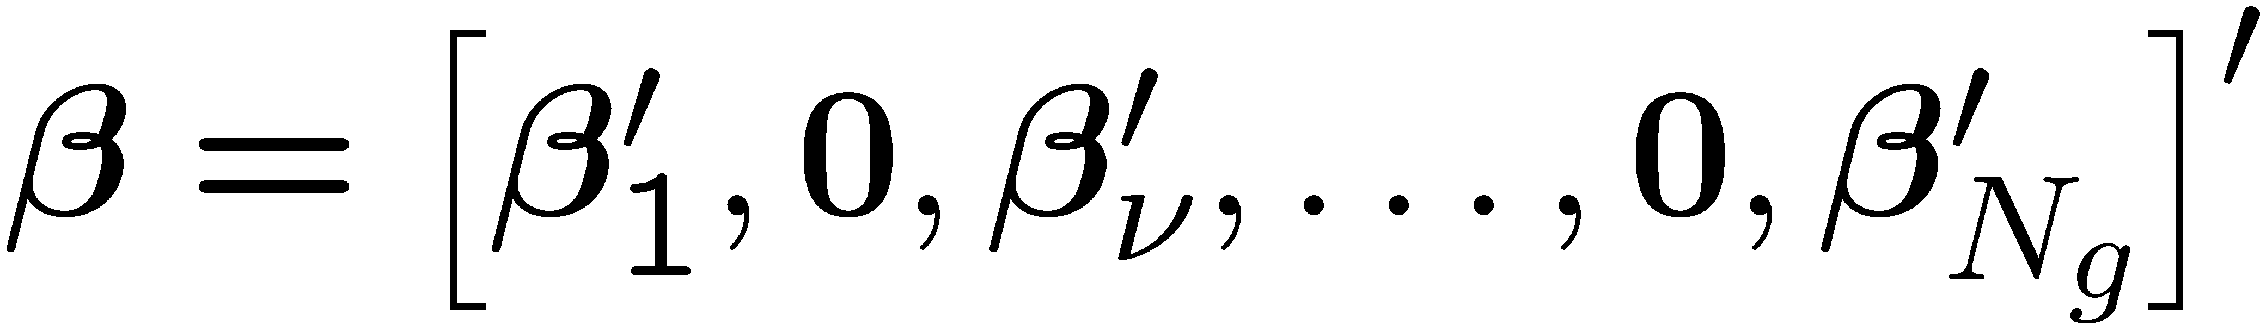
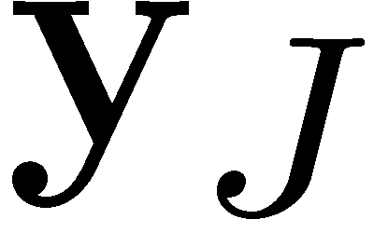
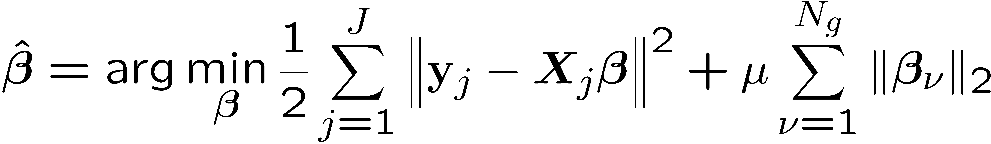
Distributed sparse estimation
Data acquired by J agents
Linear model with common
agent j
Group-level sparsity
Group Lasso
M. Yuan, Y. Lin “Model selection and estimation in regression with grouped variables,” Journal of
the Royal Statistical Society, Series B, vol. 68, pp. 49-67, 2006.
2
Notes:
In our set up there are data vectors y j of possibly different dimensions Nj that are acquired by agents denote by the index j from 1 to capital J.
These agents, you can call them wireless sensors, cognitive radios, etc are located at different points in space as shown in the figure.
In our model yj conform to a linear model with regressor matrices Xj and a vector beta common to all censors. The entries of beta are divided in groups or subvectors denoted by beta_nu, with nu being an index between 1 and the number of groups N_g.
The main assumption is that beta is sparse at the group level. That is, some of the subvectors or groups beta nu are assumed to be null.
Then we use the group lasso estimator which has the ability to effect the group sparsity, taking advantage of this prior knowledge.

Slide 3
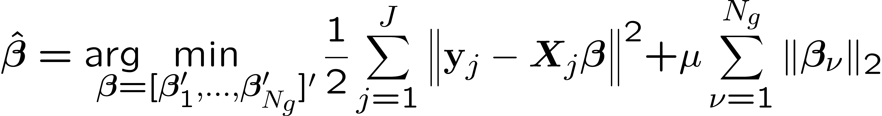
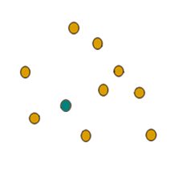
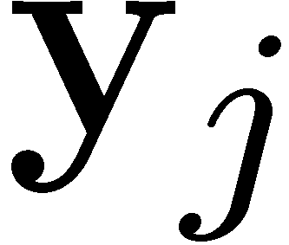
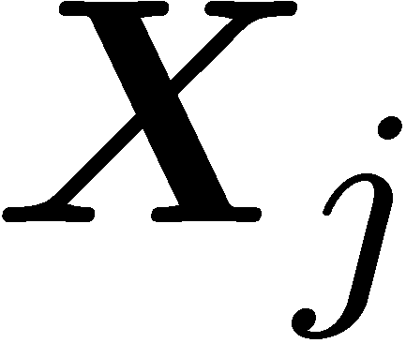

Network structure
(P1)
Centralized
Decentralized
Fusion
center
Ad-hoc
Scalability
Reliability
Lack of infrastructure
Problem statement
Given data and regression matrices available locally at agents
j=1,…,J , solve (P1) with local communications among neighbors
3
Notes:
So we have to solve problem 1 with data distributed across space. A reasonable thing to do is to select one of the agents and send all the data to its locations so that it can estimate beta with a standard group lasso solver. However there is a number of well documented reasons to prefer an ad-hoc network, for instance to avoid a global failure if the fusion center stop working. Then we will work with a decentralized network in which each radio communicates with its nearby neighbors. For the sake of clarity, our goal is: given the data vectors yj and the regressor matrices x j available locally at the agents we want to obtain the minimiser of problem 1 in a decentralized fashion.

Slide 4
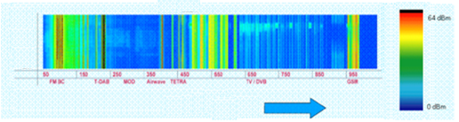
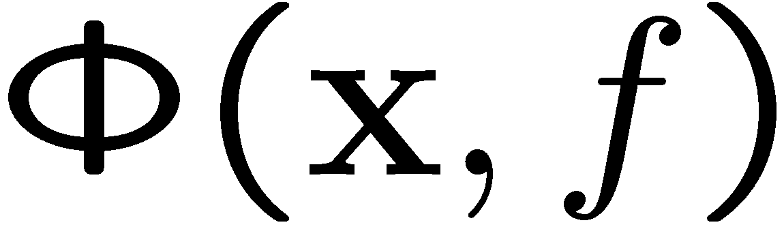
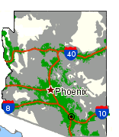




Motivating application
Scenario: Wireless cognitive radios (CRs)
Frequency (Mhz)
Goal: Spectrum cartography
Find PSD map across
space and frequency
Specification: coarse approximation suffices
Approach: basis expansion of
J. A. Bazerque, and G. B. Giannakis, “Distributed Spectrum Sensing for Cognitive Radio Networks by Exploiting Sparsity,” IEEE Transactions on Signal Processing, vol. 58, no. 3, pp. 1847-1862, March 2010.
4
Notes:
And before presenting our method, let me use four slides to show the application that prompted us to develop the distributed group lasso. In the scenario of wireless communications we wanted to do what we call spectrum cartography. That is to find a map phi of the spectrum across space and frequency. As I tried to exemplify in these pictures if you fix the point x in space we obtain how the spectrum looks at this point, and if you fix the frequency, then you have a coverage map over the area of interest, In this case Arizona.
4

Slide 5
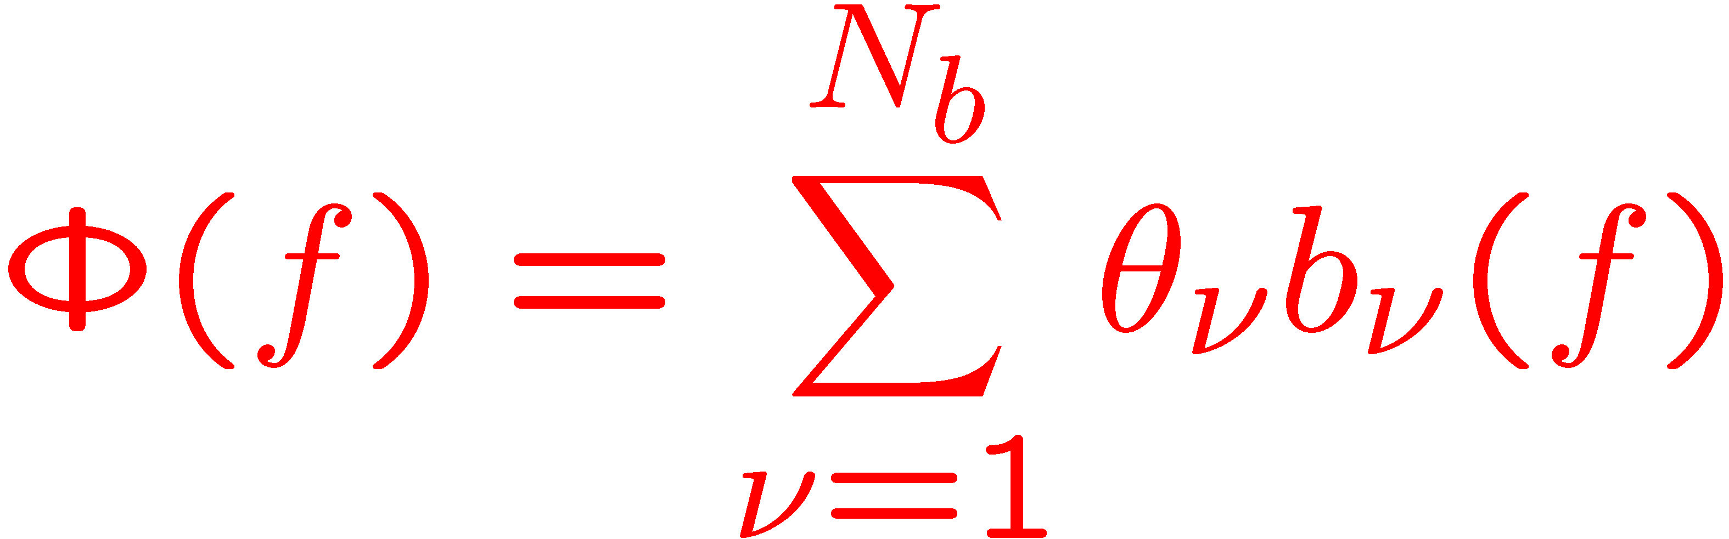
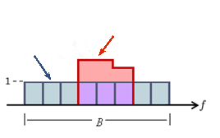
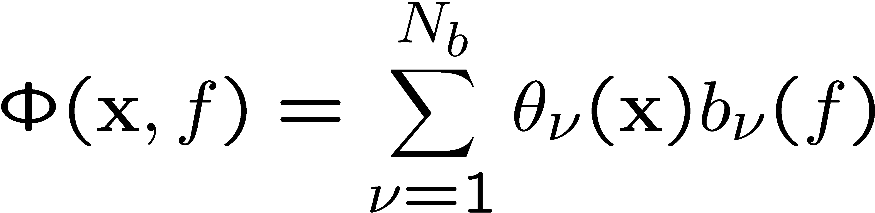
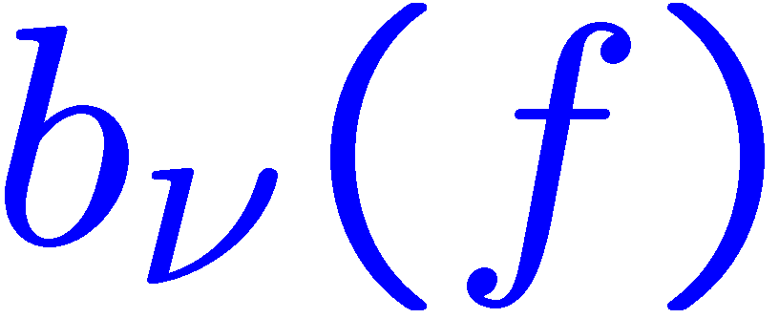
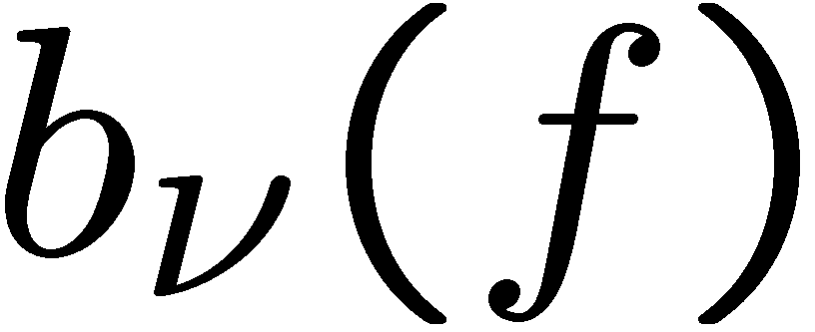
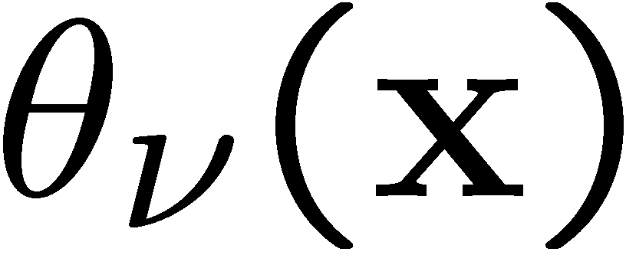

Basis expansion model
Basis expansion in the frequency domain
: known bases accommodate prior knowledge
: unknown dependence on spatial variable
Learn shadowing effects from periodograms at spatially distributed CRs
Notes:
Our bilinear basis expansion model assumes that at any point in space the spectrum can be approximated by a combination of bases denoted by b_nu, for instance the blue rectangular boxes in the figure. The variation of the PSD across space is then expressed in the coefficients theta nu which are considered as function of the space variable x.
We select which bases to use, so they are known to us, and the problem is to estimate the functions theta nu from periodogram data aquired by a set of J sensing radios.

Slide 6
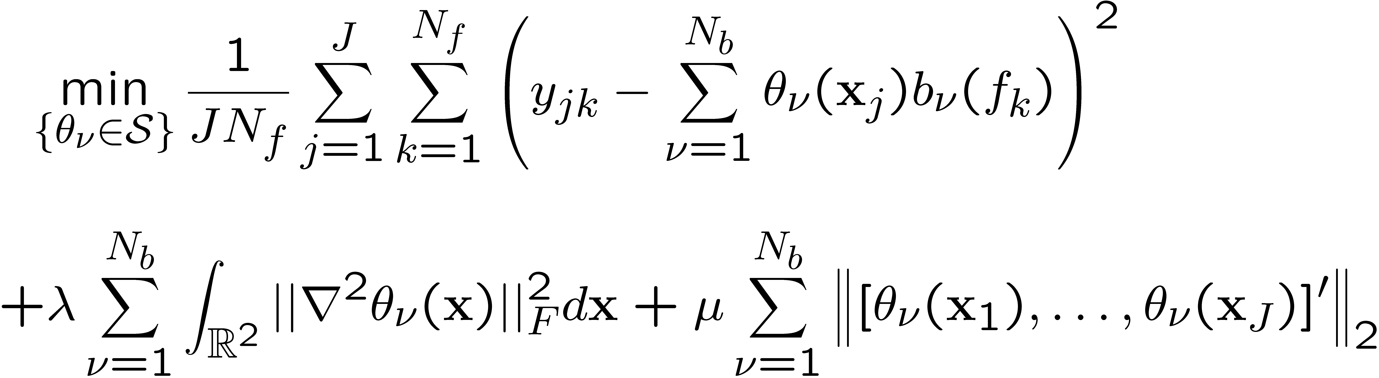
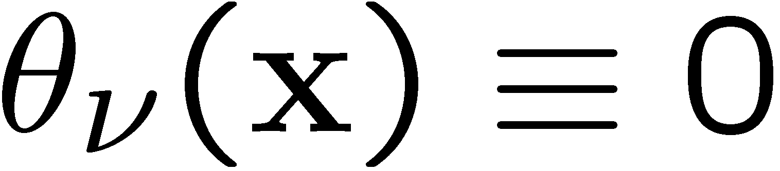

Nonparametric compressed sensing
Twofold regularization of variational LS estimator for
(P2)
smoothness regularization
sparsity enforcing penalty
Goals:
  Avoid overfitting by promoting smoothness
  Nonparametric basis selection ( not selected)
J. A. Bazerque, G. Mateos, and G. B. Giannakis, "Group-Lasso on Splines for Spectrum Cartography," IEEE Transactions on Signal Processing, submitted June 2010; also arXiv D.O.I 1010.0274v1[stat.ME]
Notes:
The we proposed the following estimator. We look for functions theta with continuous second derivatives, and minimize the residual sum of squares between the periodograms yjk and the psd model at a set of preselected frequencies f_k and positions of the sensing radios x_j. Two regularizing penalties are added, the first is intended to avoid overfitting by controling smoothness as it penalizes functions with strong Hessians. The second penalty is intended to set some of the functions theta nu to zero. As we’ll see, even if the functions are penalized at the measured points x_j, some of the functions are set identically to zero, removing the corresponding bases from the model. By tuning the parameter mu, we indicate the estimator how many bases should survive in the psd map estimate.

Slide 7

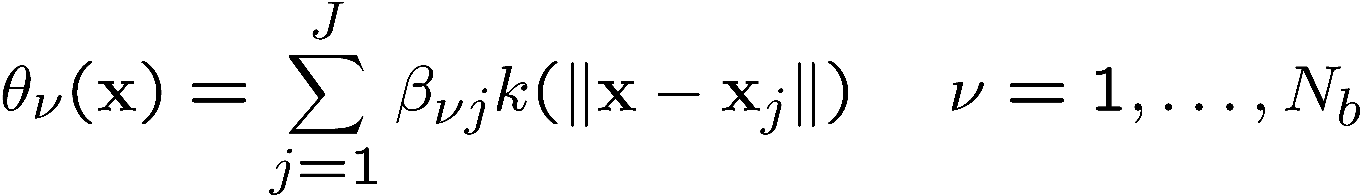

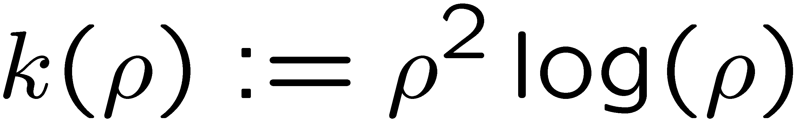




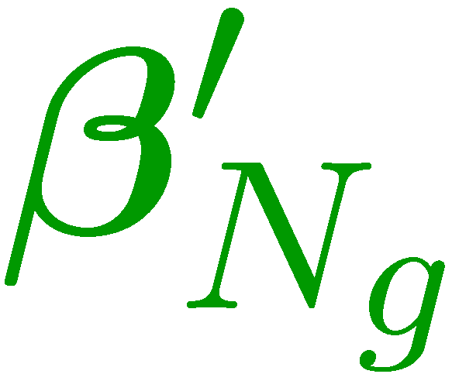

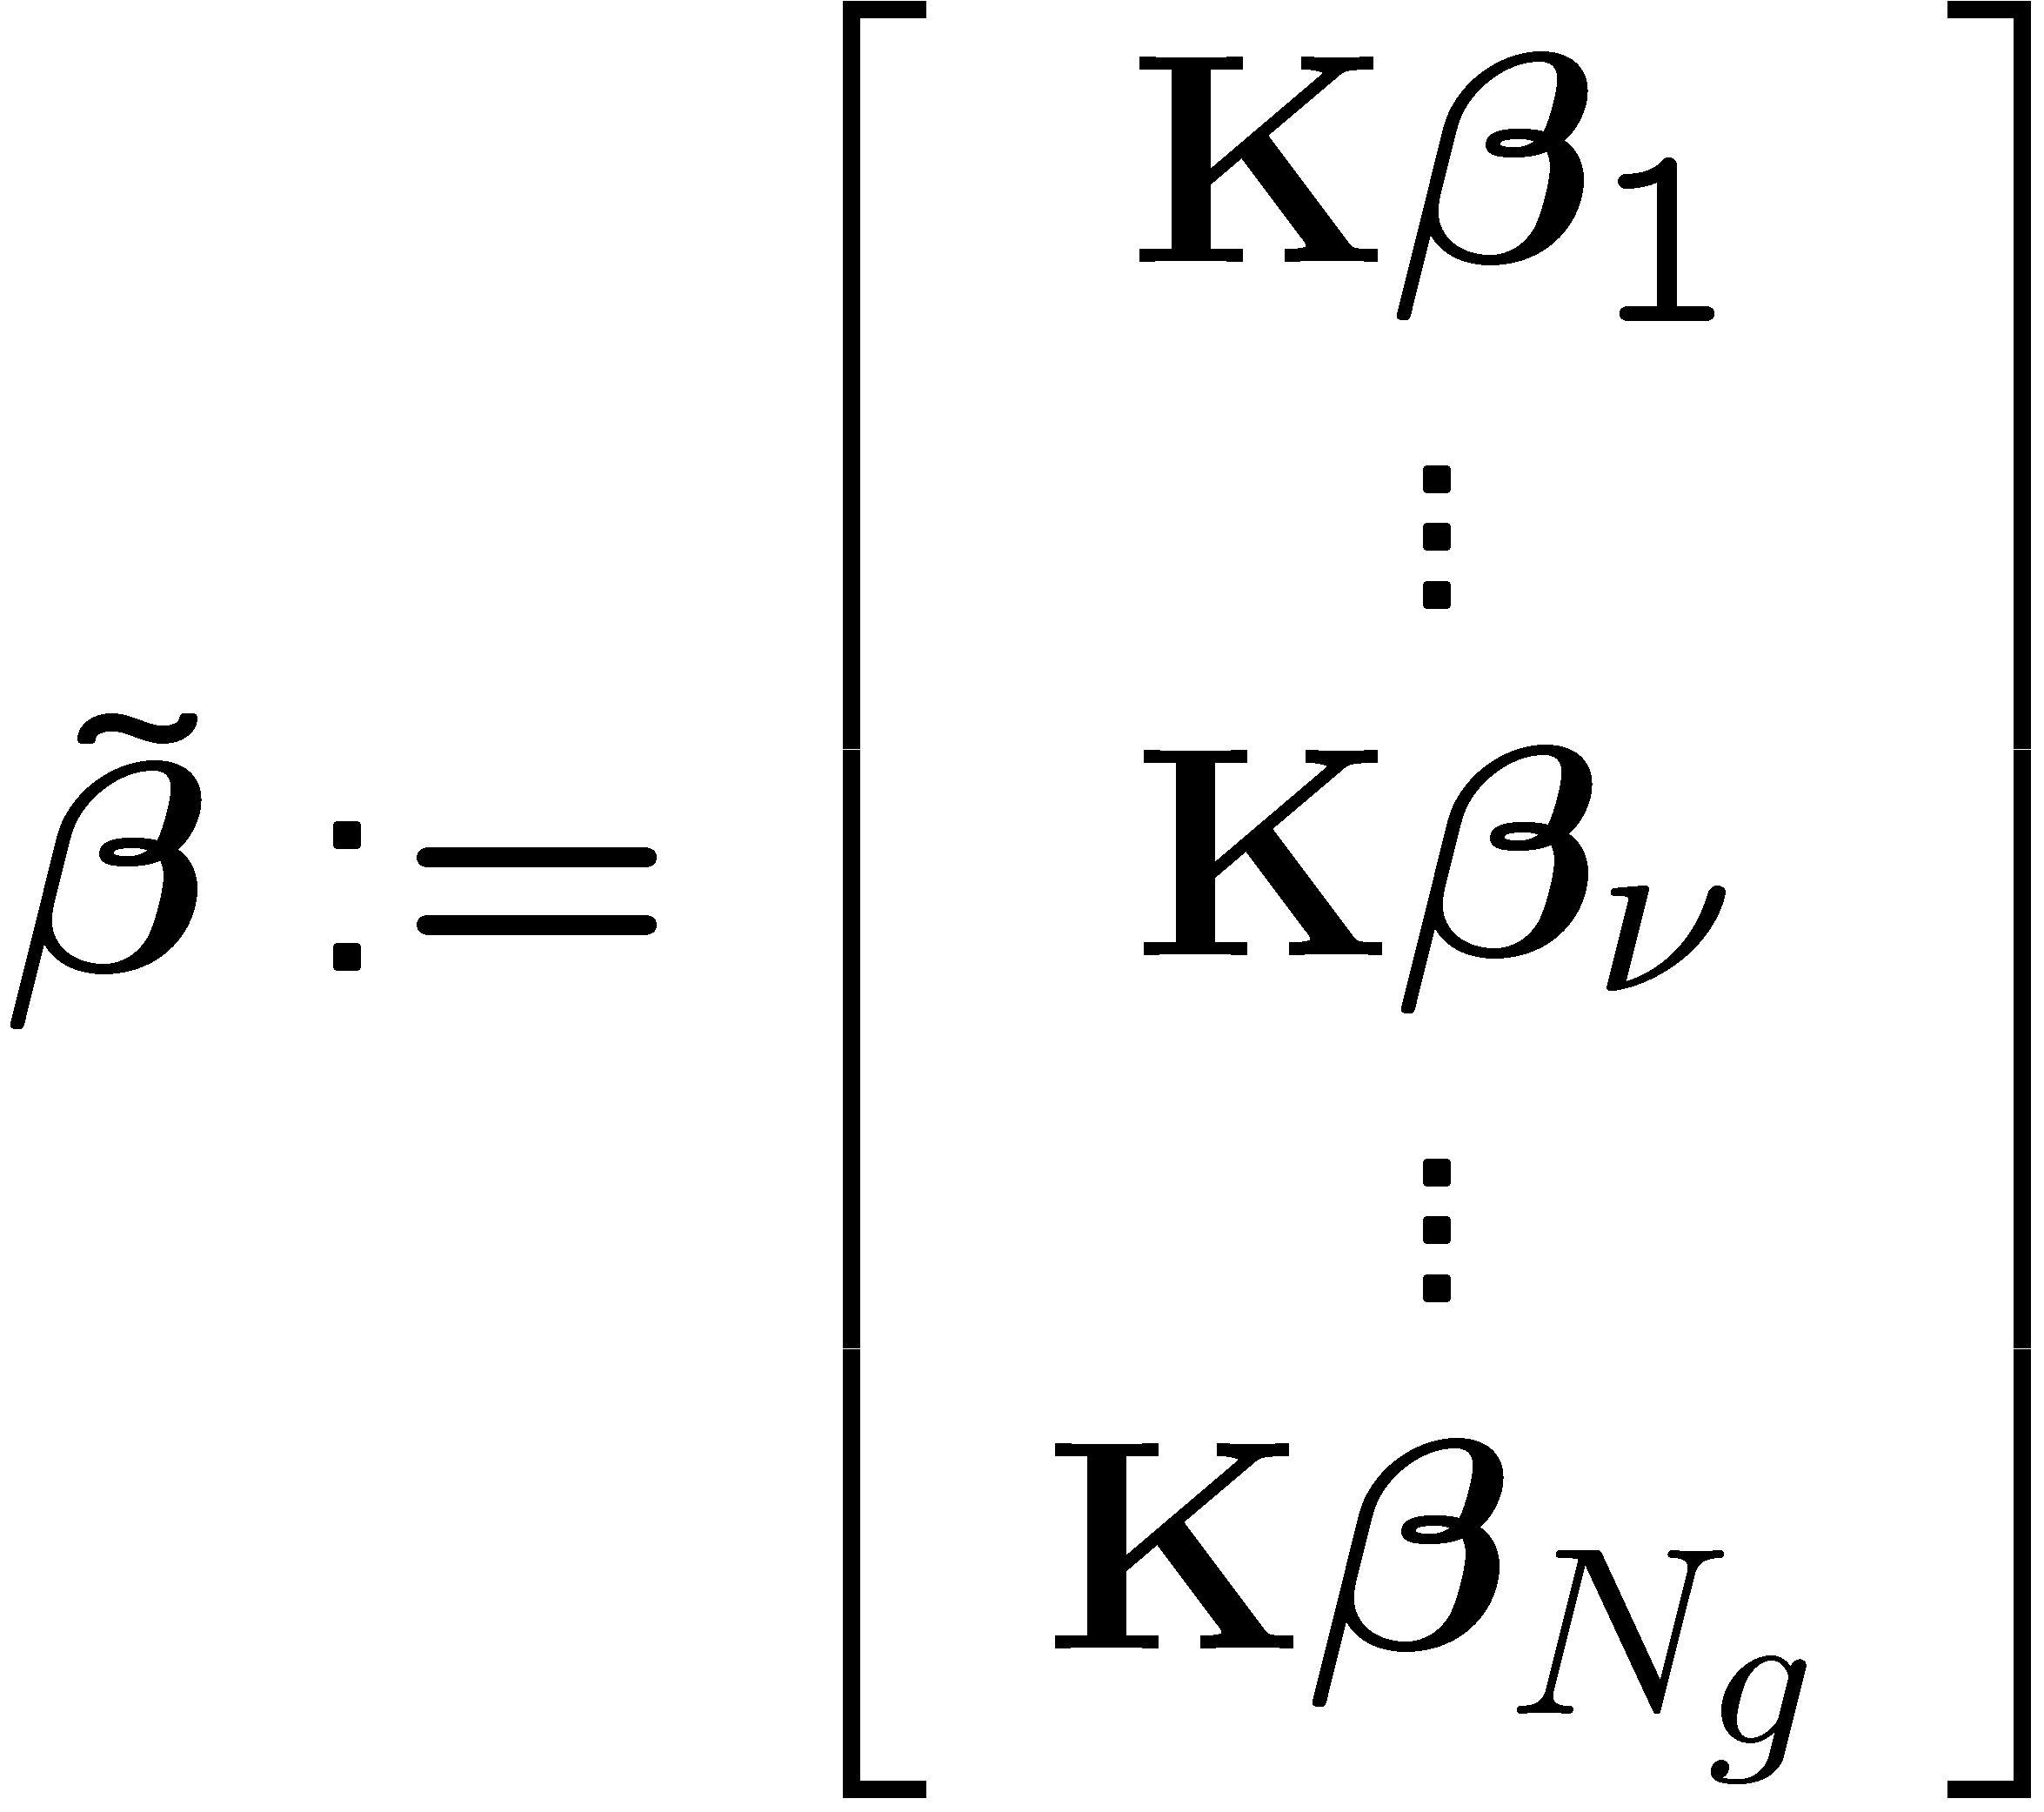

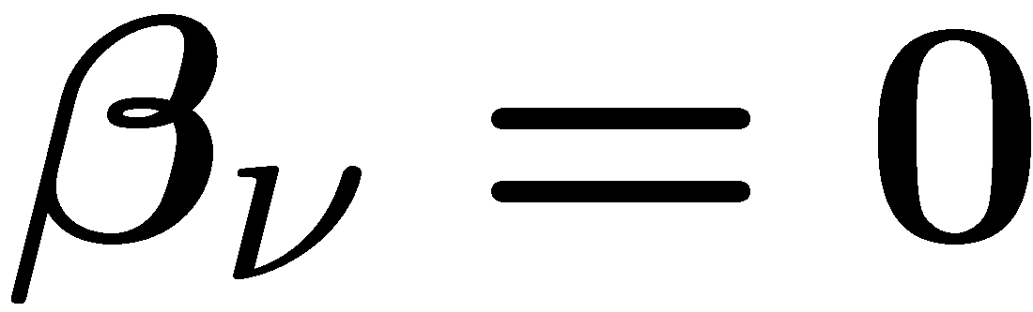
Lassoing bases
Result: Optimal finite-dimensional kernel interpolator
( )
with kernel
Substituting ( ) in (P2) Group-Lasso on
Distributed Group Lasso
  Basis selection
  Distributed operation with communication among neighboring radios
Notes:
It turns out that the minimizers of the previous problem the form of a finite-dimensional combination of splines kernels sit at the measuring points, parametric in the scalars beta nu, j.
With this result at hand, it remains to plug this expression for theta nu in the previous problem and solve for the coefficients beta. Please believe me that if you do so, grouping the parameters corresponding to theta nu in a subvector b nu and if you do the change of variable beta’_nu=K times beta nu, then we obtain a group lasso estimator for beta’, where the number of bases is identified with the number of groups.
And this is very convenient, because for selected indexes nu the group lasso will set the entire subvector beta nu to zero, setting the corresponding function theta nu to zero, and thuis eliminating the base bnu from the model.
Also a decentralized estimator is desired because of the lack of infraestructure. That is as when you turn on your wireless router youknow which are your neighbors but not the entire system.

Slide 8

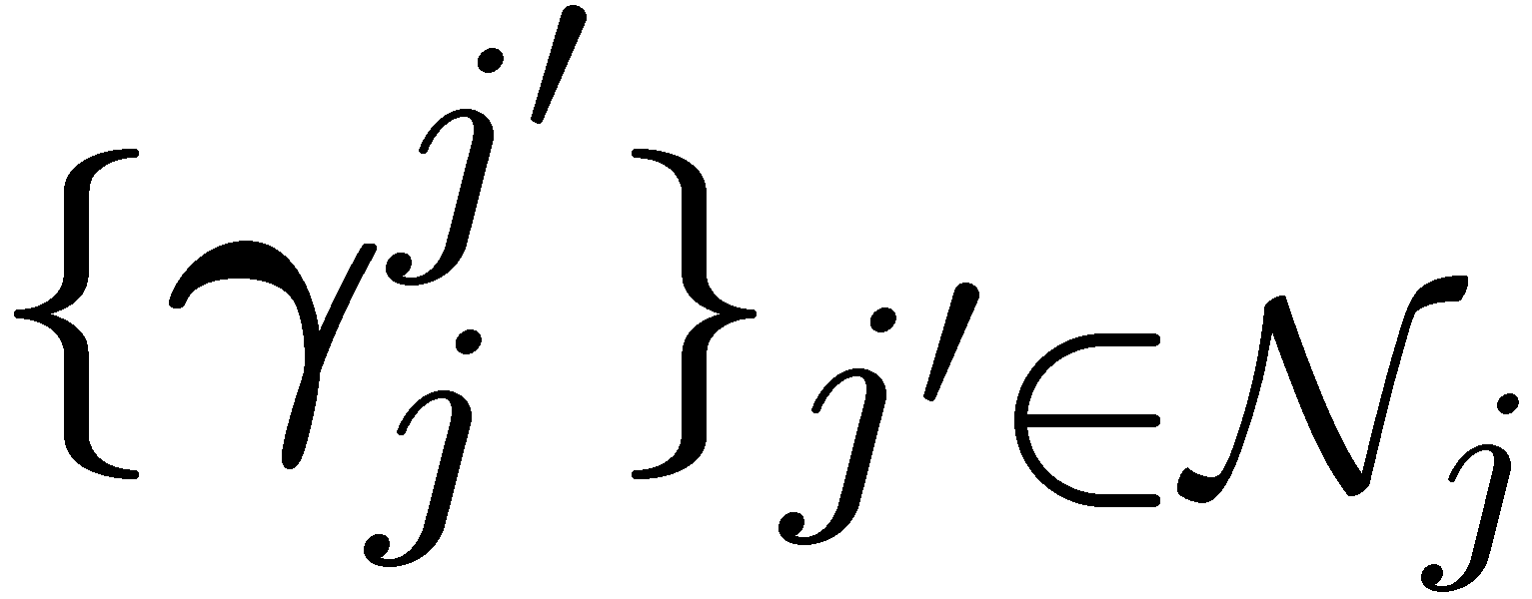
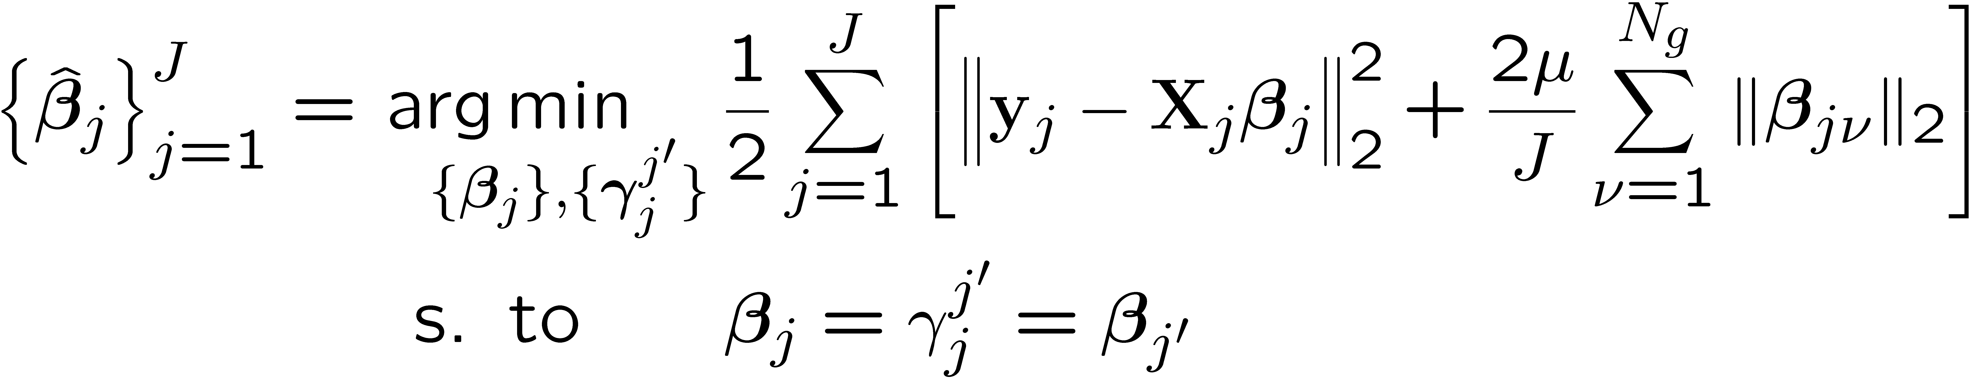
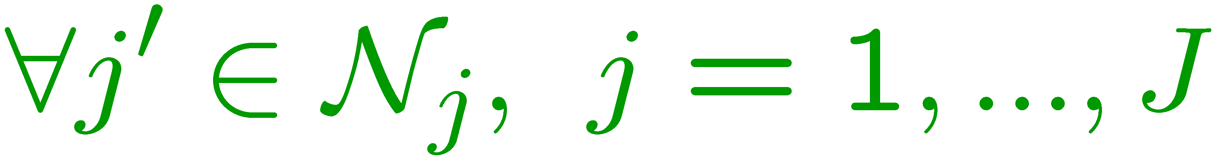
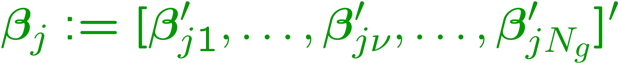
Consensus-based optimization
(P1)
Consider local copies and enforce consensus
Introduce auxiliary variables for decomposition
(P2)
(P1) equivalent to (P2) distributed implementation
8
Notes:
Having presented the application, let us return to our goal of solving the group lasso problem P1 in distributed fashion. The challenge is that we are solving for the same beta at different locations. The trick to solve that is to consider local copies beta j of beta hold at each agent. Then we enforce consensus, that is we force beta j of agent j to be equal to beta j’ of each of the neighbors of j, we use the notation betajnu to indicate each sub-vector in the vector beta j. The dummy variables gamma j j’ are just a technicality. Then if the network graph is connected all beta_j’s will be equal, to let say a unique beta. So problem 2 is equivalent to problem 1. However we will see that this new formulation yields a distributed implementation.

Slide 9
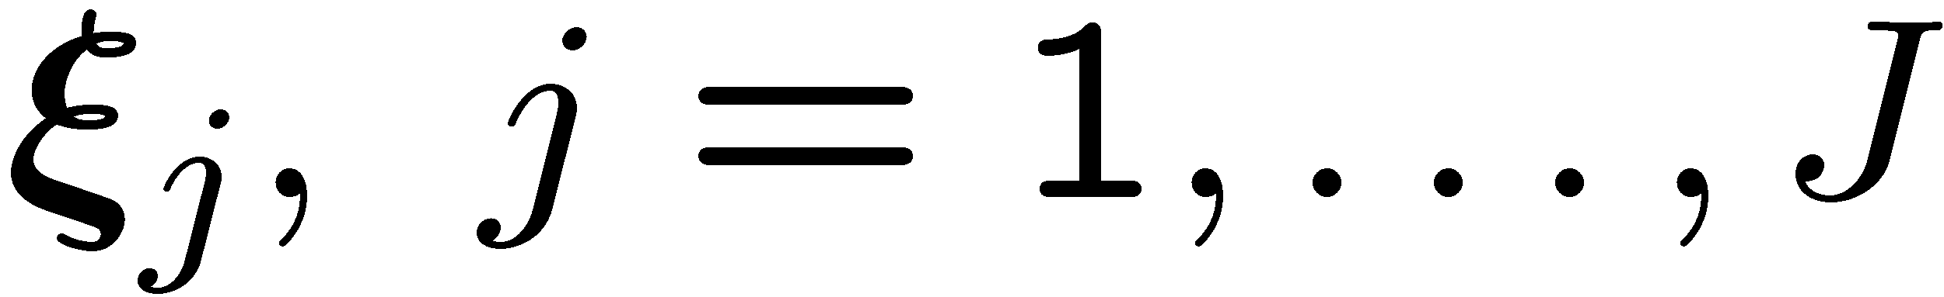
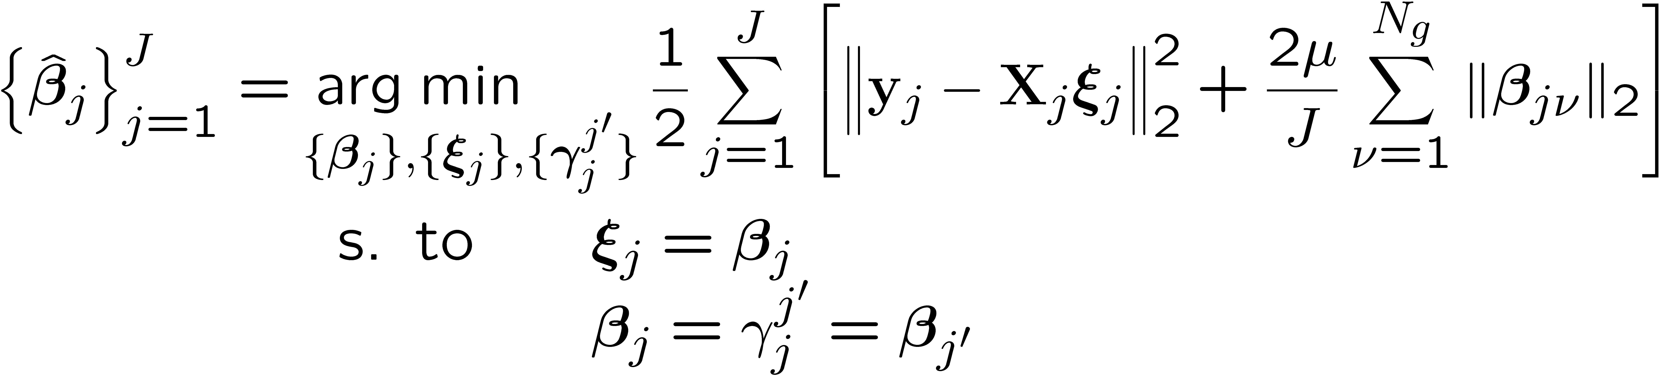
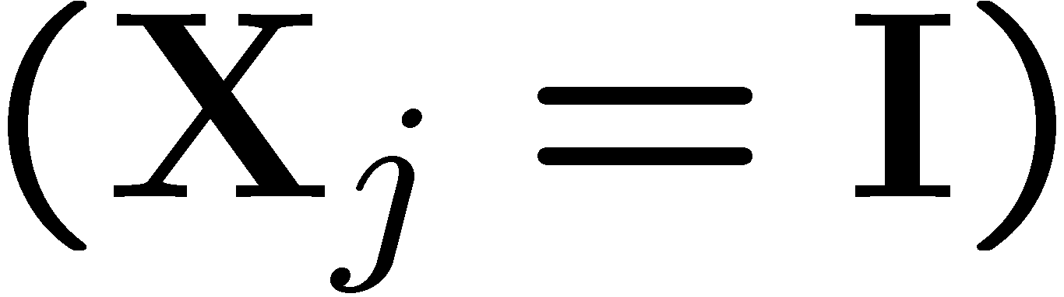

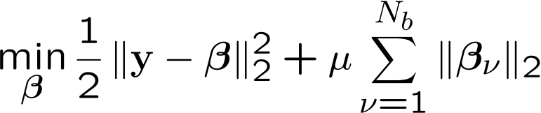



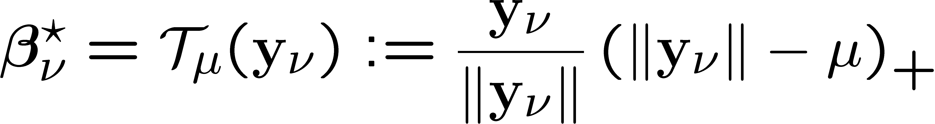
Vector soft-thresholding operator
Introduce additional variables
(P3)
Idea: orthogonal system solvable in closed form
9
Notes:
Good, we are almost there, but we want to kill to birds with one stone. That is, we want to use the constraints, not only for consensus but also to obtain closed-form for the iterates of our algorithm. For this purpose we add additional dummy variables xij one per agent and we force them to be equal to beta j. Then we substitute them for beta j in the squared sample error term arriving to an equivalent problem 3. The idea is to separate the residual sum of squares from the nondifferentiable part. We will detail in the next slide that using the augmented Lagrangian yields an orthonormal problem for beta_j, and we have shown in the paper that such simplified problem is solvable in closed form. In particular it is given by the vector soft thresholding operator, represented in the figure. If the norm of the data suvvector yjnu is smaller than the parameter mu in the penalty, then the entire subvecor is set to zero.
Now, we have problem 3 to solve, which is equivalent to the original problem 1 but with some conviniently introduced new variables and constraints, and we have the soft thresholding tool, let see how to use the tool to solve the problem.

Slide 10

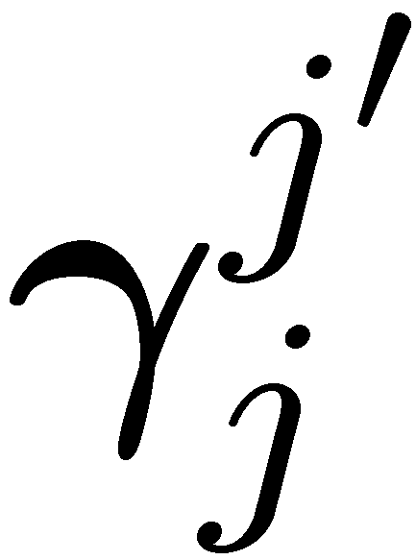
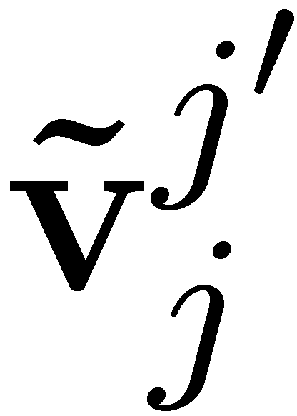
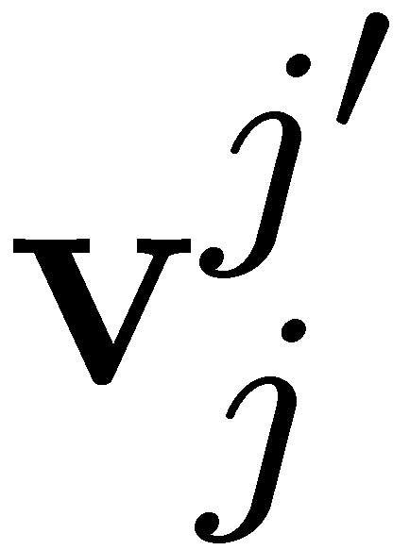




Alternating-direction method of multipliers
Augmented Lagrangian variables , , multipliers , ,
AD-MoM 1st step: minimize w.r.t.
AD-MoM 2st step: minimize w.r.t.
AD-MoM 3st step: minimize w.r.t.
AD-MoM 4st step: update multipliers
10
D. P. Bertsekas and J. N. Tsitsiklis, Parallel and Distributed Computation: Numerical Methods,
2nd ed. Athena-Scientific, 1999.
Notes:
And so we are in the core of the method. We solve P3 using the alternating method of multipliers which implies writing the augmented Lagrangian and minimize it in block coordinate descent alternating. I want to show how all partial minimizations can be done in closed form. First we minimize with respect to the gammas where only the terms in the box are involved. Then this is an unconstrained quadratic problem. Then we solve with respect to beta and we have an orthogonal group lasso as in the previous slide, so we can apply the soft thresholding operator. Finally we solve with respect to xi which corresponds to another unconstrained quadratic problem. And finally we update the constraints.

Slide 11
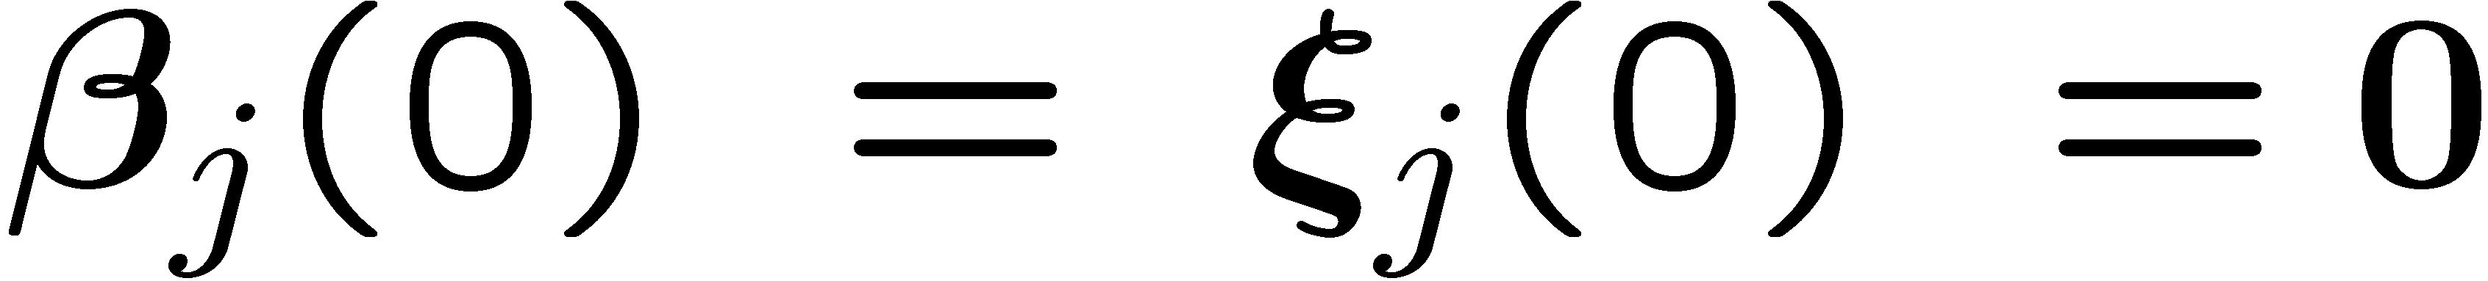
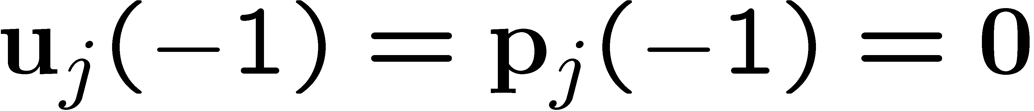
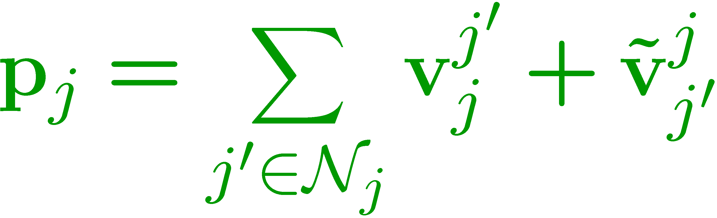
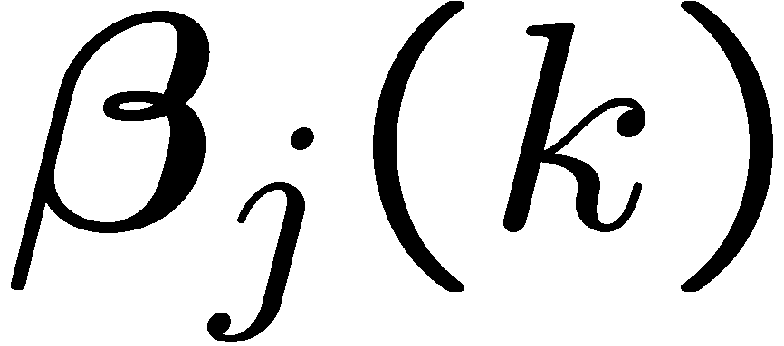
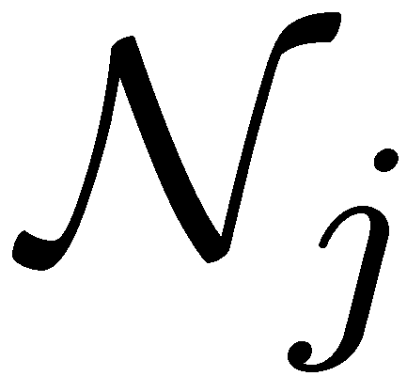
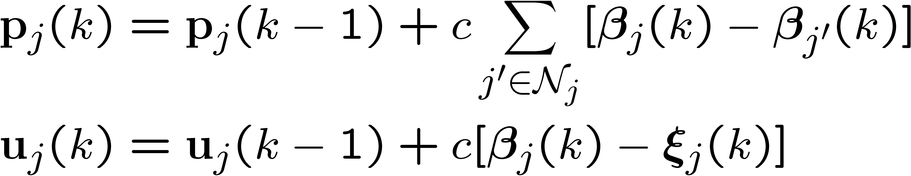
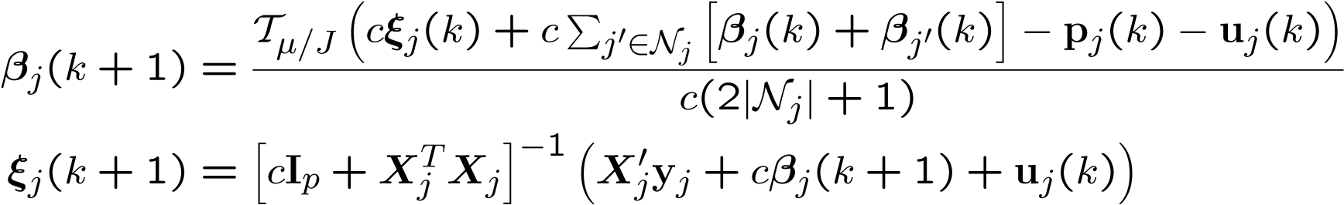
DG-Lasso algorithm
Agent j initializes and locally runs
FOR k = 1,2,…
Exchange with agents in
Update
END FOR
offline, inversion NjxNj
11
Notes:
After some manipulation the previous minimizations yield the following algorithm. We initialize to zero because of the group-sparsity assumption, but we could initialize arbitrarily. It turns out that we do not need to keep track of all multipliers vjj’ but we only need their sums that we call pj. This is interesting because we end with a price pj that can be carried locally and we don’t need to exchange multipliers. Instead agent j exchanges the local beta j with its neighbors. Then agent j update the multipliers, and its local betaj using a soft tresholding operator per coordinate. Now this inversion in the update of xi involves a matrix of dimension p, the dimension of p. This could be an issue in many applications where p is huge. However this inversion can be done offline, not once per iteration. More important, if we use the MIL we end up inverting a matrix of dimensions Nj, the dimension of the local data vector yj.

Slide 12


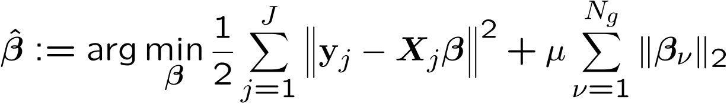


DG-Lasso: Convergence
Proposition
For every , local estimates generated by DG-Lasso satisfy
where
Properties
  Consensus achieved across the network of distributed agents
  Affordable communication of sparse with neighbors
  Network-wide data percolates through exchanges
  Distributed computation for multiprocessor architectures
(P1)
G. Mateos, J. A. Bazerque, and G. B. Giannakis, "Distributed Algorithms for Sparse Linear Regression,“
IEEE Transactions on Signal Processing, Oct. 2010.
12
Notes:
We do have this convergence result. For any constant step size c the local iterates converge to a unique limit beta. This limit is the minimiser of the centralized problem P1. Some attractive features to highlight are that the consensus is achieved across the network. The betas are the only parameters communicated and these are sparse. The data of remote agents percolate through the network to end up affecting the local beta j. And with the use of the MIL the agents invert a reduced matrix of dimensions of its local data vectors, not of the complete data set. Then we say that the algorithm also distributes the numerical computation. So the agents could be different processors.

Slide 13
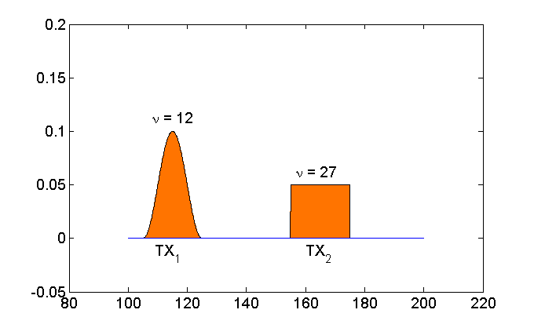
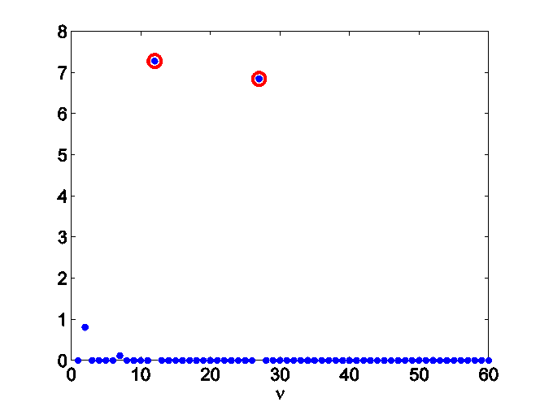
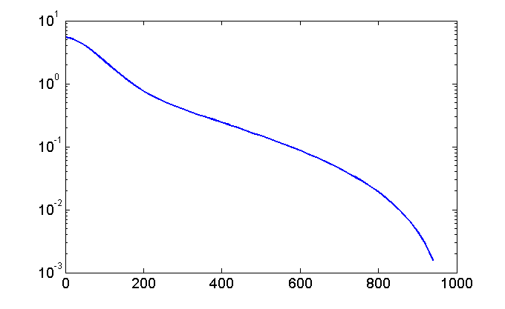




Power spectrum cartography
    2 sources - raised cosine pulses
    J =50 sensing radios uniformly deployed in space
    N_{g}=(2x15x2)=60 bases (roll off, center frequency, bandwidth)
S
P
E
C
T
R
U
M
M
A
P
Φs(f)
frequency (Mhz)
base/group index
iteration
    DG-Lasso converges to centralized counterpart
    PSD map estimate reveals frequency and spatial RF occupancy
Notes:
As a closure we present simulated results for the application of spectrum cartography. Two sources transmitt rised cosine pulses of roll-over factors 0 and 1 as the ones shown in the orange plot. Their transmitter power is affected by rayleigh fading and shadowing.
At your top right the psd generated by the first source is depicted, and at your left the estimator obtained with the distributed group lasso. The figure in the center bottom, shows how the groups of variables (or correspondingly the bases) are selected by plotting the norm of the estimated beta_nu for each nu. The red circles represent the ground through, so that dglasso succeeds ion picking the correct bases used for transmission. Finally the most important plot is at your left bottom. It shows the sum of errors between the local updates and the centralized solution, corroborating that the iterates converge to it.

Slide 14
Thank You!
Conclusions and future directions
Sparse linear model with distributed data
  Sparsity at group level Group-Lasso estimator
  Ad-hoc network topology
DG-Lasso
  Guaranteed convergence for any constant step-size
  Linear operations per iteration
Application: Spectrum cartography
  Map of interference across space and time
  Nonparametric compressed sensing
Future directions
  Online distributed version
  Asynchronous updates
D. Angelosante, J.-A. Bazerque, and G. B. Giannakis, “Online Adaptive Estimation of Sparse Signals:
Where RLS meets the 11-norm,” IEEE Transactions on Signal Processing, vol. 58, 2010.
14
Notes:
That is, we had a distributed data conforming to a linear group-sparse model, for which we developed an iterative algorithm that works decentralized, and we have applied this to find the spectrum across space and frequency.
In the future, we want to combine this with the results that we had on online Lasso, and we want to consider asynchronous operation modeled as Bernoulli failures in the communication links. We would be glad to discuss about these points or about any other questions that you could have now or after the session.
Thank you.
14

Slide 15





Leave-one-agent-out cross-validation
  Agent j is set aside in round robin fashion
    agents estimate
    compute
    repeat for λ= λ₁,…, λ_{N} and select λ_{min} to minimize the error
c-v error vs λ
path of solutions
Requires sample mean to be computed in distributed fashion

Slide 16






Vector soft-thresholding operator
Consider the particular case
(P4)
Lemma: The minimizer of problem is obtained
via the soft-thresholding operator
(P4)
Notes:
The proof of Proposition (1) will strongly rely on the following instrumental result by Duchon.
Go through the Lemma, the dependence of h on g should be clear.

Slide 17











Proof of Lemma
  decouples
Minimizer is colinear with
Scalar problem for

Slide 18



Smoothing regularization
(P2)
Fundamental result: solution to P1 expressible as kernel expansion
Kernel
Parameters satisfying
G. Wahba, Spline models for observational data, SIAM, Philadelphia, PA, 1990.
Notes:
18

Slide 19








Optimal parameters
Plug the solution: variational problem constrained, penalized LS
s. to
Introduce matrices (knot dependent)
s.t.
Nonparametric compressed sensing
s. to
19
Notes:
19
Now that we know that the functions g_\nu are splines the remaining problem is to compute the coefficients. For this purpose we plug the splines into the original problem and after some manipulation it reduces to the following constrained and penalized LS problem in the vector variables alpha and beta.
To understand it we need to define some notation, first we collect the unknown parameters in vectors bold alpha and bold beta stacking one under the other the columns of a matrix that results naturally from ordering the beta_nur respect these two variables.
Then we do the same with the data phi_rn which results in the vector bold phi. Next we define the matrices T and K depending on the knot values x_r , and finally we define the matrix B related to the frequency bases where each column correspond to one basis evaluated at all frequencies f_n. As for the circled cross symbol it stands for the kronecker product between matrices that arises because of the vectorization as it has the nice property that the vectorization of three matrices can be put in terms of the kronecker product. Looking back to the minimization problem we can identify the the first term with the residual sum of squares, and the second one that derives from the smoothing penalty and the constraint on the coefficients beta that arises from the lemma. Among other things we require the matrix K to be full rank, and Wahba throws light about this, it is not trivial to see but even when K is not definite positive it evaluates positive for all vectors satifying the constraint b_\nu^T T=0 and that is required in condensated form in the constraint so we are safe. In order to solve the equation it would be required the identity kroneker the matrix K to be positive definite. Adapting an argument in the book of wahba, which is not trivial at all, we see that even when that is not the case the positiveness hold for all vectors satisfying the constrain, so we are safe.

Slide 20


From splines to group-Lasso
Kernel expansion renders
s. to
(P2’)
Define
Build P2’ rewritten as

