Slide 1


Rank Minimization for Subspace Tracking from Incomplete Data
Morteza Mardani, Gonzalo Mateos and Georgios Giannakis
ECE Department, University of Minnesota
Acknowledgment: AFOSR MURI grant no. FA9550-10-1-0567
Vancouver, Canada
May 18, 2013
1
Notes:
1

Slide 2



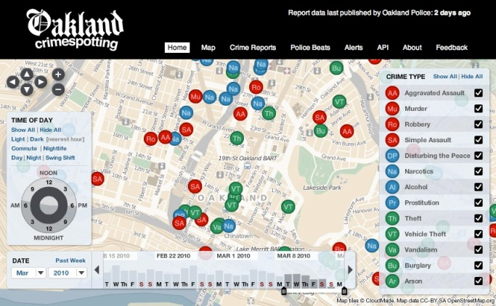



Learning from “Big Data”
`Data are widely available, what is scarce is the ability to extract wisdom from them’
Hal Varian, Google’s chief economist
BIG
Ubiquitous
Fast
Productive
Smart
Messy
Revealing
K. Cukier, ``Harnessing the data deluge,'' Nov. 2011.
2
Notes:
2

Slide 3



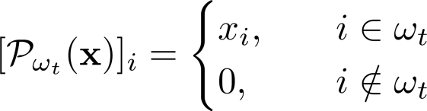




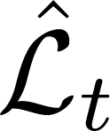
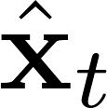
Streaming data model
Preference modeling
Incomplete observations
?
?
?
?
?
?
?
?
Sampling operator:
lives in a slowly-varying low-dimensional subspace
Goal: Given and estimate and recursively

Slide 4
Prior art
(Robust) subspace tracking
  Projection approximation (PAST) [Yang’95]
  Missing data: GROUSE [Balzano et al’10], PETRELS [Chi et al’12]
  Outliers: [Mateos-Giannakis’10], GRASTA [He et al’11]
Batch rank minimization
  Nuclear norm regularization [Fazel’02]
  Exact and stable recovery guarantees [Candes-Recht’09]
Novelty: Online rank minimization
  Scalable and provably convergent iterations
  Attain batch nuclear-norm performance
Notes:
subspace tracking which has a rich litertature,
PAST (projection approximation subspace tracking):
GROUSE (Grassmanian rand-one update subspace estimation): inceremental gradient over the Grassmanian
PETRELS: simple extension of PAST to account for missing data, knows the true rank, second order algorithm, original algorithms lack regularization and thus it is numerically unstable especially for large amounts of missing observations

Slide 5

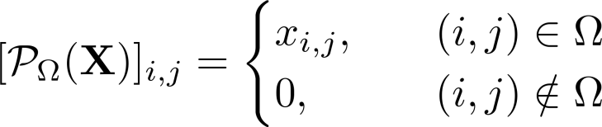
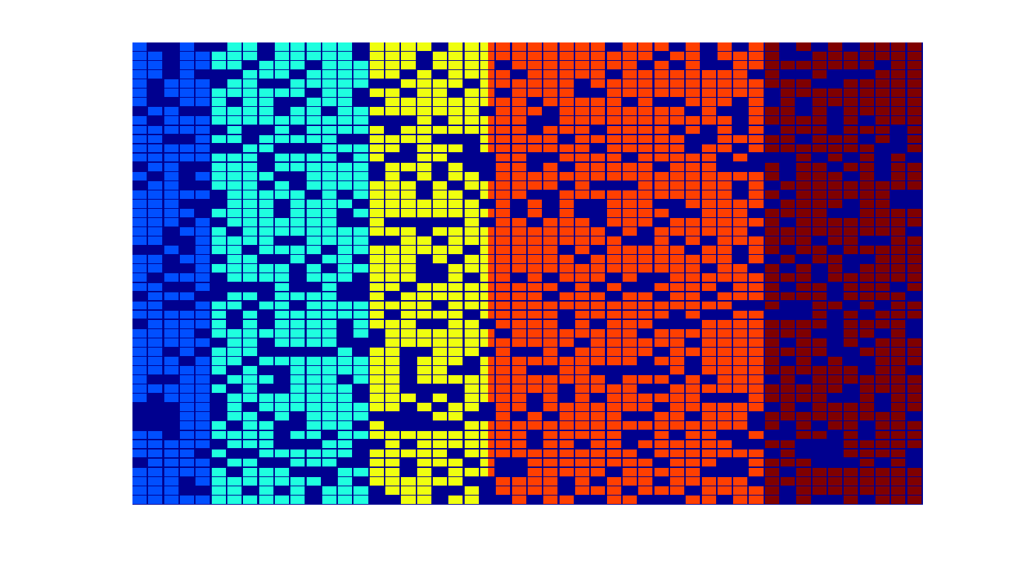
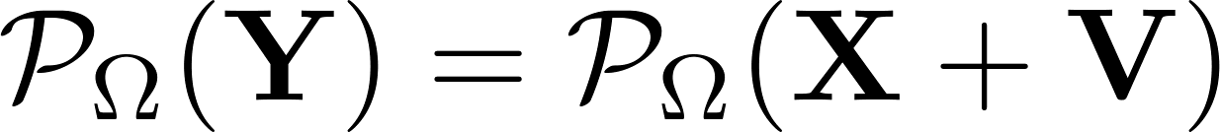

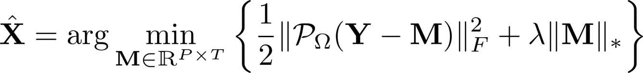
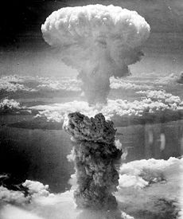

Low-rank matrix completion
Consider matrix , set
Sampling operator
Given incomplete (noisy) data
(as) has low rank
Goal: denoise observed entries, impute missing ones
Nuclear-norm minimization [Fazel’02],[Candes-Recht’09]
5
Notes:
5

Slide 6
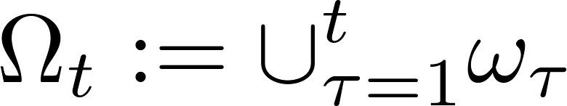
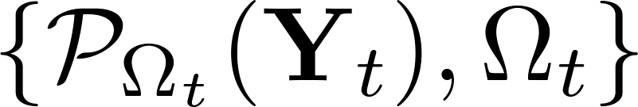
Problem statement
Available data at time t
?
?
?
?
?
?
?
?
?
?
?
?
?
?
Goal: Given historical data , estimate from
(P1)
Challenge: Nuclear norm is not separable
Variable count Pt growing over time
Costly SVD computation per iteration
6
Notes:
6

Slide 7
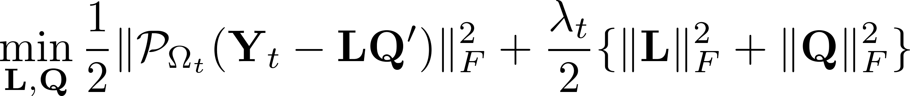
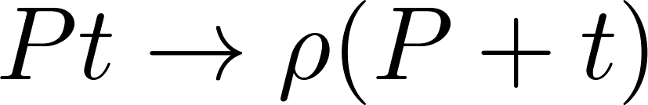



Separable regularization
Key result [Burer-Monteiro’03]
Pxρ
≥rank[X]
New formulation equivalent to (P1)
(P2)
Nonconvex; reduces complexity:
Proposition 1. If stationary pt. of (P2) and ,
then is a global optimum of (P1).
7
Notes:
7

Slide 8
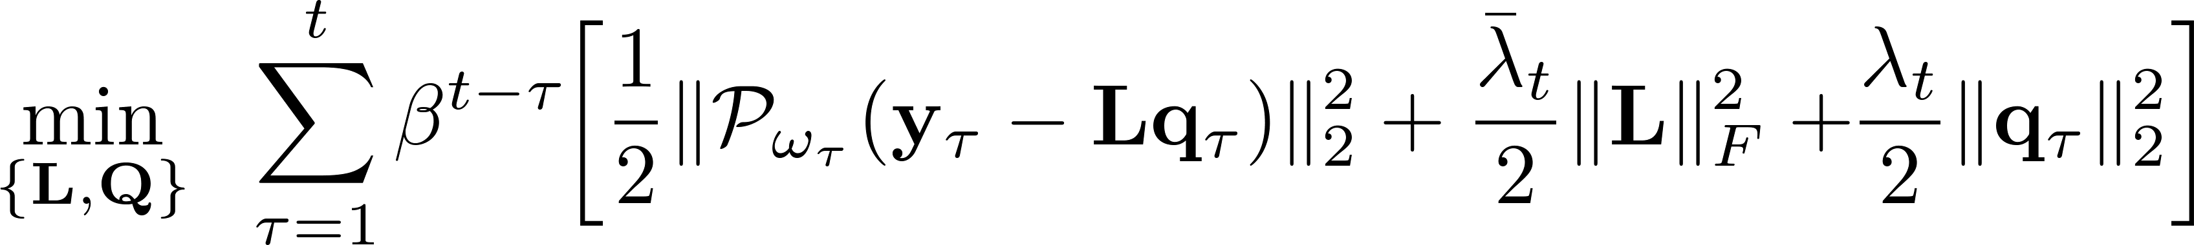
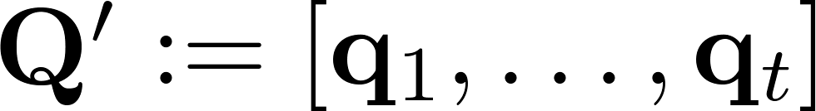

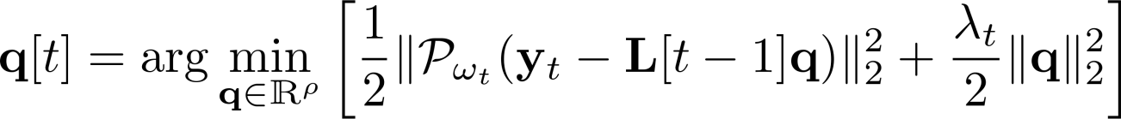
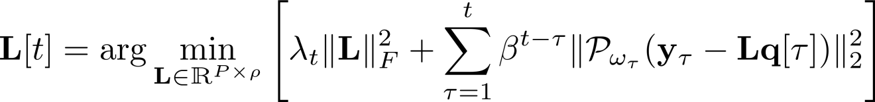
Online estimator
Regularized exponentially-weighted LS estimator (0 < β ≤ 1 )
(P3)
:= C_{t}(L,Q)
Alternating minimization (at time t)
  Step1: Projection coefficient updates
  Step2: Subspace update
:= g_{t}(L[t-1],q)
8
Notes:
8

Slide 9
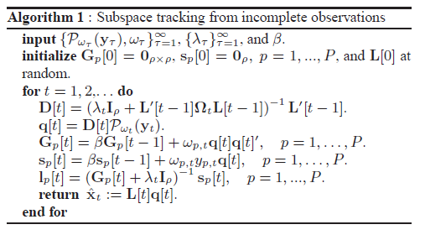
Online iterations
Attractive features
  ρxρ inversions per time, no SVD, O(Pρ³) operations (ind. of time)
  β=1: recursive least-squares; O(Pρ²) operations
9
Notes:
9

Slide 10
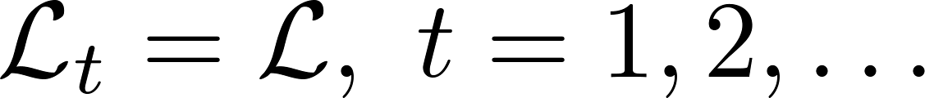
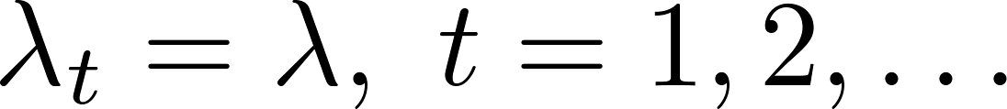
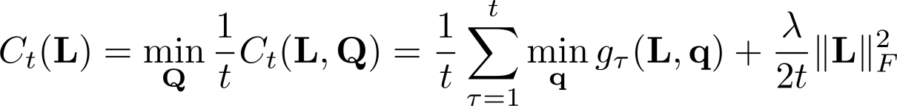
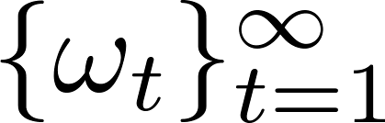
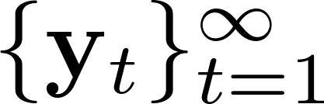

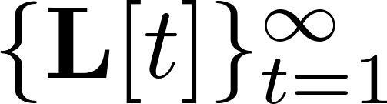


Convergence
  As1) Invariant subspace and
  As2) Infinite memory β = 1
Proposition 2: If and are i.i.d., and
c1) is uniformly bounded;
c2) is in a compact set; and
c3) is strongly convex w.r.t.
hold, then almost surely (a. s.)
  asymptotically converges to a stationary point of batch (P2)
Notes:
Q1: is it reasonable to assume {y_t} is i.i.d. over time?
????
Q2: what is the general idea of the proof technique?
????

Slide 11



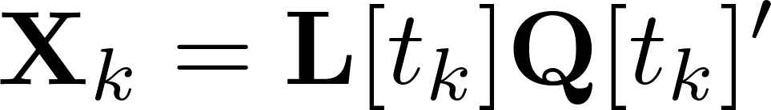

Optimality
Q: Given the learned subspace and the corresponding
is an optimal solution of (P1)?
Proposition 3: If there exists a subsequence s.t.
then satisfies the optimality conditions
for (P1) as a. s.
c1) a. s.
c2)
11
Notes:
11

Slide 12


Numerical tests
Optimality (β=1)
Data
  ,
  ,
  ,
(P1)
Performance comparison (β=0.99, λ=0.1)
(P1)
Efficient for large-scale matrix
completion
Complexity comparison
Algorithm 1 | O(Pρ³)
PETRELS | O(Pρ²)
GROUSE | O(Pρ)
12
Notes:
12

Slide 13
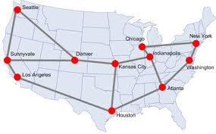
Tracking Internet2 traffic
Goal: Given a small subset of OD-flow traffic-levels
estimate the rest
Traffic is spatiotemporally correlated
Real network data
  Dec. 8-28, 2008; N=11, L=41, F=121, T=504
  k=ρ=10, β=0.95
π=0.25
13
Data: http://www.cs.bu.edu/~crovella/links.html
13
Notes:
13
13

Slide 14
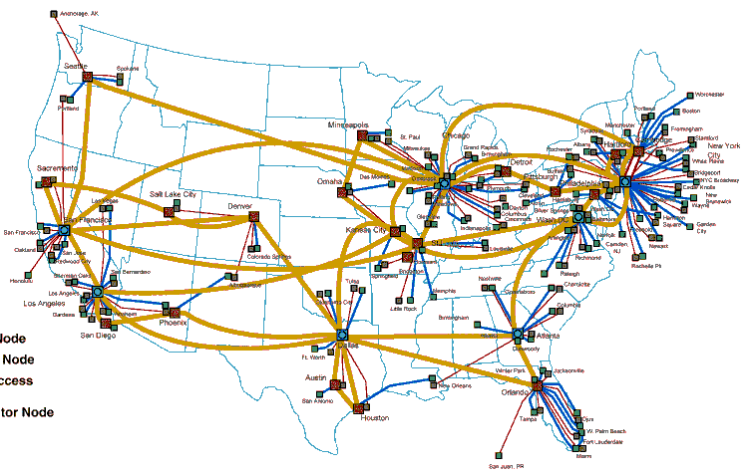



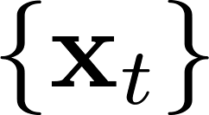

Dynamic anomalography
Estimate a map of anomalies in real time
Streaming data model:
Goal: Given estimate online when is in a
low-dimensional space and is sparse
---- estimated
---- real
M. Mardani, G. Mateos, and G. B. Giannakis, "Dynamic anomalography: Tracking network anomalies via
sparsity and low rank," IEEE Journal of Selected Topics in Signal Process., vol. 7, pp. 50-66, Feb. 2013.

Slide 15

Conclusions
Track low-dimensional subspaces from
  Incomplete (noisy) high-dimensional datasets
Online rank minimization
  Scalable and provably convergent iterations
  attaining batch nuclear-norm performance
Viable alternative for large-scale matrix completion
Extensions to the general setting of dynamic anomalography
Future research
  Accelerated stochastic gradient for subspace update
  Adaptive subspace clustering of Big Data
Thank You!
15
Notes:
15

