Slide 1


Imputation of Streaming Low-Rank Tensor Data
Morteza Mardani, Gonzalo Mateos and Georgios Giannakis
ECE Department, University of Minnesota
Acknowledgment: AFOSR MURI grant no. FA9550-10-1-0567
A Coruna, Spain
June 25, 2013
1
Notes:
1

Slide 2

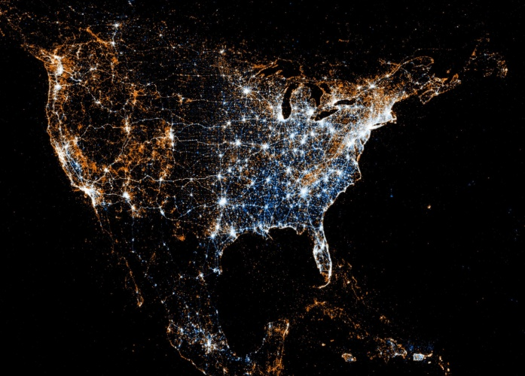

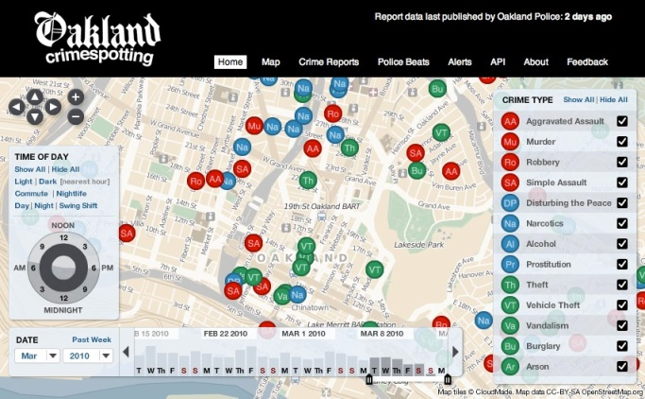



Learning from “Big Data”
`Data are widely available, what is scarce is the ability to extract wisdom from them’
Hal Varian, Google’s chief economist
BIG
Ubiquitous
Fast
Productive
Smart
Messy
Revealing
K. Cukier, ``Harnessing the data deluge,'' Nov. 2011.
2
Notes:
2

Slide 3

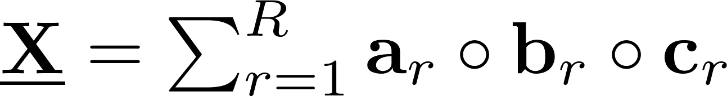
Tensor model
Data cube
PARAFAC decomposition
a_{r}
b_{r}
c_{r}
A=
α_{i}
B=
β_{i}
C=
γ_{i}
Notes:
subspace tracking which has a rich litertature,
PAST (projection approximation subspace tracking):
GROUSE (Grassmanian rand-one update subspace estimation): inceremental gradient over the Grassmanian
PETRELS: simple extension of PAST to account for missing data, knows the true rank, second order algorithm, original algorithms lack regularization and thus it is numerically unstable especially for large amounts of missing observations

Slide 4


Streaming tensor data
Streaming data
Tensor subspace comprises R rank-one matrices
Goal: given the streaming data , at time t learn the subspace matrices (A_{t},B_{t}) and impute the missing entries of Y_{t}?
Notes:
subspace tracking which has a rich litertature,
PAST (projection approximation subspace tracking):
GROUSE (Grassmanian rand-one update subspace estimation): inceremental gradient over the Grassmanian
PETRELS: simple extension of PAST to account for missing data, knows the true rank, second order algorithm, original algorithms lack regularization and thus it is numerically unstable especially for large amounts of missing observations

Slide 5
Prior art
Matrix/tensor subspace tracking
  Projection approximation (PAST) [Yang’95]
  Misses: rank regularization [Mardani et al’13], GROUSE [Balzano et al’10]
  Outliers: [Mateos et al’10], GRASTA [He et al’11]
  Adaptive LS tensor tracking [Nion et al’09] with full data; tensor slices treated as long vectors
Batch tensor completion [Juan et al’13], [Gandy et al’11]
Novelty: Online rank regularization with misses
  Tensor decomposition/imputation
  Scalable and provably convergent iterates
Notes:
subspace tracking which has a rich litertature,
PAST (projection approximation subspace tracking):
GROUSE (Grassmanian rand-one update subspace estimation): inceremental gradient over the Grassmanian
PETRELS: simple extension of PAST to account for missing data, knows the true rank, second order algorithm, original algorithms lack regularization and thus it is numerically unstable especially for large amounts of missing observations

Slide 6
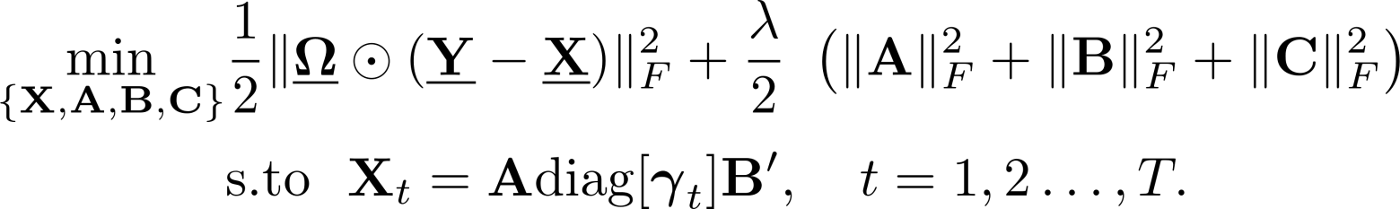

Batch tensor completion
Rank-regularized formulation [Juan et al’13]
(P1)
Tikhonov regularizer promotes low rank
Proposition 1 [Juan et al’13]: Let , then
Notes:
subspace tracking which has a rich litertature,
PAST (projection approximation subspace tracking):
GROUSE (Grassmanian rand-one update subspace estimation): inceremental gradient over the Grassmanian
PETRELS: simple extension of PAST to account for missing data, knows the true rank, second order algorithm, original algorithms lack regularization and thus it is numerically unstable especially for large amounts of missing observations

Slide 7

Tensor subspace tracking
Exponentially-weighted LS estimator
(P2)
f_{t}(A,B)
``on-the-fly’’ imputation
Alternating minimization with stochastic gradient iterations (at time t)
    Step1: Projection coefficient updates
    Step2: Subspace update
O(|Ω_{t}|R²) operations per iteration
M. Mardani, G. Mateos, and G. B. Giannakis, “Subspace learning and imputation for streaming Big Data matrices and
tensors," IEEE Trans. Signal Process., Apr. 2014 (submitted).
Notes:
subspace tracking which has a rich litertature,
PAST (projection approximation subspace tracking):
GROUSE (Grassmanian rand-one update subspace estimation): inceremental gradient over the Grassmanian
PETRELS: simple extension of PAST to account for missing data, knows the true rank, second order algorithm, original algorithms lack regularization and thus it is numerically unstable especially for large amounts of missing observations

Slide 8
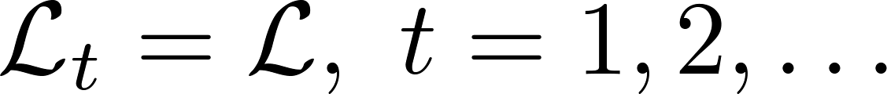
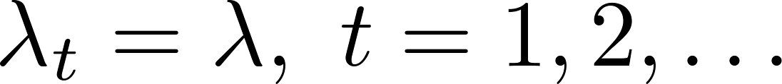
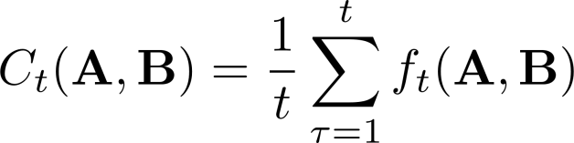






Convergence
  As1) Invariant subspace and
  As2) Infinite memory β = 1
Proposition 2: If and are i.i.d., and
c1) is uniformly bounded;
c2) is in a compact set; and
c3) is strongly convex w.r.t.
hold, then almost surely (a. s.)
  asymptotically converges to a st. point of batch (P1)
Notes:
Q1: is it reasonable to assume {y_t} is i.i.d. over time?
????
Q2: what is the general idea of the proof technique?
????

Slide 9
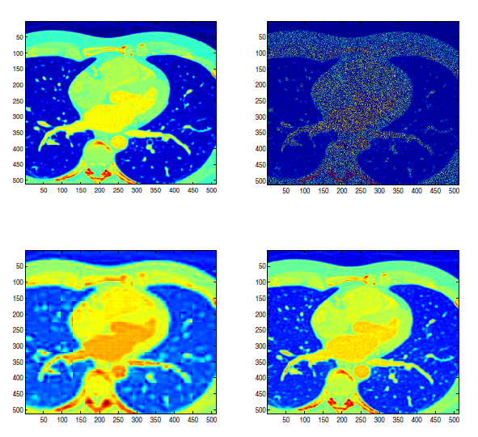
Cardiac MRI
FOURDIX dataset
  263 images of 512 x 512
  Y: 32 x 32 x 67,328
(a)
(b)
75% misses
  R=10 → e_{x}=0.14
  R=50 → e_{x}=0.046
(c)
(d)
Ground truth, (b) acquired image;
reconstructed for R=10 (c), R=50 (d)
http://www.osirix-viewer.com/datasets.

Slide 10
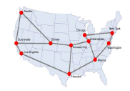
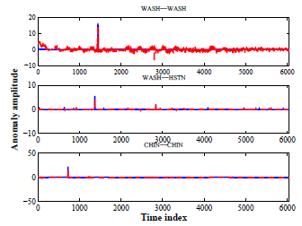
Tracking traffic anomalies
Link load measurements
Internet-2 backbone network
  Y_{t}: weighted adjacency matrix
  Available data Y: 11x11x6,048
  75% misses, R=18
http://internet2.edu/observatory/archive/data-collections.html
Notes:
subspace tracking which has a rich litertature,
PAST (projection approximation subspace tracking):
GROUSE (Grassmanian rand-one update subspace estimation): inceremental gradient over the Grassmanian
PETRELS: simple extension of PAST to account for missing data, knows the true rank, second order algorithm, original algorithms lack regularization and thus it is numerically unstable especially for large amounts of missing observations

Slide 11
Conclusions
Real-time subspace trackers for decomposition/imputation
  Streaming big and incomplete tensor data
  Provably convergent scalable algorithms
Applications
  Reducing the MRI acquisition time
  Unveiling network traffic anomalies for Internet backbone networks
Ongoing research
  Incorporating spatiotemporal correlation information via kernels
  Accelerated stochastic-gradient for subspace update
Notes:
subspace tracking which has a rich litertature,
PAST (projection approximation subspace tracking):
GROUSE (Grassmanian rand-one update subspace estimation): inceremental gradient over the Grassmanian
PETRELS: simple extension of PAST to account for missing data, knows the true rank, second order algorithm, original algorithms lack regularization and thus it is numerically unstable especially for large amounts of missing observations

