Slide 1


Robust Kriged Kalman Filtering
B. Baingana, E. Dall’Anese, G. Mateos and G. B. Giannakis
Acknowledgments: NSF Grants 1343248, 1423316, 1442686, 1508993, 1509040
ARO W911NF-15-1-0492
Asilomar Conference
November 11, 2015
1
Notes:
1

Slide 2
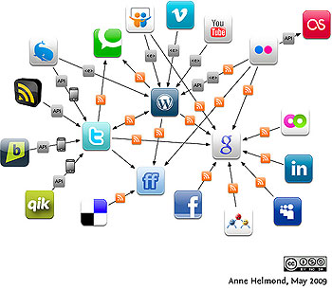


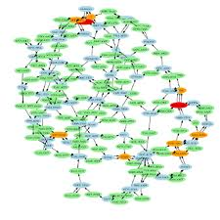
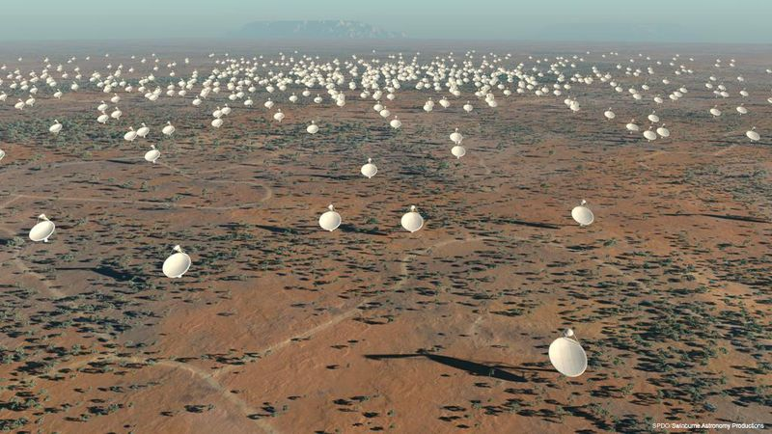
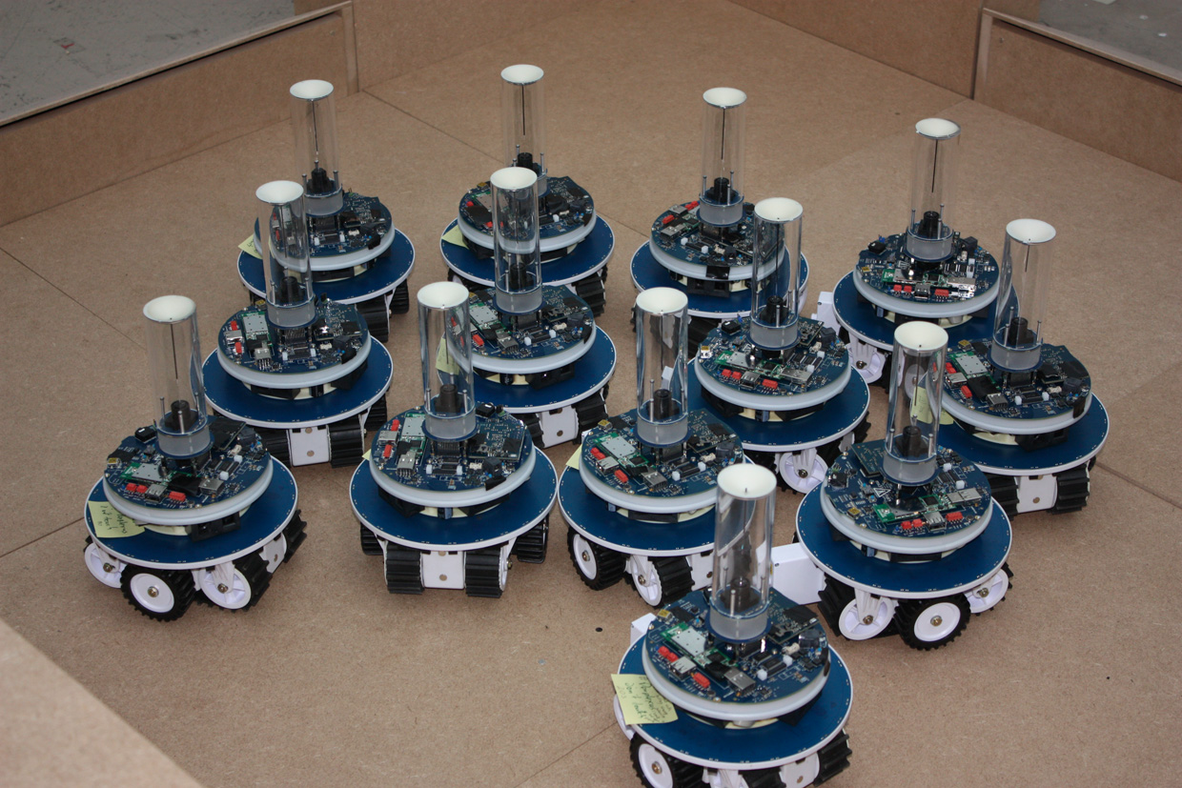
General context: NetSci analytics
Online social media
Internet
Clean energy and grid analytics
Biological networks
Square kilometer array telescope
Robot and sensor networks
Goal: process, analyze, and learn from large pools of network data
E. D. Kolaczyk, “Statistical Analysis of Network Data: Methods and Models,’’ Springer, 2010.
Notes:
2

Slide 3
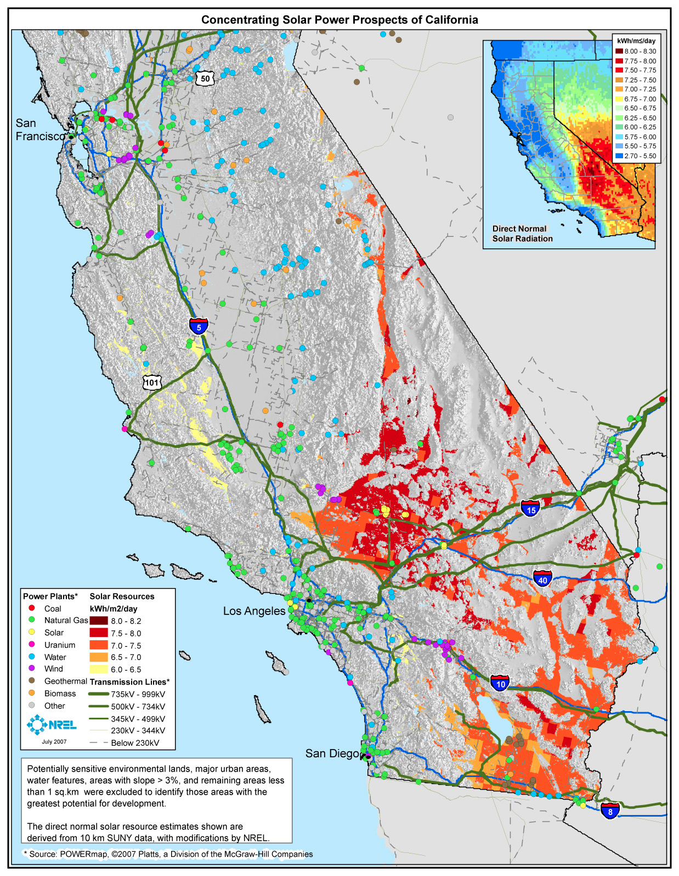
Motivation: Grid analytics
Monitoring for situational awareness key to power grid operation
Photovoltaic resources in California
Network state
Renewable generation
Loads
Customer behavior
Ubiquitous installation of sensing devices
Not there yet, costly!
Goal: infer global state from a subset of
measurements only!
G. B. Giannakis et al, “Monitoring and optimization for power grids: A signal processing perspective,” IEEE Signal Process. Mag., vol. 30, pp. 107-128, 2013.
Notes:
.

Slide 4
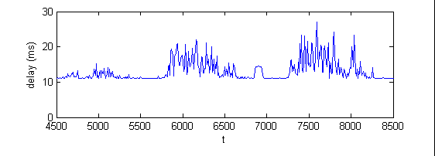

Motivation: Internet monitoring
High delay variability
End-to-end-delays in IP networks
Asses network health
Fault diagnosis, network planning
Few tools widely supported, e.g., traceroute, ping
Additional tools from CAIDA
Require software installation at routers
Useless if intermediate routers inaccessible
AT&T
C&W
Sprint
UUNet
PSINet
Desiderata: infer delays from a limited number of end-to-end measurements only!
Qwest
Level 3
G. Mateos and K. Rajawat, “Dynamic network cartography,” IEEE Signal Process. Mag., vol. 30, pp. 129-143, 2013.

Slide 5






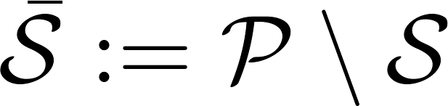
Problem statement
Consider a network graph with links, nodes, and paths
Challenges
Overhead: # paths ( ) ~ # nodes
Heavily congested routers may drop packets
Outliers due to anomalous events
Q: Can fewer measurements suffice?
Most paths tend to share a lot of links [Chua’06]
Inference task a.k.a. network kriging problem
Measure path delays on subset
Predict on remaining paths

Slide 6
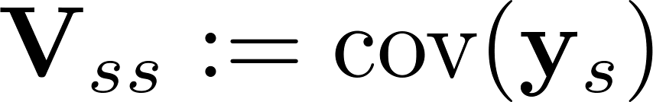
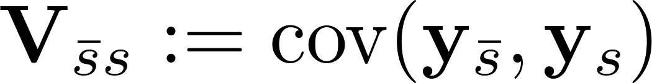
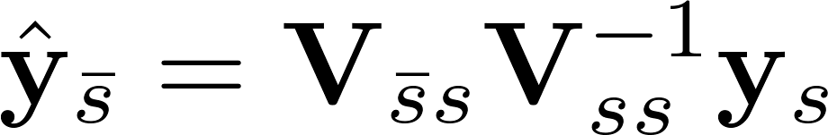
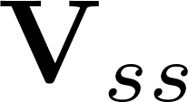
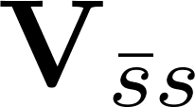
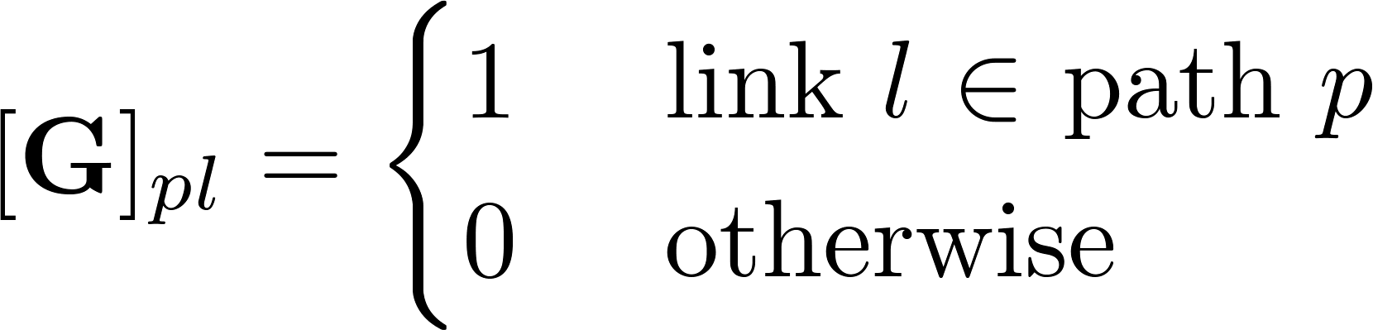
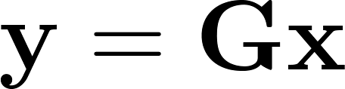
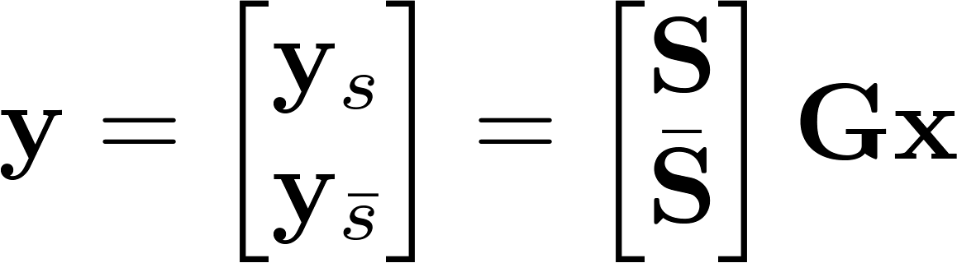
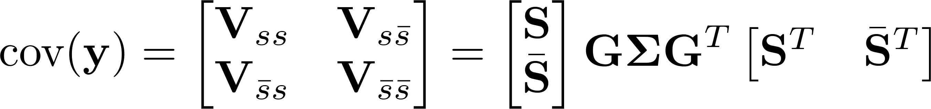
Network Kriging prediction
Given , , universal Kriging predictor is
To obtain , adopt a linear model for path delays
Sampling matrix S known (selected via heuristic algorithms)
D. B. Chua, E. D. Kolaczyk, and M. Crovella, “Network kriging,” IEEE J. Sel. Areas Communications., vol. 24, pp. 2263-2272, 2006.
Notes:
.

Slide 7

Spatio-temporal prediction
Wavelet-based approach [Coates’07]
Diffusion wavelet matrix constructed using network topology
Can capture temporal correlations, for time slots cost
Q1: Robust inference of path costs from end-to-end measurements?
Spot anomalous events? Measurement equipment failures?
Q2: Should the same set of paths be measured per time slot?
Load balancing? Measurement on random paths?
Prior art does not jointly offer
Outlier-robust spatio-temporal inference, at low complexity
Can tackle online path-selection, not the focus today
M. Coates, Y. Pointurier, and M. Rabbat, “Compressed network monitoring for IP and all-optical networks,” in Proc. ACM Internet Measurement Conf., San Diego, CA, Oct. 2007.

Slide 8

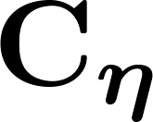
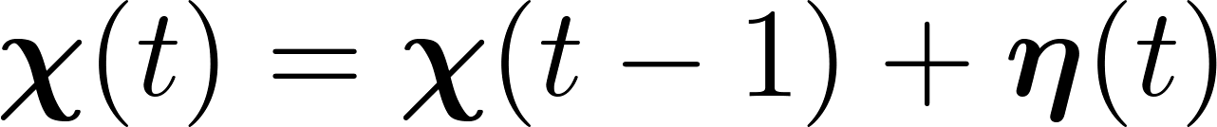

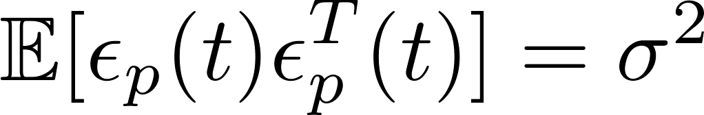
Simple delay model
Delay measured on path
Component due to traffic queuing:
random-walk with noise cov.
Component due to processing, transmission, propagation:
Traffic independent, temporally white, w/ cov.
Measurement noise i.i.d. over
paths and time with known variance
K. Rajawat, E. Dall’Anese, and G. B. Giannakis, “Dynamic network delay cartography,” IEEE Transactions on Information Theory, vol. 60, pp. 2910-2920, 2014.

Slide 9
Robust kriged Kalman filter setup
Path measured on subset
Sparse outlier vector
outlier
otherwise
RKKF:
Goal: Given history find and

Slide 10
Outlier-compensated KKF updates
Define
State and covariance recursions
KKF gain
Kriging predictor [Cresie’90]

Slide 11
Batch KKF updates
Kriging predictor expressible as
Initializing , then over intervals
Structure of LMMSE matrix unimportant, recursively obtained via
with

Slide 12
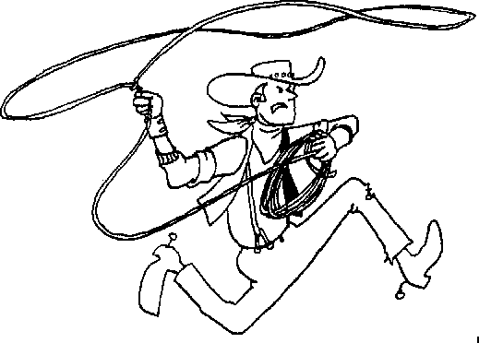
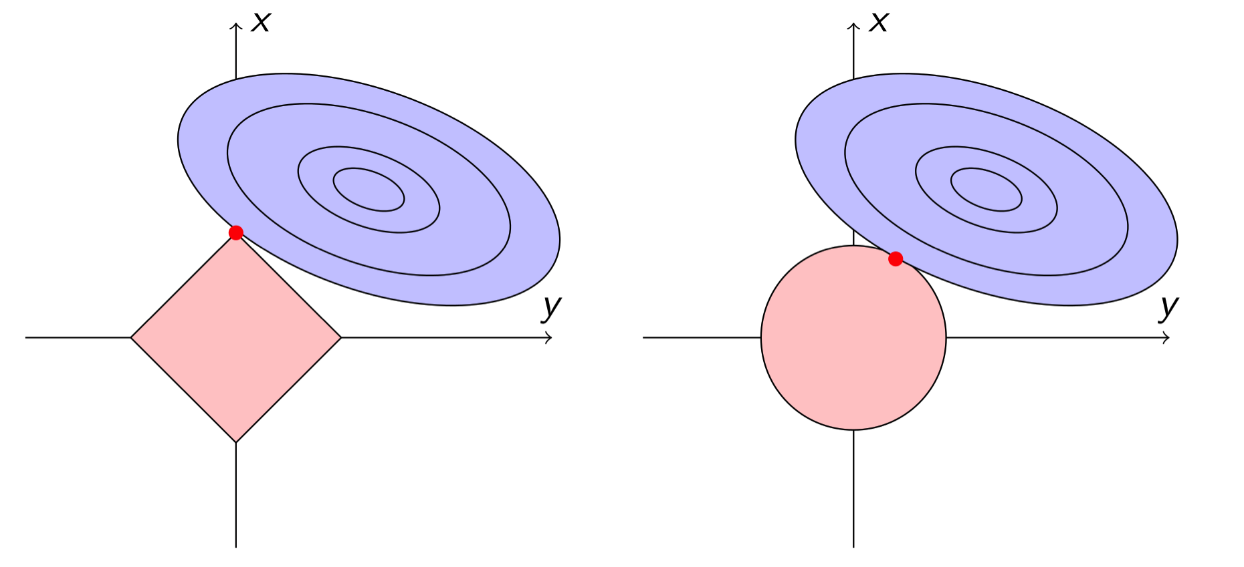
Lassoing outliers
Predictions
Batch estimation problem over intervals
Leverage outlier sparsity via - norm minimzation, e.g., [Tibshirani’94]
- norm minimization
Lasso, basis pursuit
- norm minimization
Ridge regression

Slide 13
Empirical validation: Synthetics
Synthetic IP network and path delays
8 nodes, 15 links, 56 paths, T = 100
Outlier-contaminated delays on 10 observed paths
Measurement outliers
1
7
3
5
4
6
2
8
Network

Slide 14
Predicted delays
Per-path predicted delays
Mean path delays over unobserved paths
Accurate delay map construction even in the presence of outliers
Non-robust KKF yields negative delay estimates!

Slide 15
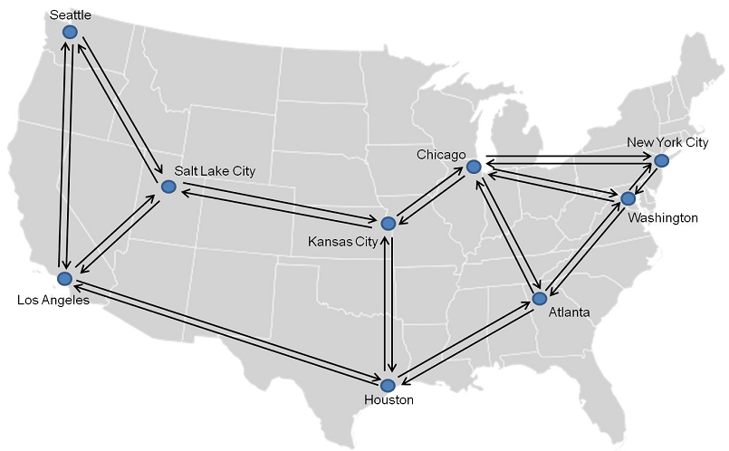


Empirical validation: Internet2
Internet2 backbone: 72 paths, lightly loaded network
One-way delay measurements using OWAMP
Every minute for 3 days in July 2011 ~ 4500 samples
Training phase employed to estimate , [Myers’76]
Modified estimators to handle measurements on subset of paths
First 1000 samples on 50 random paths used for training
Data: http://internet2.edu/observatory/archive/data-collections.html

Slide 16
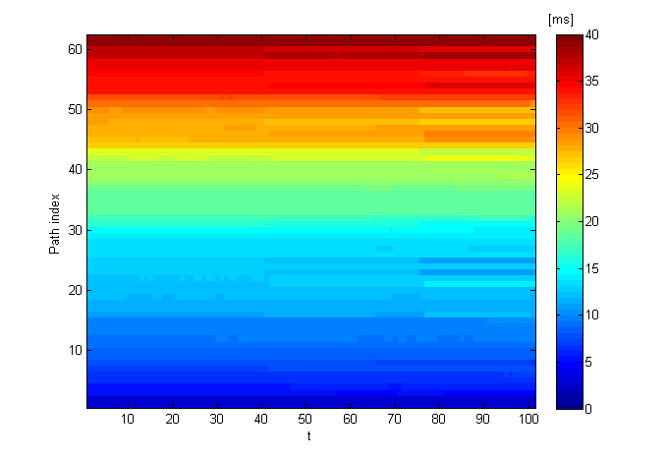
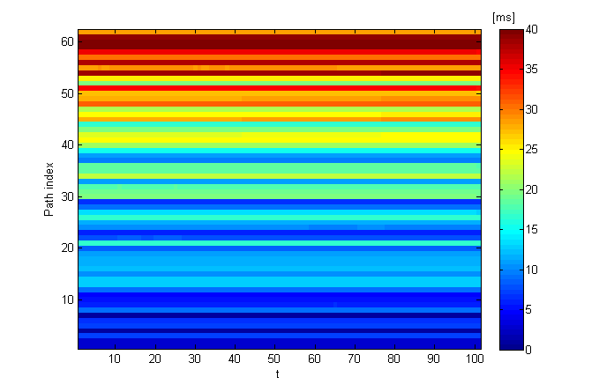
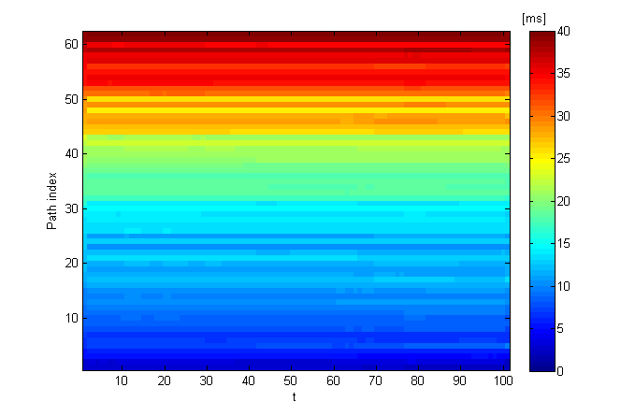
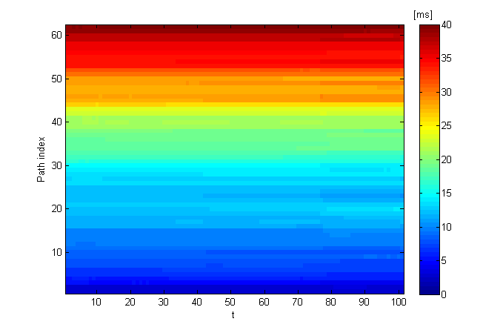
Predicted delays: Internet2
True
Kriging
Wavelet
KKF
16

Slide 17
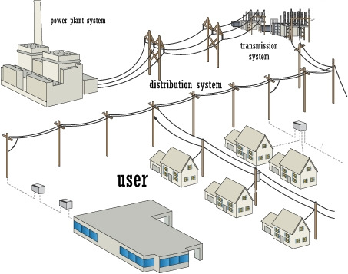
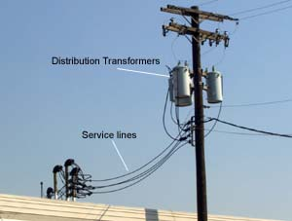
Empirical validation: Transformers
Power distribution systems: secondary transformer loads
Real load data measured from 7 feeders in Anatolia, CA
Each transformer serves 10-12 houses
Load measured every 5 seconds for 6 days in August 2012
Data: courtesy of NREL

Slide 18
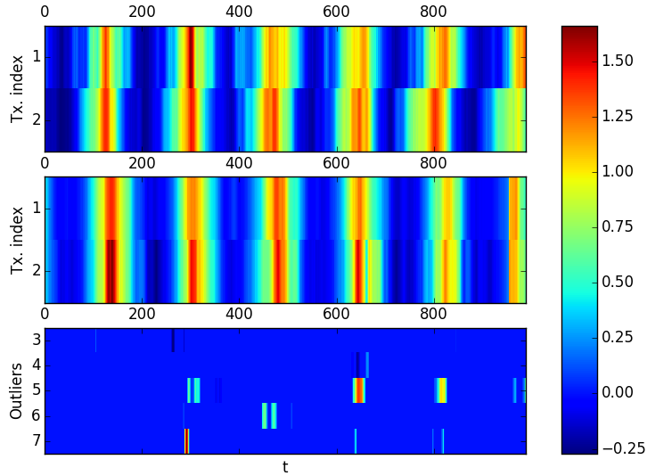
Predicted loads: Transformers
Measure load of five out of seven transformers
Actual loads
Predicted loads
Coincide with load spikes on observed Tx.

Slide 19
Takeaways and road ahead
Spatio-temporal inference of scalar random fields
Network flow costs from end-to-end measurements
Exploit spatial correlation to extrapolate from limited data
Key tool: Kriged Kalman filter facilitates dynamic predictions
Robust KKF to reject outliers
Leverage sparsity in model residuals
Empirical validation on synthetic and real network data
Internet path delay cartography
Prediction of transformer loading
Ongoing work: Real-time counterpart to batch iterations
Greedy path selection via submodularity
Leverage prediction error covariance structure for outlier rejection

Slide 20


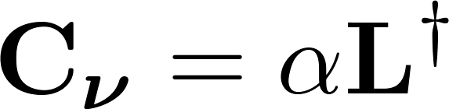
Kriging covariance
Q: How do we find ?
Idea: paths sharing many links should be highly correlated
Linear model:
Graph Laplacian model
Can also handle route changes, especially incremental changes

