Slide 1



Inference of Poisson Count Processes using Low-rank Tensor Data
Juan Andrés Bazerque, Gonzalo Mateos, and Georgios B. Giannakis
May 29, 2013
SPiNCOM, University of Minnesota
Acknowledgment: AFOSR MURI grant no. FA 9550-10-1-0567
Notes:
Thank you for attending this talk. IThis work was supported byAcknowledg: Acknowledgment
AFOSR MURI grant no. FA 9550-10-1-0567
will present this joint work with Gonzalo Mateos and our advisor Prof. Giannakis. The paper presents an algorithm to obtain the Lasso estimator in a distributed fashion.

Slide 2
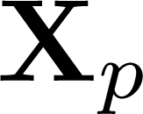

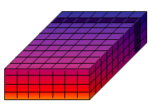




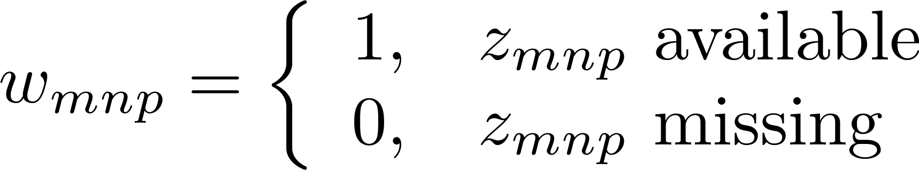



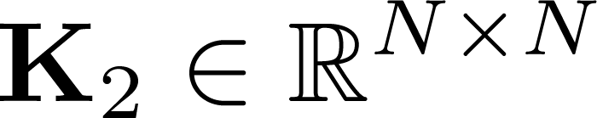
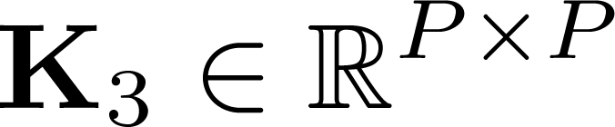






Tensor approximation
Tensor
Missing entries:
Slice covariance
            Goal: find a low-rank approximant of tensor with missing entries indexed by , exploiting prior information in covariance matrices (per mode) , , and

Slide 3
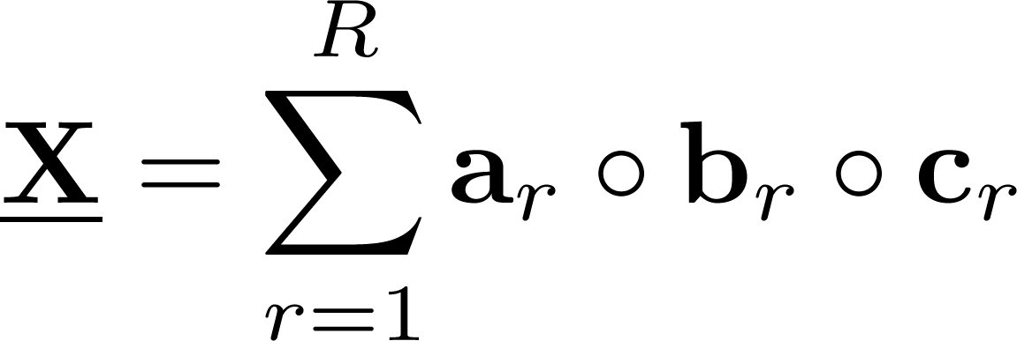
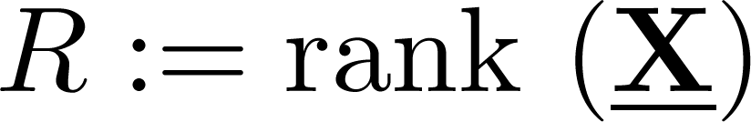
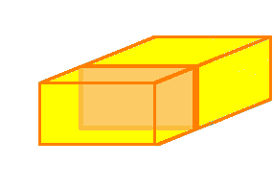





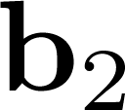




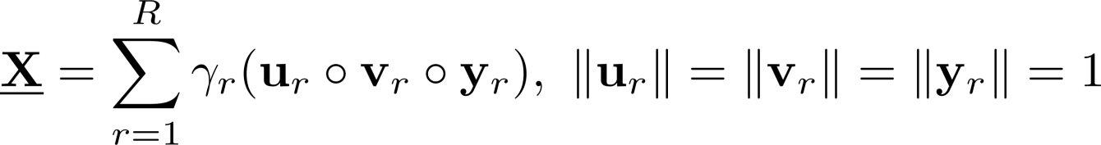






CANDECOMP-PARAFAC (CP) rank
Rank defined by sum of outer-products
Upper-bound
Normalized CP
Slice (matrix) notation

Slide 4
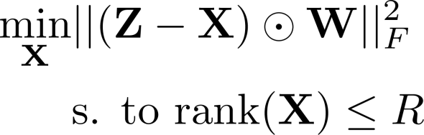









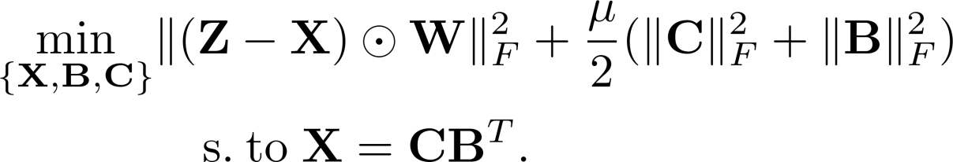
Rank regularization for matrices
Low-rank approximation
Nuclear norm surrogate
Equivalent to [Recht et al.’10][Mardani et al.’12]
B. Recht, M. Fazel, and P. A. Parrilo, “Guaranteed minimum rank solutions of linear matrix equations via nuclear norm minimization,” SIAM Review, vol. 52, no. 3, pp. 471-501, 2010.

Slide 5
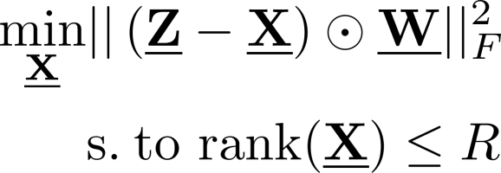
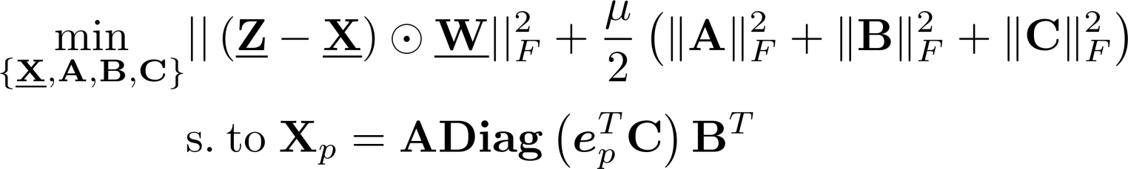



Tensor rank regularization
Challenge: CP (rank) and Tucker (SVD) decompositions are unrelated
Bypass singular values
(P1)
Initialize with rank upper-bound
5

Slide 6

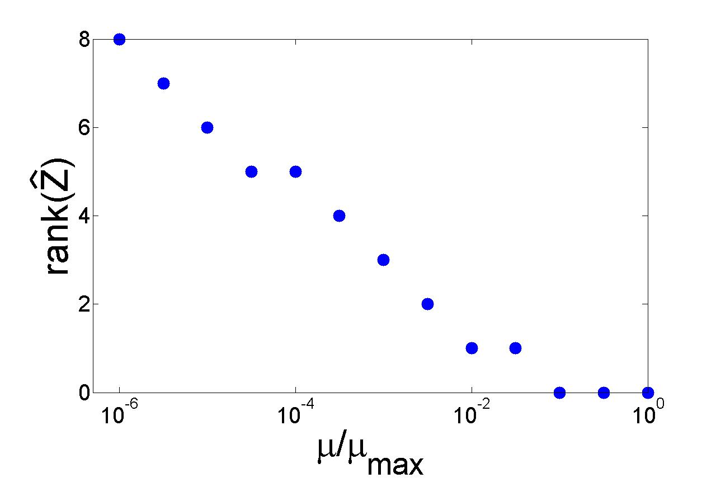
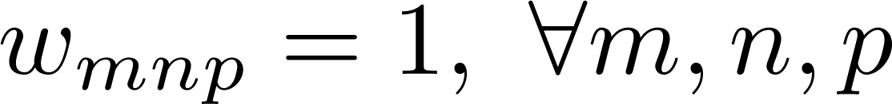

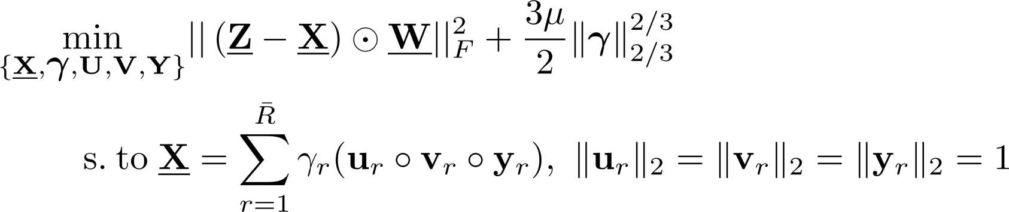
Low rank effect
Data
Solve (P1)
(P1) equivalent to:
(P2)

Slide 7
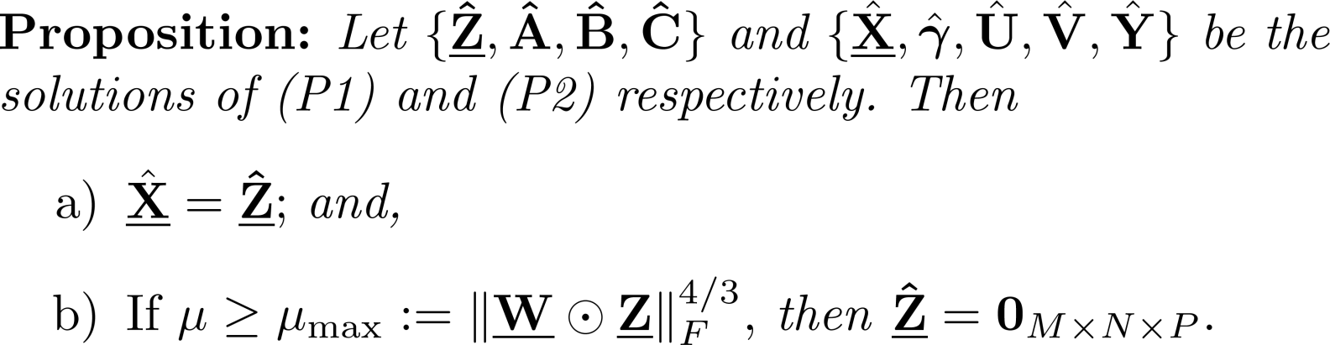
Equivalence
From the proof
ensures low CP rank

Slide 8


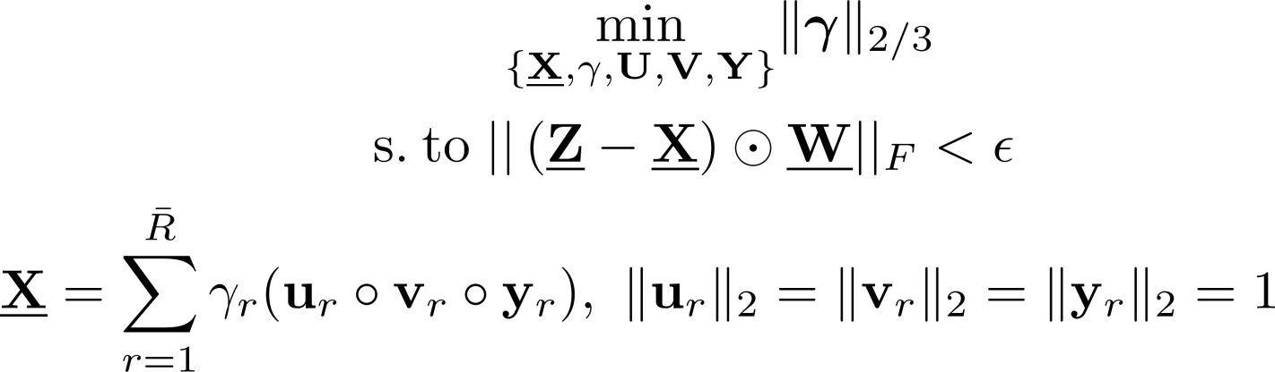




Atomic norm
(P2) in constrained form
(P3)
Recovery form noisy measurements [Chandrasekaran’10]
(P4)
Atomic norm for tensors
Constrained (P3) entails version of (P4) with
V. Chandrasekaran, B. Recht, P. A. Parrilo, and A. S. Willsky, ”The Convex Geometry of Linear Inverse Problems,” Preprint, Dec. 2010.

Slide 9







Bayesian low-rank imputation
Additive Gaussian noise model
Prior on CP factors
Remove scalar ambiguity
MAP estimator
(P5)
Covariance estimation
Bayesian rank regularization (P5) incorporates , , and

Slide 10
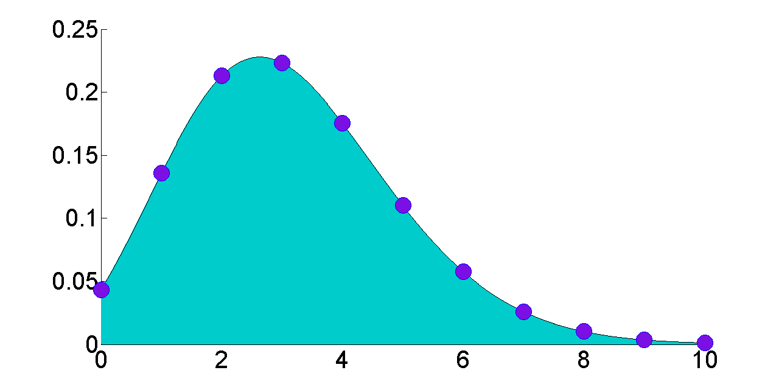


Poisson counting processes
Poisson model per tensor entry
INTEGER R.V. COUNTS INDEPENDENT EVENTS
Substitutes Gaussian model
(P6)
Regularized KL divergence for low-rank Poisson tensor data

Slide 11
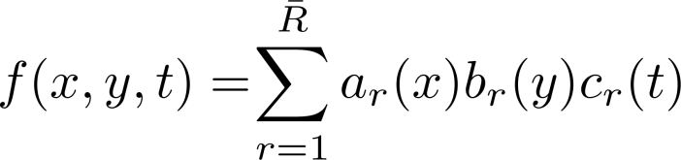
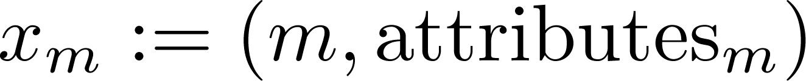
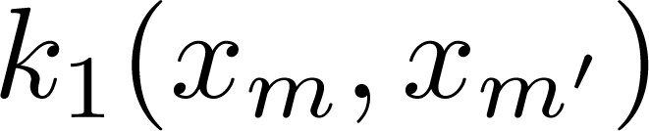
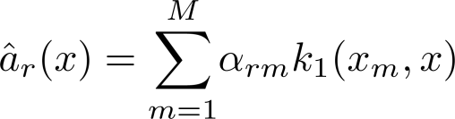
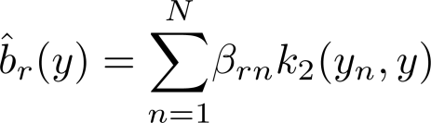
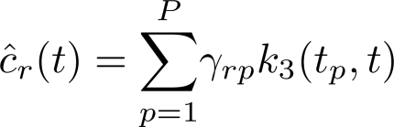
Kernel-based interpolation
Nonlinear CP model
RKHS estimator with kernel per mode; e.g,
Solution
Optimal coefficients
RKHS penalty effects tensor rank regularization
J. Abernethy, F. Bach, T. Evgeniou, and J.‐P. Vert, “A new approach to collaborative ﬁltering: Operator estimation
with spectral regularization,” Journal of Machine Learning Research, vol. 10, pp. 803–826, 2009

Slide 12






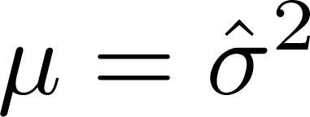


Case study I – Brain imaging
images of pixels
missing data
including slice
, , and sampled from IBSR data
obtained from background noise
Missing entries recovered up to
Slice recovered capitalizing on
Internet brain segmentation repository, “MR brain data set 657,” Center for Morphometric Analysis
at Massachusetts General Hospital, available at http://www.cma.mgh.harvard.edu/ibsr/.

Slide 13
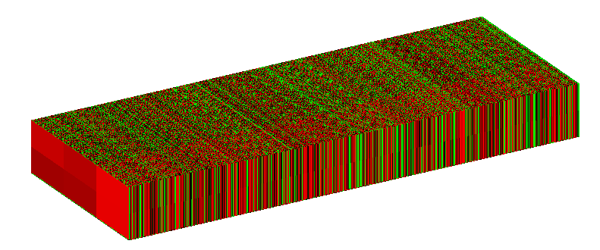

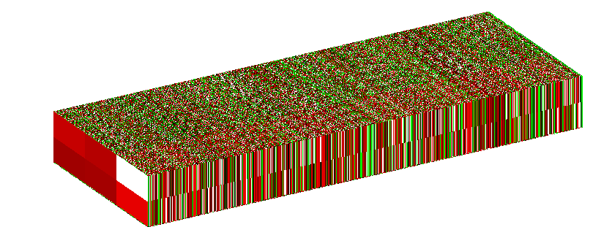
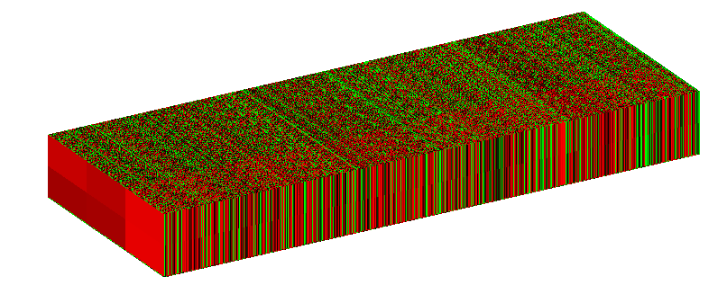



Case study II – 3D RNA sequencing
Transcriptional landscape of the yeast genome
GROUND TRUTH
Expression levels
  M=2 primers for reverse cDNA transcription
  N=3 biological and technological replicates
  P=6,604 annotated ORFs (genes)
DATA
RECOVERY
RNA count modeled as Poisson process
missing data
Missing entries recovered up to
U. Nagalakshmi et al., “The transcriptional landscape of the yeast genome defined by RNA sequencing”
Science, vol. 320, no. 5881, pp. 1344-1349, June 2008.

