Slide 1



Nonparametric low-rank tensor imputation
Juan Andrés Bazerque, Gonzalo Mateos, and Georgios B. Giannakis
August 8, 2012
Spincom group, University of Minnesota
Acknowledgment: AFOSR MURI grant no. FA 9550-10-1-0567
Notes:
Thank you for attending this talk. IThis work was supported byAcknowledg: Acknowledgment
AFOSR MURI grant no. FA 9550-10-1-0567
will present this joint work with Gonzalo Mateos and our advisor Prof. Giannakis. The paper presents an algorithm to obtain the Lasso estimator in a distributed fashion.

Slide 2

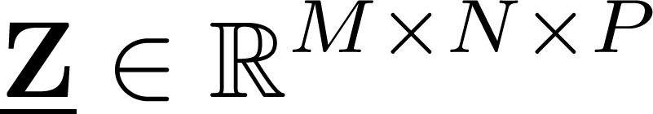



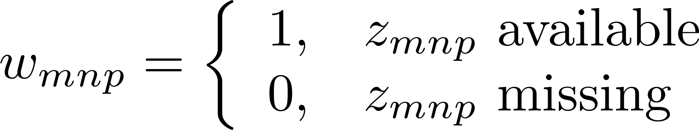


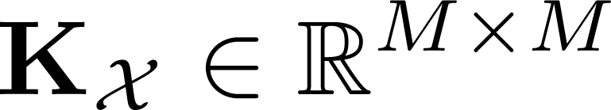
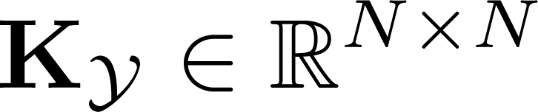
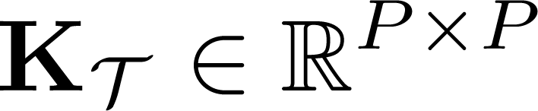






Tensor approximation
Tensor
Missing entries:
Slice covariance
            Objective: find a low-rank approximant of tensor with missing entries indexed by , exploiting prior information in covariance matrices , , and

Slide 3
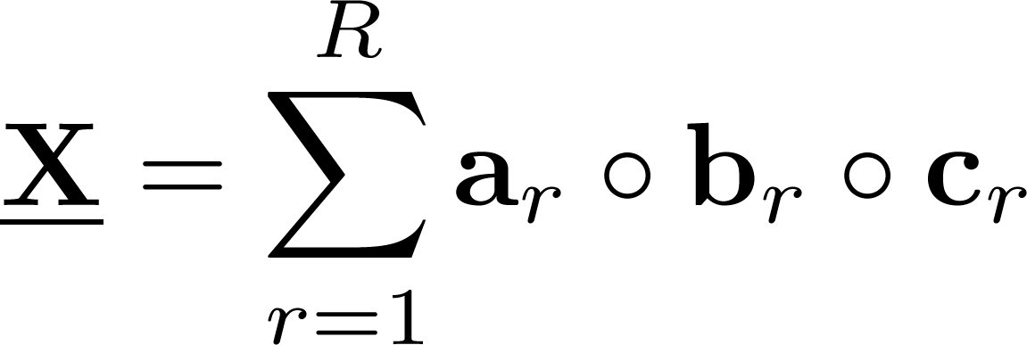
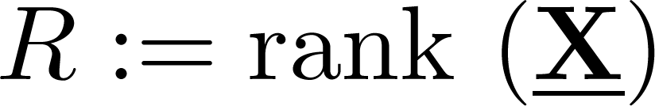
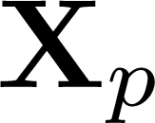
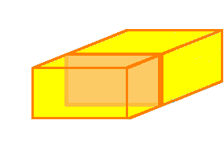





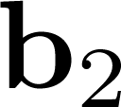




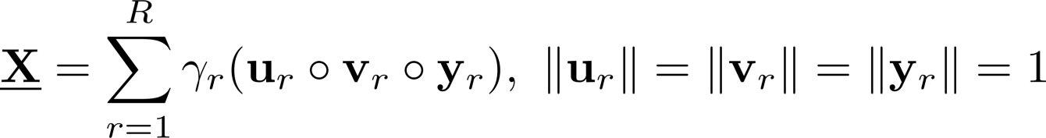
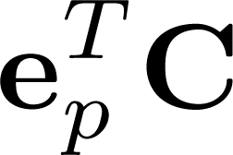





Candecomp-Parafac (CP) rank
Rank defined by sum of outer-products
Upper-bound
Normalized CP
Slice (matrix) notation

Slide 4
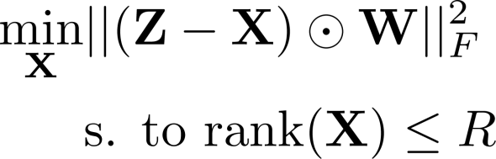




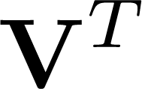




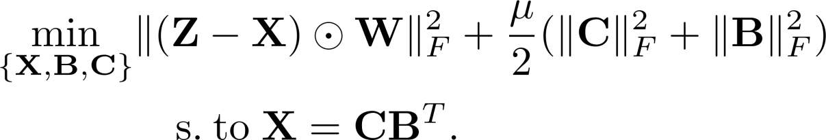
Rank regularization for matrices
Low-rank approximation
Nuclear norm surrogate
Equivalent to [Recht et al.’10][Mardani et al.’12]
B. Recht, M. Fazel, and P. A. Parrilo, “Guaranteed minimum rank solutions of linear matrix equations via nuclear norm minimization,” SIAM Review, vol. 52, no. 3, pp. 471-501, 2010.

Slide 5
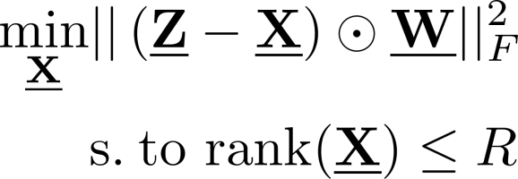
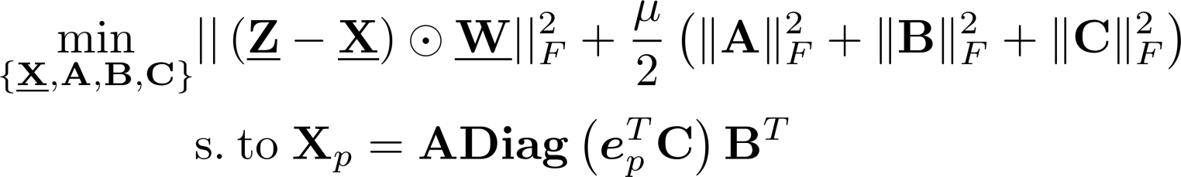


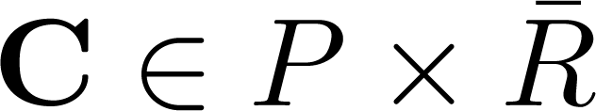
Tensor rank regularization
Challenge: CP (rank) and Tucker (SVD) decompositions are unrelated
Bypass singular values
(P1)
Initialize with rank upper-bound
5

Slide 6

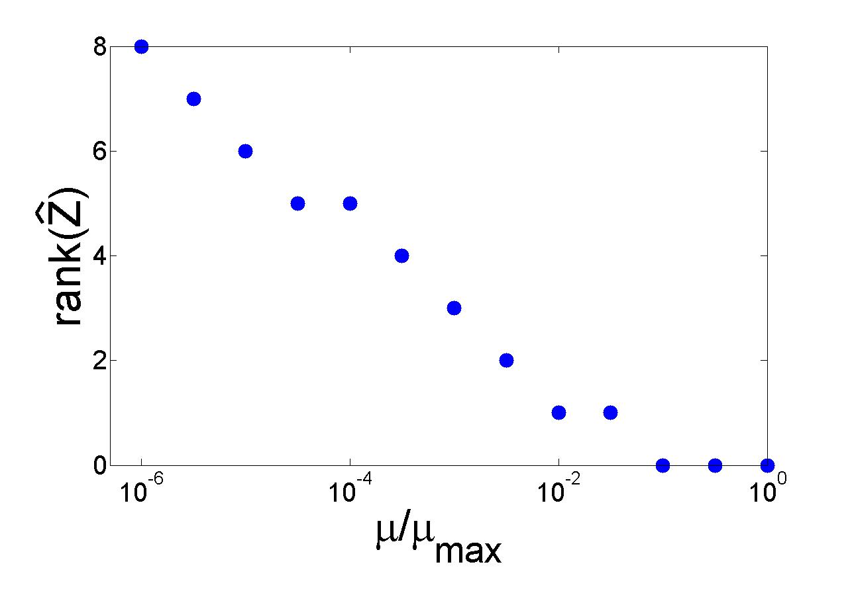
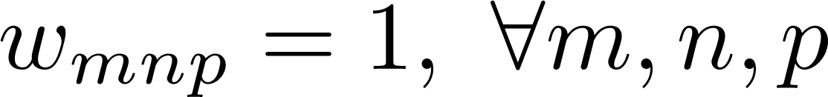

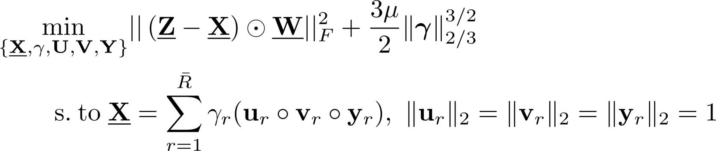
Low rank effect
Data
Solve (P1)
Equivalent to:
(P2)

Slide 7
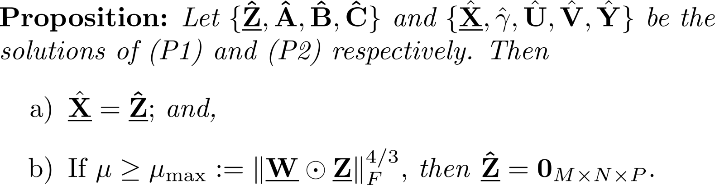
Equivalence
From the proof
ensures low CP rank

Slide 8


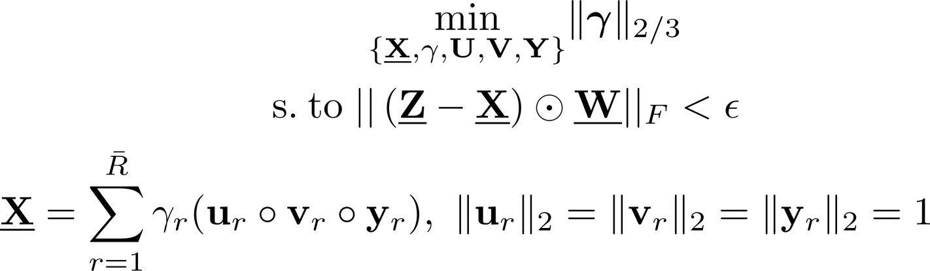


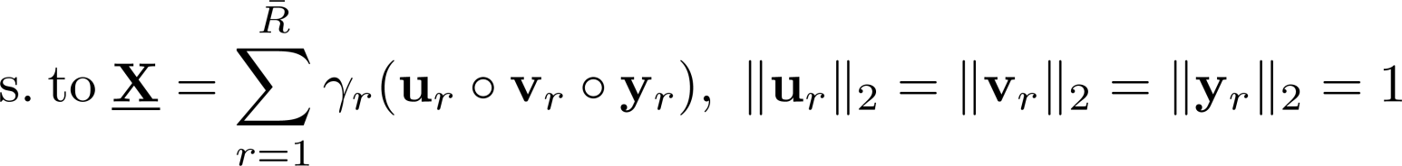


Atomic norm
Constrained form
(P3)
Recovery form noisy measurements [Chandrasekaran’10]
(P4)
Atomic norm for tensors
Constrained (P3) entails version of (P4) with
V. Chandrasekaran, B. Recht, P. A. Parrilo, and A. S. Willsky, ”The Convex Geometry of Linear Inverse Problems,” Preprint, Dec. 2010.

Slide 9







Bayesian low-rank imputation
Additive Gaussian noise model
Prior on CP components
Remove scalar ambiguity
MAP estimator
(P5)
Covariance estimation
Bayesian rank regularization (P5) incorporates , , and

Slide 10
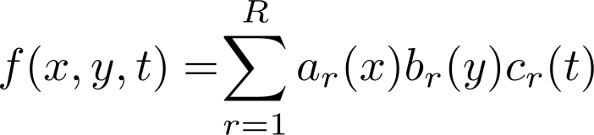
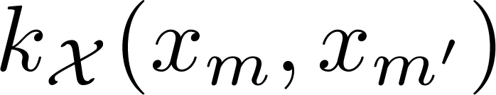
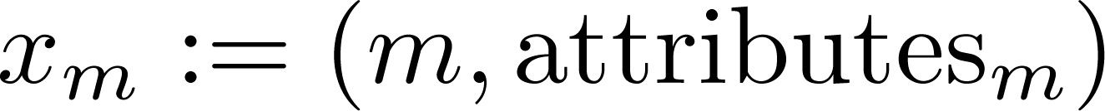
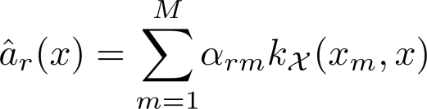
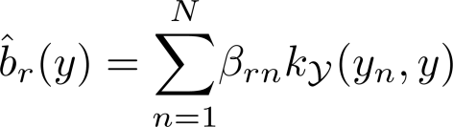
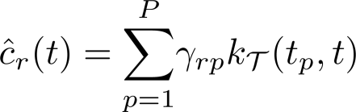
Kernel-based interpolation
Nonlinear CP model
Introduce similarities ( ) based on attributes [Abernethy’09]
RKHS estimator
Solution
Optimal coefficients
RKHS penalty effects tensor rank regularization
J. Abernethy, F. Bach, T. Evgeniou, and J.‐P. Vert, “A new approach to collaborative ﬁltering: Operator estimation
with spectral regularization,” Journal of Machine Learning Research, vol. 10, pp. 803–826, 2009

Slide 11




Case study I – Brain imaging
images of pixels
Missing data
at random
+
missing column slice
Missing entries
recovered up to
Slice recovered by
capitalizing on
covariance symmetries
OsiriX, “DICOM sample image sets repository,” http://pubimage.hcuge.ch:8080

Slide 12
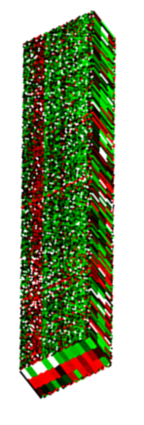
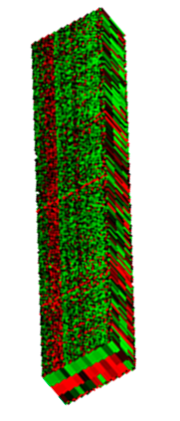
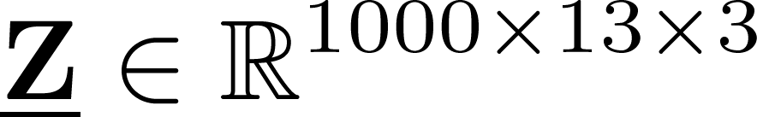


Case study II – 3D microarray data
DATA
RECOVERY
Expression levels
genes
Oxidative stress induces cell
cycle arrest
stress
Identify proteins involved in
stress-induced arrest
missing data in
acquisition process
time
Missing entries recovered up to
M. Shapira, M. E. Segal, and D. Botstein, ”Disruption of yeast forkhead-associated cell cycle transcription
by oxidative stress,” Molecular Biology of the Cell, vol. 15, no. 12, pp. 5659–5669, Dec. 2004.

