Slide 1


Unveiling Anomalies in Large-scale Networks via Sparsity and Low Rank
Morteza Mardani, Gonzalo Mateos and Georgios Giannakis
ECE Department, University of Minnesota
Acknowledgments: NSF grants no. CCF-1016605, EECS-1002180
Asilomar Conference
November 7, 2011
1
Notes:
1

Slide 2
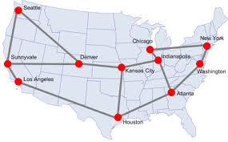
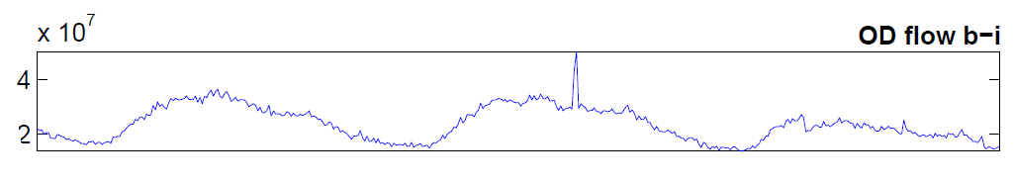
Context
Backbone of IP networks
Traffic anomalies: changes in origin-destination (OD) flows
Failures, transient congestions, DoS attacks, intrusions, flooding
Motivation: Anomalies→ congestion→ limits end-user QoS provisioning
Goal: Measuring superimposed OD flows per link, identify anomalies
by leveraging sparsity of anomalies and low-rank of traffic.
2
Notes:
2
Routers are nodes in backbone net., also BGP protocol is running to exchange routing information among the routers, representing different AS, to update a routing table at each node. However, inside each AS, the intra domain routing protocols like distance vector(DV) and open shortest path first (OSPF) are running to exchange routing information among different entities.
DV (distance vector): Each router informs its neighbors of topology (position w.r.t its neighbors) changes periodically, then each router uses this information gathered from neighbors and tries to update its routing table via Belman-Ford algorithm.
LS (link state): Each router informs all nodes in the network about its topology changes via flooding. Finally every node ends up with a map of the network.
SNMP protocol: simple network management protocol keeps data about different devices of the network like routers, switches, etc.
Two main approaches to studying the network ensemble behavior:
Net. Tomography: inference of the network behavior through the use of probes, there is no assumption made about the network e.g., topology is not known, network is like a black box
Entity-based study: some information about the network layout like topology is known
Broad classification of network anomalies:
performance-related problems, e.g., Network failures, Transient congestions
Security-related problems, e.g., DOS and network intrusions
DOS happens when the services offered by the network are hijacked by some malicious entity
Intruders hijack the network bandwidth by flooding the network with unnecessary traffic

Slide 3
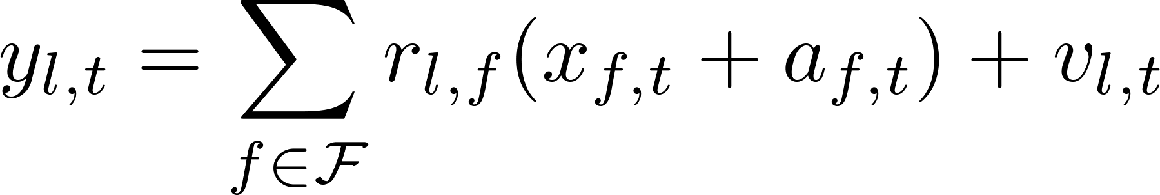

Model
Graph G (N, L) with N nodes, L links, and F flows (F >> L)
(as) Single-path per OD flow x_{f,t}
Packet counts per link l and time slot t
Anomaly
є {0,1}
Matrix model across T time slots
LxT
LxF
3
Notes:
3

Slide 4
Low rank and sparsity
X: traffic matrix is low-rank [Lakhina et al‘04]
A: anomaly matrix is sparse across both time and flows

Slide 5
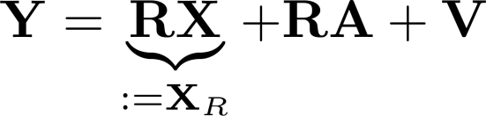




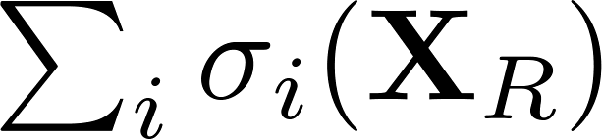
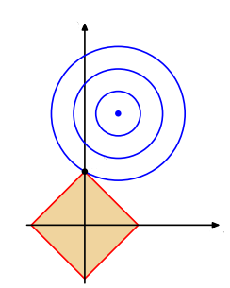
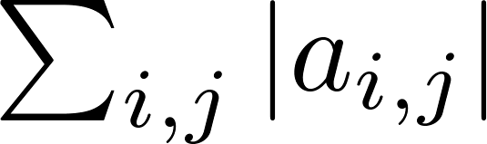
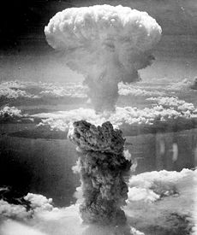
Objective and criterion
Given and routing matrix , identify sparse when is low rank
R fat but X_{R} still low rank
Low-rank → sparse vector of SVs → nuclear norm || ||* and l₁ norm
(P1)
5
Notes:
5
Q: under what conditions on R and A, RA is sparse?

Slide 6
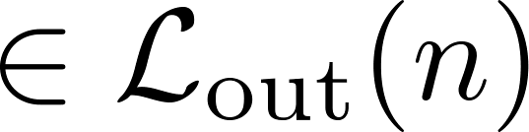

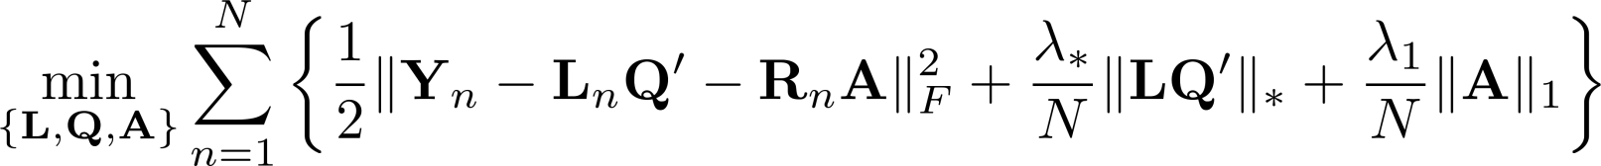
Distributed approach
Centralized
Y=
n
Goal: Given (Y_{n}, R_{n}) per node n є N and single-hop exchanges, find
(P2)
X_{R}=LQ’
Lxρ
≥r
Nonconvex; distributed solution reduces complexity: LT+FT → ρ(L+T)+FT
M. Mardani, G. Mateos, and G. B. Giannakis, ``In-network sparsity-regularized rank minimization: Algorithms and applications," IEEE Trans. Signal Proc., 2012 (submitted).
6
Notes:
6
Q: How to estimate lam_1 and lam_s in a distributed way?

Slide 7

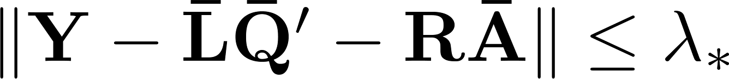

Separable regularization
Key result [Recht et al’11]
New formulation equivalent to (P2)
(P3)
Proposition 1. If stationary pt. of (P3) and ,
then is a global optimum of (P1).
7
Notes:
7

Slide 8
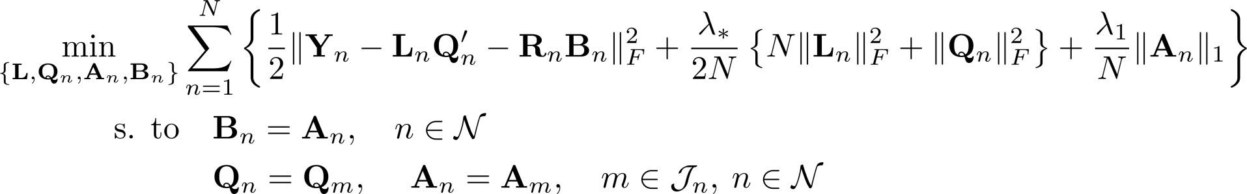

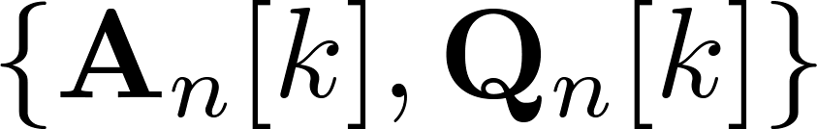
Distributed algorithm
(P4)
Consensus with
neighboring nodes
Network connectivity implies (P3) ⬄ (P4)
Alternating direction method of multipliers (AD-MoM) solver
Primal variables per node n :
Message passing:
n
8
Notes:
8

Slide 9
Distributed iterations
Dual variable updates
Primal variable updates
9
Notes:
9

Slide 10
Attractive features
Highly parallelizable with simple recursions
Low overhead for message exchanges
  Q_{n}[k+1] is T x ρ and A_{n}[k+1] is sparse
FxF
S_{τ}(x)
τ
Recap
(P1) ⬄ (P2) ⬄ (P3) ⬄ (P4)
Centralized
Convex
LQ’ fact.
Nonconvex
Sep. regul.
Nonconvex
Consensus
Nonconvex
Stationary (P4) Stationary (P3) Global (P1)
10
Notes:
10

Slide 11




Optimality
Proposition 2. If converges to ,
and , then:
i)
ii)
where is the global optimum of (P1).
AD-MoM can converge even for non-convex problems
Simple distributed algorithm identifying optimally network anomalies
Consistent network anomalies per node across flows and time
11
Notes:
11

Slide 12
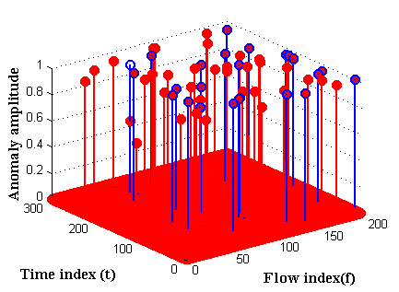
Synthetic data
Random network topology
  N=20, L=108, F=360, T=760
  Minimum hop-count routing
---- True
---- Estimated
P_{f}=10⁻⁴
P_{d} = 0.97
12
Notes:
12
Figures:
1) ROC
2) 3D plot of the detected anomalies like the proposal

Slide 13
Real data
Abilene network data
  Dec. 8-28, 2008
  N=11, L=41, F=121, T=504
---- True
---- Estimated
P_{f} = 0.03
P_{d} = 0.92
Q_{e} = 27%
13
Notes:
13
Figures:
1) ROC
2) 3D plot of the detected anomalies like the proposal

Slide 14

Concluding summary
Anomalies challenge QoS provisioning
Unveiling anomalies via convex optimization
Leveraging sparsity and low rank
Distributed algorithm
Identify when and where anomalies occur
Ongoing research
  Missing data
  Online implementation
Thank You!
14
Notes:
14

