Slide 1


Exact Recovery of Low-Rank Plus Compressed
Sparse Matrices
Morteza Mardani, Gonzalo Mateos and Georgios Giannakis
ECE Department, University of Minnesota
Acknowledgments: MURI (AFOSR FA9550-10-1-0567) grant
Ann Arbor, USA
August 6, 2012
1
Notes:
1

Slide 2
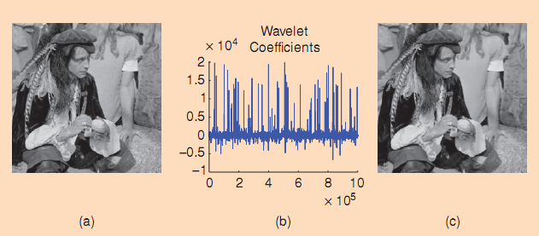
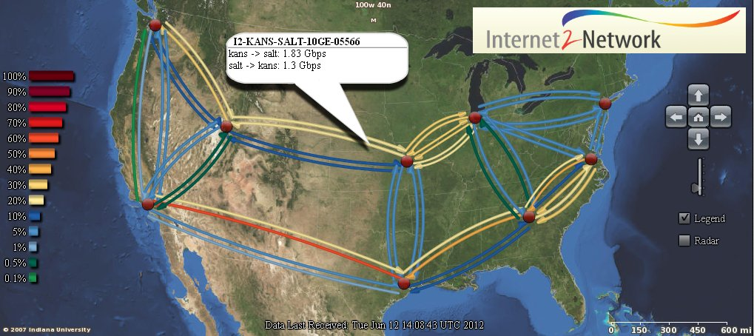
Context
Image processing
Occam’s razor
Among competing hypotheses, pick one which makes the fewest assumptions and thereby offers the simplest explanation of the effect.
Network cartography

Slide 3
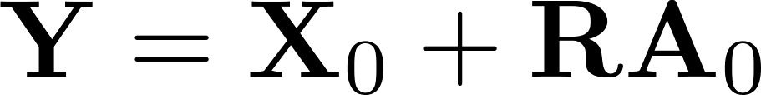
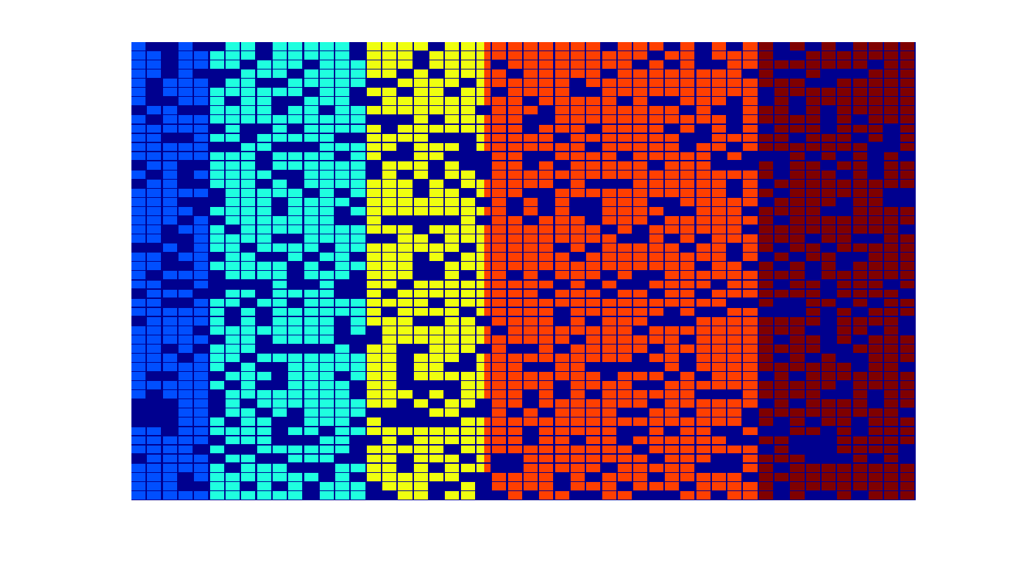
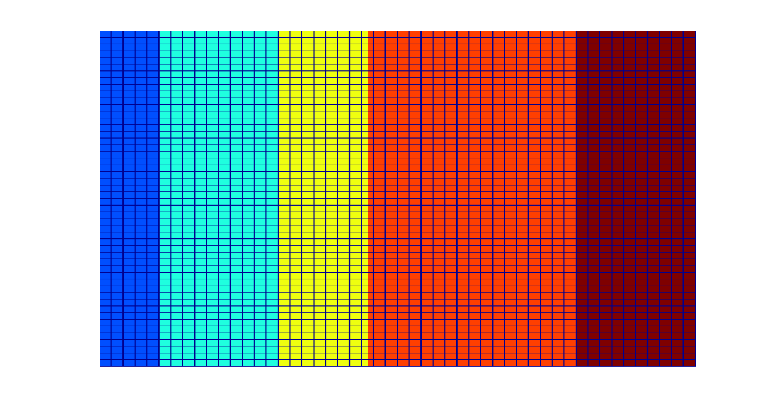
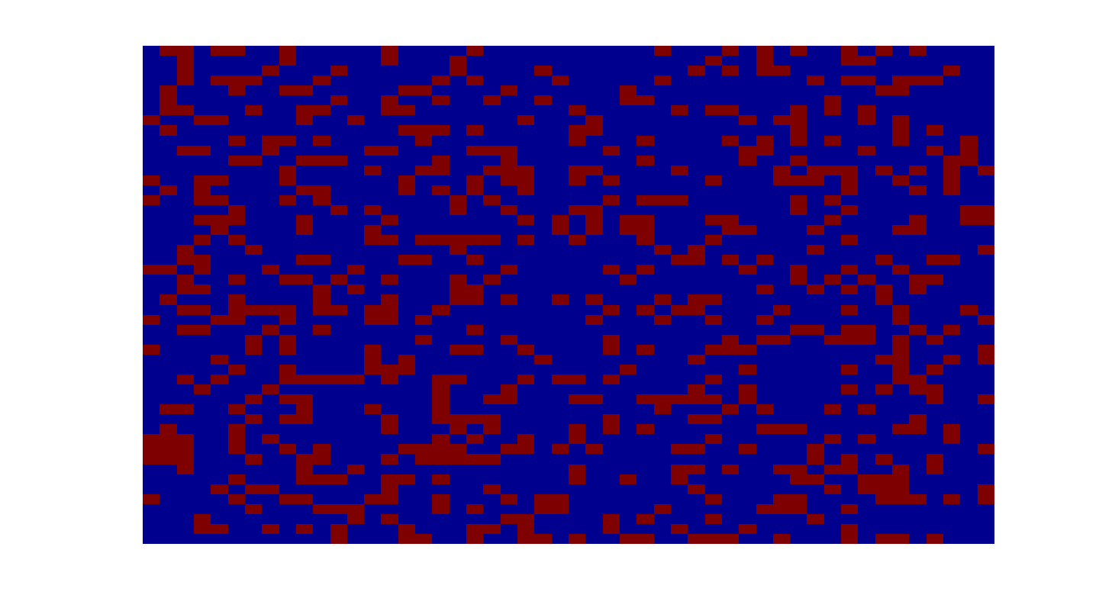

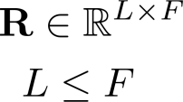




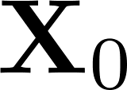
Objective
T
F
L
Goal: Given data matrix and compression matrix , identify sparse
and low rank .
3
Notes:
3
Q: under what conditions on R and A, RA is sparse?

Slide 4
Challenges and importance
Both rank( ) and support of generally unknown
Seriously underdetermined LT + FT >> LT
X
A
Y
(F ≥ L)
Important special cases
  R = I : matrix decomposition [Candes et al’11], [Chandrasekaran et al’11]
  X = 0 : compressive sampling [Candes et al’05]
  A = 0: (with noise) PCA [Pearson’1901]

Slide 5
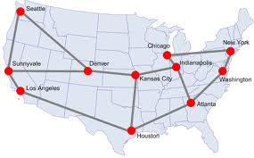
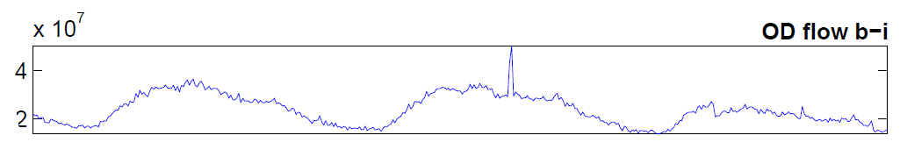
Unveiling traffic anomalies
Backbone of IP networks
Traffic anomalies: changes in origin-destination
(OD) flows
Failures, transient congestions, DoS attacks, intrusions, flooding
Anomalies→ congestion→ limits end-user QoS provisioning
Measuring superimposed OD flows per link, identify anomalies
5
Notes:
5
Routers are nodes in backbone net., also BGP protocol is running to exchange routing information among the routers, representing different AS, to update a routing table at each node. However, inside each AS, the intra domain routing protocols like distance vector(DV) and open shortest path first (OSPF) are running to exchange routing information among different entities.
DV (distance vector): Each router informs its neighbors of topology (position w.r.t its neighbors) changes periodically, then each router uses this information gathered from neighbors and tries to update its routing table via Belman-Ford algorithm.
LS (link state): Each router informs all nodes in the network about its topology changes via flooding. Finally every node ends up with a map of the network.
SNMP protocol: simple network management protocol keeps data about different devices of the network like routers, switches, etc.
Two main approaches to studying the network ensemble behavior:
Net. Tomography: inference of the network behavior through the use of probes, there is no assumption made about the network e.g., topology is not known, network is like a black box
Entity-based study: some information about the network layout like topology is known
Broad classification of network anomalies:
performance-related problems, e.g., Network failures, Transient congestions
Security-related problems, e.g., DOS and network intrusions
DOS happens when the services offered by the network are hijacked by some malicious entity
Intruders hijack the network bandwidth by flooding the network with unnecessary traffic

Slide 6
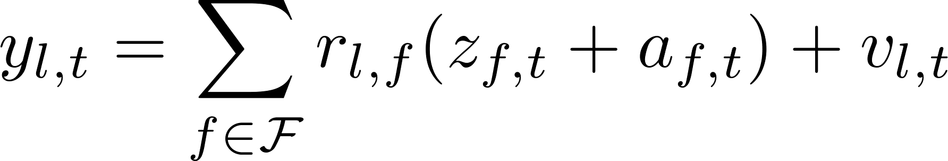

Model
Graph G (N, L) with N nodes, L links, and F flows (F=O(N²) >> L)
(as) Single-path per OD flow z_{f,t}
Packet counts per link l and time slot t
Anomaly
є {0,1}
Matrix model across T time slots
LxT
LxF
6
Notes:
6

Slide 7
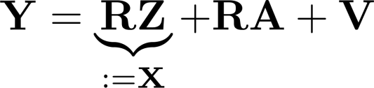
Low rank and sparsity
Z: traffic matrix is low-rank [Lakhina et al‘04] → X: low-rank
A: anomaly matrix is sparse across both time and flows

Slide 8
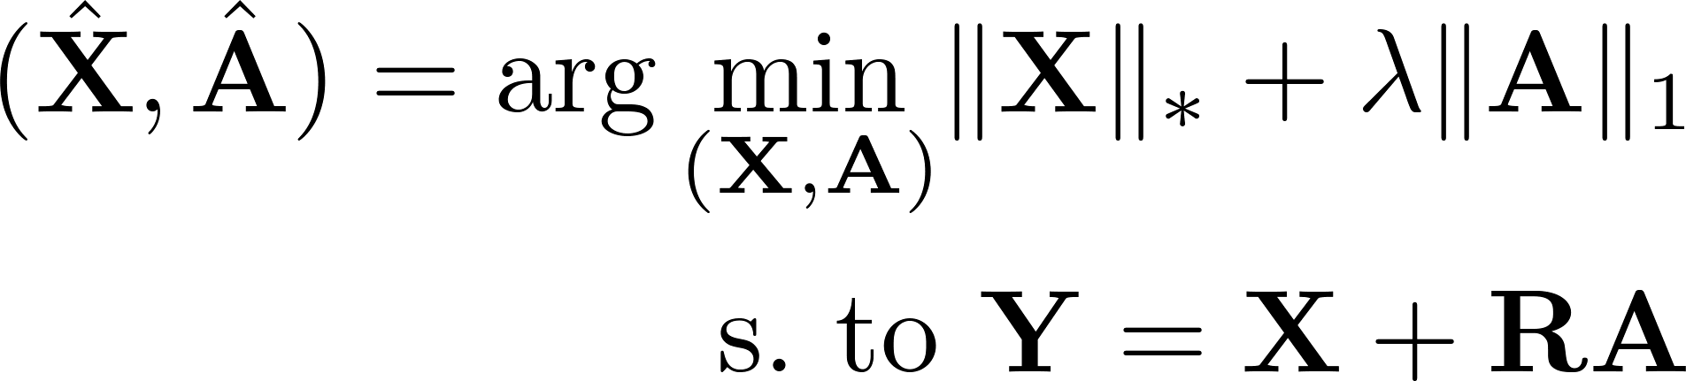
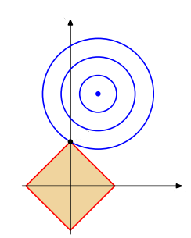
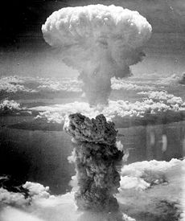

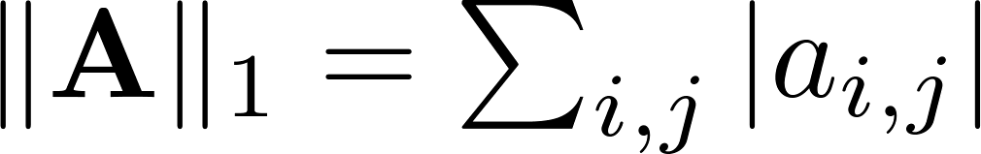

Criterion
Low-rank → sparse vector of SVs → nuclear norm || ||* and l₁ norm
(P1)
Q: Can one recover sparse and low-rank exactly?
A: Yes! Under certain conditions on

Slide 9





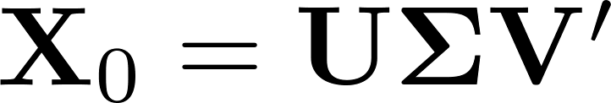
Identifiability
Y = X₀+ RA₀ = X₀ + RH + R(A₀ - H)
X₁
A₁
Problematic cases
  but low-rank and sparse
  ,
For and r = rank(X₀), low-rank-preserving matrices RH
Sparsity-preserving matrices RH

Slide 10
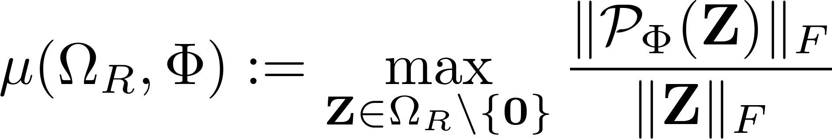





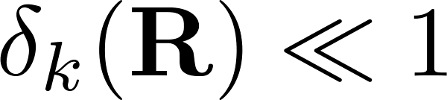
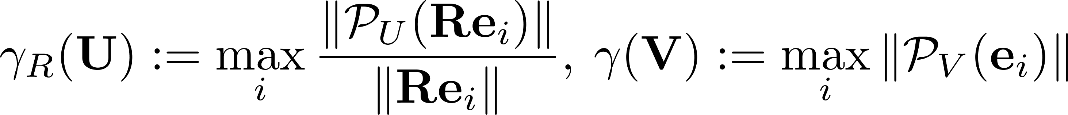
Incoherence measures
Ω_{R}
θ=cos⁻¹(μ)
Ф
Incoherence among columns of R → ,
Local identifiability requires
,
Exact recovery requires ,
Incoherence between X₀ and R

Slide 11
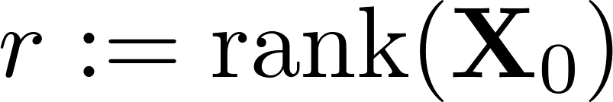

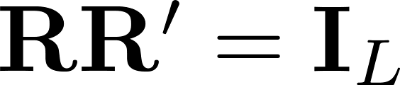
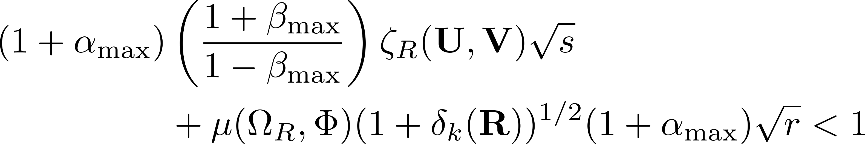


Main result
Theorem: Given and , if every row and column of has at most k non-zero entries and , then
imply Ǝ for which (P1) exactly recovers
M. Mardani, G. Mateos, and G. B. Giannakis,``Recovery of low-rank plus compressed sparse matrices with application to unveiling traffic anomalies," IEEE Trans. Info. Theory, submitted Apr. 2012.(arXiv: 1204.6537)

Slide 12
Intuition
Exact recovery if
  r and s are sufficiently small
  Nonzero entries of A₀ are “sufficiently spread out”
  Columns (rows) of X₀ not aligned with basis of R (canonical basis)
  R behaves like a “restricted” isometry
  Interestingly
    Amplitude of non-zero entries of A₀ irrelevant
    No randomness assumption
  Satisfiability for certain random ensembles w.h.p

Slide 13
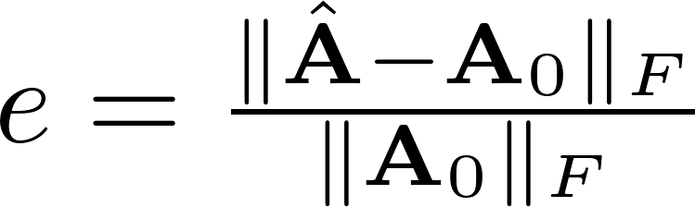
Validating exact recovery
Setup
L=105, F=210, T = 420
R=U_{R}S_{R}V’_{R}~ Bernoulli(1/2)
X = V’_{R} WZ’, W, Z ~ N(0, 10⁴/FT)
a_{ij} ϵ {-1,0,1} w. prob. {ρ/2, 1-ρ, ρ/2}
Relative recovery error

Slide 14
Real data
Abilene network data
  Dec. 8-28, 2008
  N=11, L=41, F=121, T=504
---- True
---- Estimated
Anomaly amplitude
P_{f} = 0.03
P_{d} = 0.92
Q_{e} = 27%
Flow
14
Data: http://internet2.edu/observatory/archive/data-collections.html
Notes:
14
Figures:
1) ROC
2) 3D plot of the detected anomalies like the proposal

Slide 15
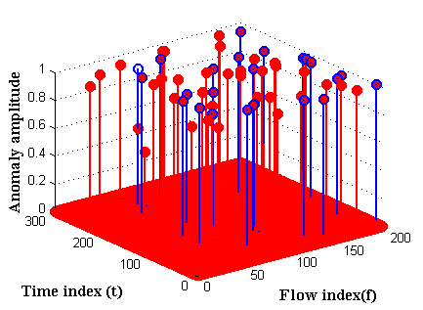
Synthetic data
Random network topology
  N=20, L=108, F=360, T=760
  Minimum hop-count routing
---- True
---- Estimated
P_{f}=10⁻⁴
P_{d} = 0.97
15
Notes:
15
Figures:
1) ROC
2) 3D plot of the detected anomalies like the proposal

Slide 16





Distributed estimator
Centralized
(P2)
Network: undirected, connected graph
?
?
?
?
?
?
n
?
?
Challenges
Nuclear norm is not separable
Global optimization variable A
Key result [Recht et al’11]
16
M. Mardani, G. Mateos, and G. B. Giannakis, "In-network sparsity-regularized rank minimization:
Algorithms and applications," IEEE Trans. Signal Process., submitted Feb. 2012.(arXiv: 1203.1570)
Notes:
16

Slide 17
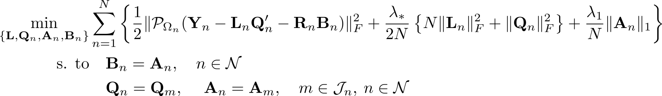

Consensus and optimality
(P3)
Consensus with
neighboring nodes
Alternating-directions method of multipliers (ADMM) solver
Highly parallelizable with simple recursions
n
Low overhead for message exchanges
Claim: Upon convergence attains the global optimum of (P2)

Slide 18

Online estimator
Streaming data:
(P4)
---- estimated
---- real
o---- estimated
---- real
Claim: Convergence to stationary point set of the batch estimator
M. Mardani, G. Mateos, and G. B. Giannakis, "Dynamic anomalography: Tracking network anomalies via
sparsity and low rank," IEEE Journal of Selected Topics in Signal Processing, submitted Jul. 2012.

