Slide 1




Transferability of Spatiotemporal CoVariance Neural Networks
for Multiscale fMRI Analysis
Saurabh Sihag¹, Andrea Cavallo$3$, Yucheng Zhu¹, Elvin Isufi$3$, Gonzalo Mateos$2$, and Alejandro Ribeiro⁴
¹University at Albany
²University of Rochester
³Delft University of Technology
⁴University of Pennsylvania
Asilomar Conference on Signals, Systems, and Computers, 2026

Slide 2
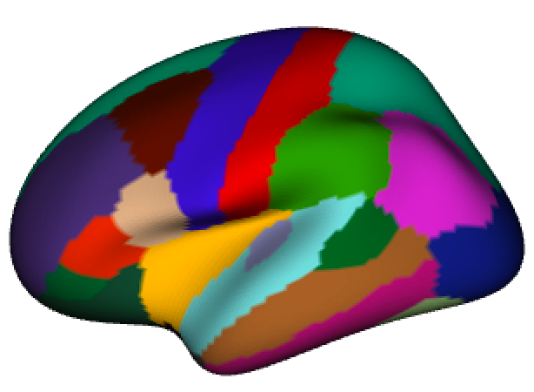
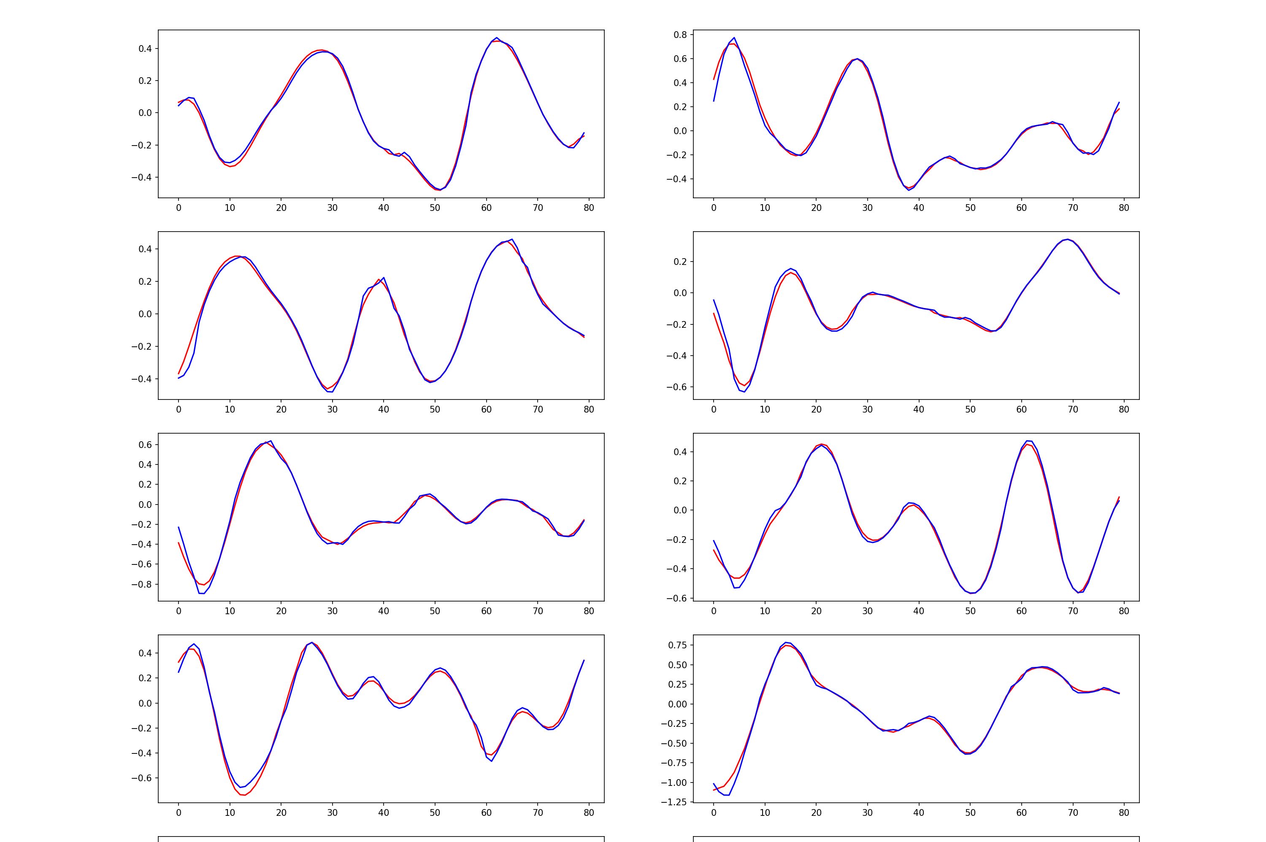
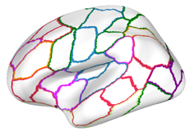
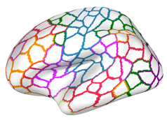


Multi-scale fMRI Data
fMRI captures brain functional activity (BOLD time series)
Functional activity can be represented at
different spatial resolutions
Information redundancy or compatibility across spatial resolutions
Brain atlas with $m_{1}$parcellations
Brain atlas with $m_{2}$parcellations
Notes:
An fMRI scan provides blood oxygen level–dependent, or BOLD, signals that reflect changes associated with brain activity.
BOLD activity is curated according to brain atlases, which are maps dividing the brain into regions. There exitst numerous brain atlases in practice. Some have coarser spatial resolution and define fewer, larger regions, while others define many smaller regions at a finer spatial resolution.
The same fMRI scan can therefore be represented in different spatial representations, with potentially redundant information across resolutions.

Slide 3
Can One ML Model Transfer Across Spatial Scales?
A model that transfers across resolutions has advantages
  reduces dependence on a particular brain atlas
  (robust scientific findings, flexibility to choose spatial scale)
  reusing models for data represented at different resolutions
  (computational and data efficiency, deployment flexibility)
Notes:
In this work, we ask whether one machine learning model could effectively transfer across different scales. Such a transferable model would provide flexibility of selecting the spatial resolution for the analysis according to scientific needs, without making it necessary for training.
It would also allow us to reuse learned parameters across representations with different numbers of regions. This could reduce retraining and make models easier to integrate into existing analysis pipelines

Slide 4
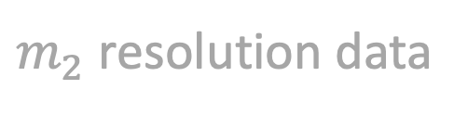

Can One ML Model Transfer Across Spatial Scales?
A model that transfers across resolutions has advantages
  reduces dependence on a particular brain atlas
  (robust scientific findings, flexibility to choose spatial scale)
  reusing models for data represented at different resolutions
  (computational and data efficiency, deployment flexibility)
Key challenge: Learning representations that transfer
across spatial resolutions
ML model
Consistent
findings
ML model
Key challenge: Learn representations that connect information across spatial resolutions
$m_{1}$resolution data
$m_{2}$resolution data
4
Notes:
The structure of the brain signals changes with spatial resolutions. In this work, our goals are to provide an architecture whose parameters can process information at different resolutions, and a theoretical explanation of when its outputs should remain consistent.

Slide 5
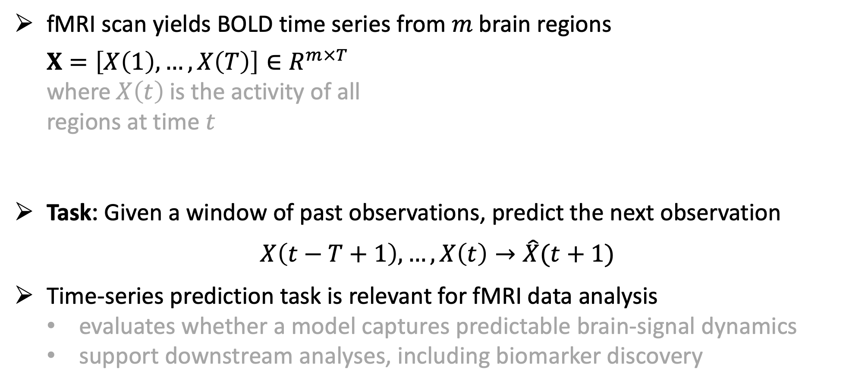
Learning from fMRI Data
fMRI scan yields BOLD time series from $m$brain regions
  $$X=\left[X\left(1\right), …, X\left(T\right)\right]∈R^{m×T}$$
  where $X\left(t\right)$ is the activity of all
  regions at time $t$
Task: Given a window of past observations, predict the next observation
$$X\left(t−T+1\right), …, X\left(t\right)→\hat{X}(t+1)$$
Time-series prediction task is relevant for fMRI data analysis
  evaluates whether a model captures predictable brain-signal dynamics
  support downstream analyses, including biomarker discovery
Notes:
Our learning is time-series prediction, i.e., using a window of past observations to predict the next observation. In the experiments, we also examine predictions up to five steps ahead.
Forecasting gives us a direct way to evaluate whether a model is effectively capturing the spatial and temporal signal dynamics. Existing bioinformatics studies have also used predictions or errors of such models to support downstream analyses like candidate biomarker research.

Slide 6
Prediction Depends on Spatial and Temporal Relationships
Region’s predicted activity depends on both temporal history and activity elsewhere in the brain
  Temporal information: How has the
    region’s signal evolved?
  Spatial information: Which other
    regions exhibit related fluctuations?
Notes:
A region’s recen.t history provides information about the subsequent activity. But other regions may also provide useful predictive information because brain signals exhibit coordinated fluctuation
We therefore want to process temporal history together with spatial relationships across regions.

Slide 7

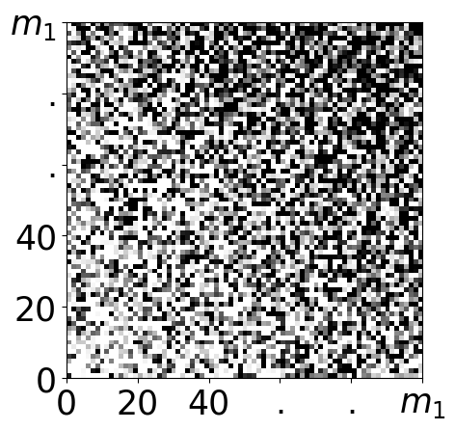
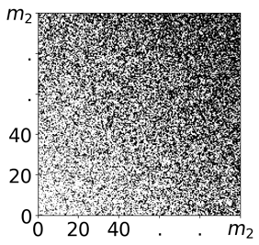




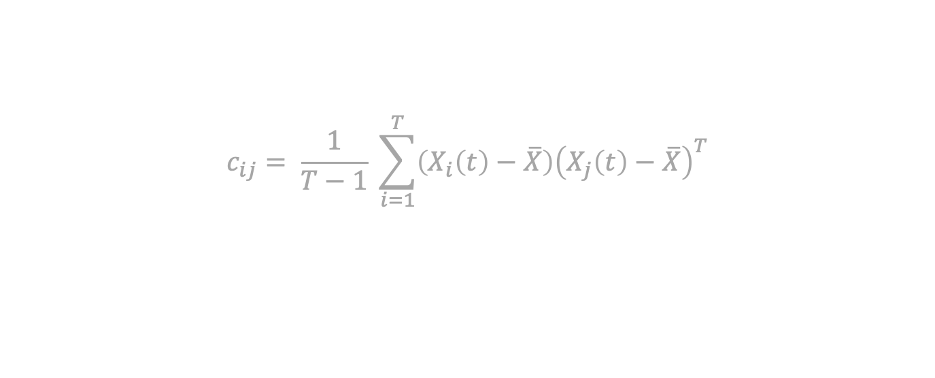
Covariance Captures Relationships Between Brain Regions
Spatial covariance summarizes how signals from different regions vary together
Covariance matrices for multi-scale data:
  different dimensionalities, consistent information
Covariance provides inductive bias for learning from spatiotemporal data (Cavallo, et al., 2024)
$$c_{ij}= \frac{1}{T−1} \sum_{i=1}^{T}{\left(X_{i}\left(t\right)−\overline{X}\right){\left(X_{j}\left(t\right)−\overline{X}\right)}^{T}}$$
Notes:
We use covariance to represent the spatial relationships.
Spatial covariance summarizes how regional signals fluctuate together. It provides a data-driven structure for combining information across regions.
At different resolutions, covariance matrices are of different sizes. Nevertheless, they may reflect related underlying organization. Our approach uses this covariance relational structure as an inductive bias.

Slide 8

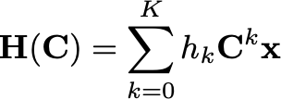

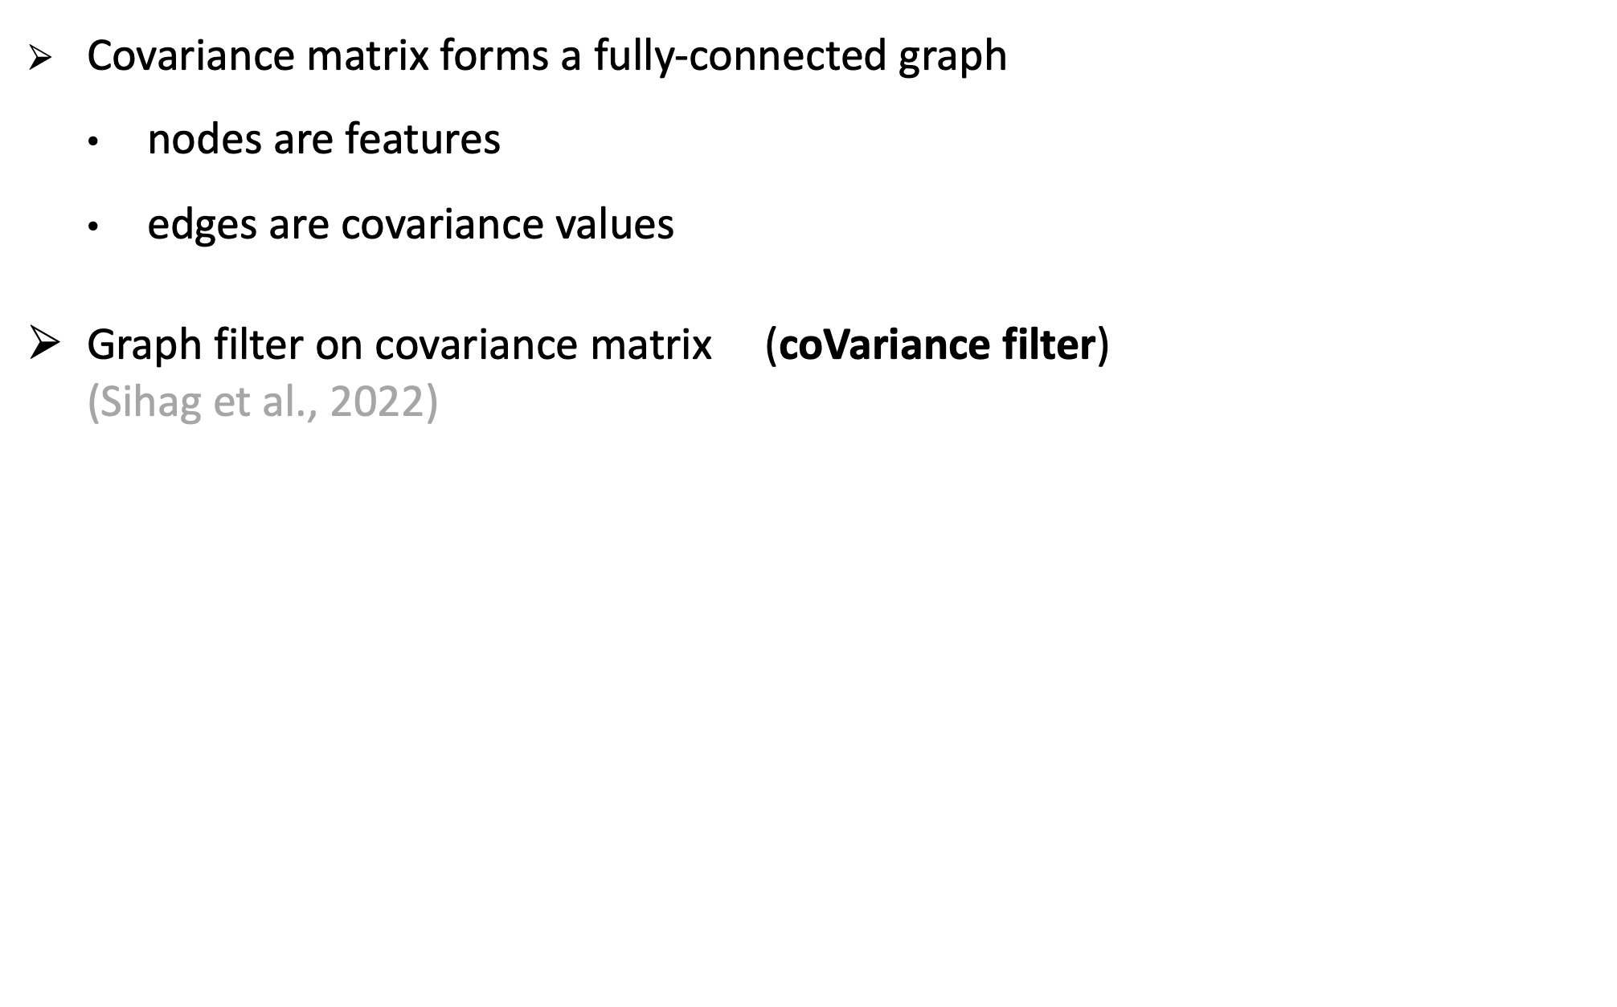
Graph Filter on Covariance Matrix: Covariance Filter
Covariance matrix forms a fully-connected graph
  nodes are features
  edges are covariance values
Graph filter on covariance matrix (coVariance filter)
(Sihag et al., 2022)
1
2
6
3
5
4
Notes:
We can interpret the covariance matrix as a weighted graph, where brain regions are nodes, and covariance values define the connections between them.
A covariance filter is a polynomial in the covariance matrix, where the powers of the covariance determine how signals are mixed through covariance relationships.

Slide 9
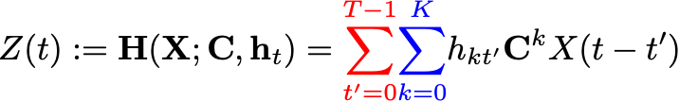

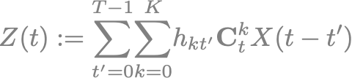

Spatiotemporal CoVariance Filter
Spatiotemporal coVariance filter [Cavallo et al., 2024]
For non-stationary case, online covariance matrix estimate
Spatial and
temporal convolution
$h_{kt}$: scalar learnable parameters
Notes:
We extend the simple covariance filter operation to spatiotemporal setting by incorporating delayed observations. The sptiotemporal covariance filter combines information across both covariance powers and temporal lags.
The spatial component determines how signals mix across regions and the temporal component determines how past observations contribute. The learned scalar coefficients weight these joint spatial and temporal contributions.
For a nonstationary setting, we can update the covariance estimate online as new observations become available.

Slide 10


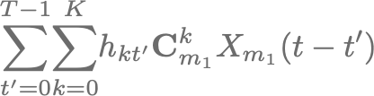





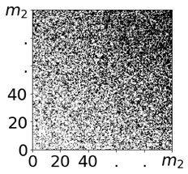




Spatiotemporal coVariance filters are scale-free models
learnable parameters
A coVariance filter with scalar filter taps ${\{h}_{kt}\}$ can process dataset of any arbitrary dimensionality: scale-free model
Notes:
The important observation in the ST covariance filter is that the learned coefficients do not depend on the number of regions
Changing resolution changes the covariance matrix and signal dimensions, but the same filter coefficients still define a valid operation. This makes ST covariance filter reusable across multiscale datasets.

Slide 11
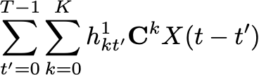

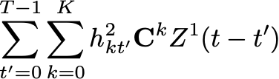

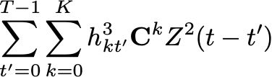

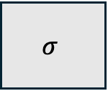
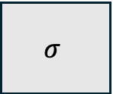
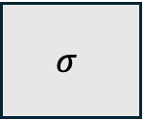
Spatiotemporal coVariance Neural Nets (STVNNs)
STVNN: Sequences of spatiotemporal covariance filters followed by pointwise non-linearity
STVNNs are stable
w.r.t finite sample effect in covariance
$$σ$$
Layer 1
$$σ$$
Layer 2
$$σ$$
(robust, reproducible findings)
Layer 3
  [Cavallo et al., 2024]
Notes:
An STVNN stacks spatiotemporal covariance filters with pointwise nonlinearities. Multiple layers allow the model to learn more expressive relationships than a single linear filter.
Prior theoretical results have established the robustness of STVNN outcmes to finite-sample errors in covariance estimation. That is relevant because we estimate covariance from a limited number of observations.
In this work, we investigate what happens when the spatial resolution itself changes?

Slide 12


STVNNs as scale-free models
STVNN
STVNN
learnable parameters
Notes:
The figure in this slide extends the filter-level argument to the STVNN. We can instantiate the same learned architecture using covariance matrices of different sizes.
At this point, we have established that the STVNN can operate across dimensions. Our next focus is on establishing when its outputs will remain similar across multiscale data.

Slide 13


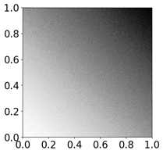

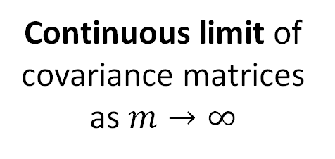
STVNNs as scale-free models
STVNN
STVNN
learnable parameters
Continuous limit of
covariance matrices as $m→∞$

Slide 14


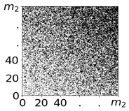
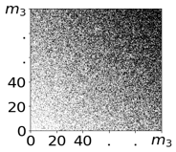
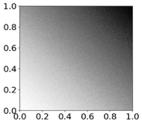

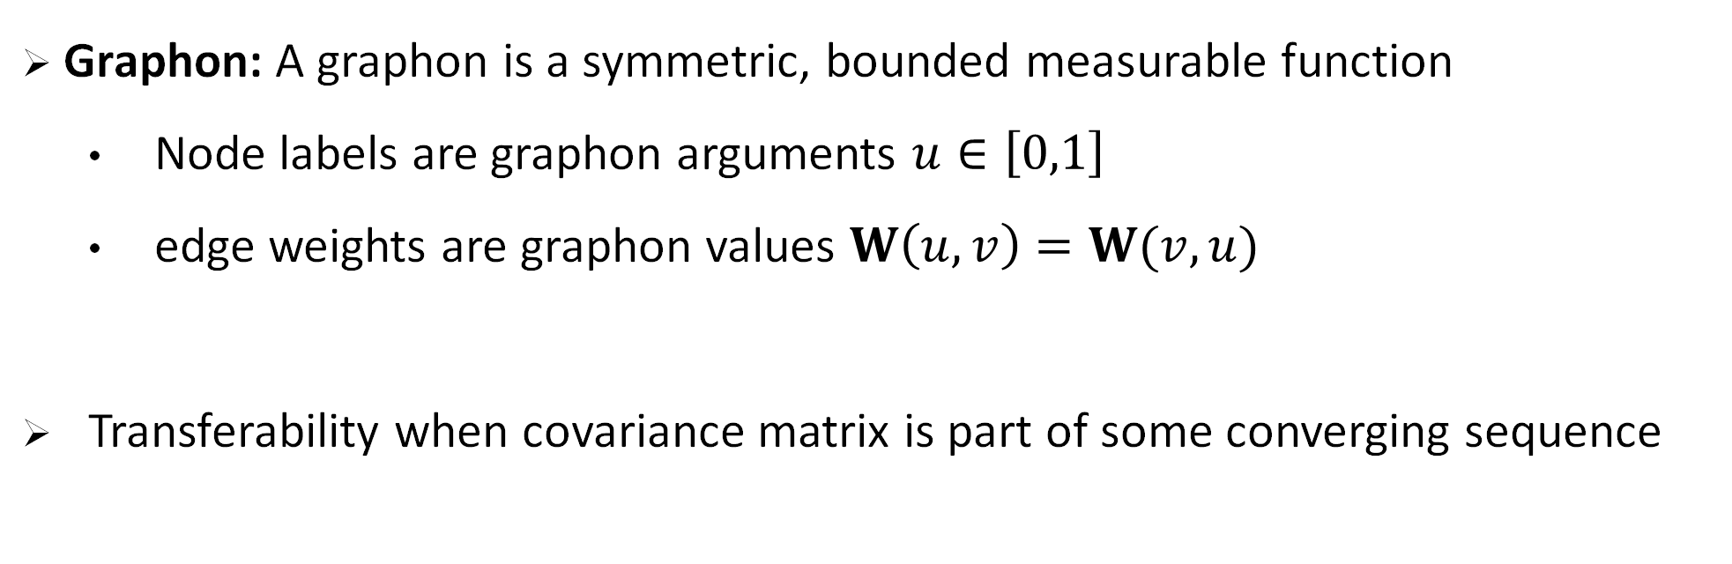
Graphons as continuous limits
Graphon: A graphon is a symmetric, bounded measurable function
  Node labels are graphon arguments $u∈\left[0,1\right]$
  edge weights are graphon values $W\left(u,v\right)=W(v,u)$
Transferability when covariance matrix is part of some converging sequence
Symmetric continuous
function (graphon) $W$

Slide 15
Redefining STVNNs in continuous domain
STVNN

Slide 16


Redefining VNNs in continuous domain
0
1
STVNN

Slide 17


Redefining VNNs in continuous domain
Representation of discrete VNN
output on interval [0,1]
0
1
STVNN
0
1

Slide 18
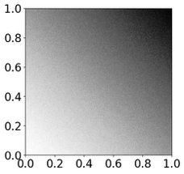



Problem formulation for transferability
Representation of discrete STVNN
output on interval [0,1]
STVNN
0
1
STVNN
0
1

Slide 19
Problem formulation for transferability
Representation of discrete STVNN
output on interval [0,1]
STVNN
0
1
STVNN
0
1

Slide 20
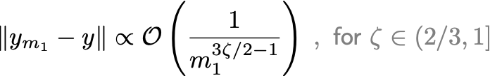

STVNNs are provably transferable
0
1
0
1
STVNN
STVNN
learnable parameters
Transferability bound*
*Assumption: data are a discretization of a common continuous model
Symmetric continuous
function $W$

Slide 21




STVNNs are provably transferable
0
1
0
1
STVNN
STVNN
learnable parameters
Transferability bound
Notes:
We can now connect the mathematical arguments back to multiscale brain data. For any two spatial scales m1 and m2, the representations learned by
The experiments examine how this idea behaves with real fMRI data.

Slide 22
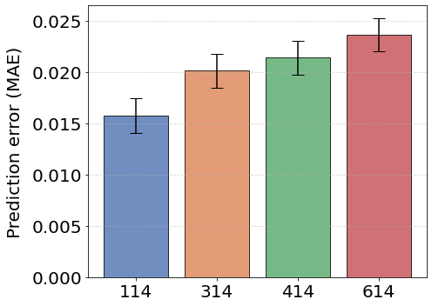
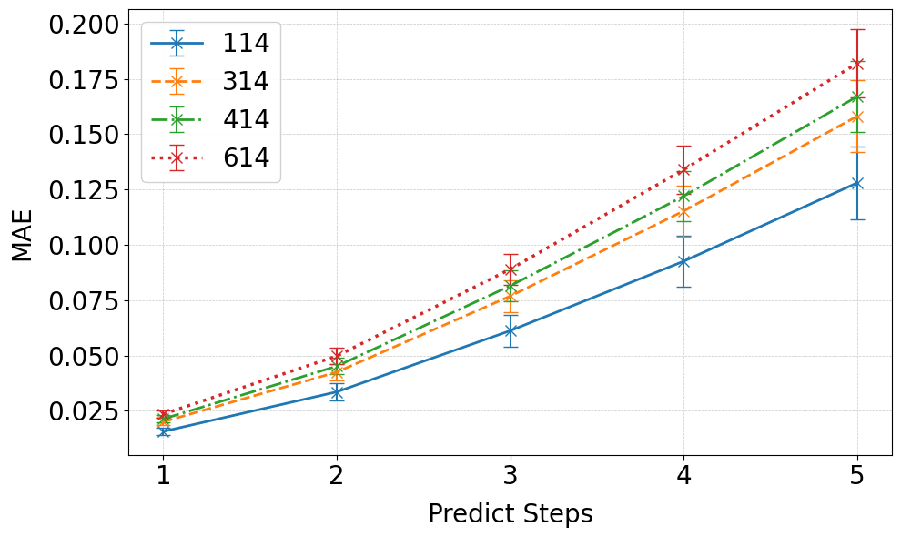
Numerical results
Time series prediction task (1-5 steps ahead)
  Data: resting state fMRI from HCP Young-adult dataset (819 individuals)
  BOLD data at spatial scales of 114, 314, 414, 614 (Schaefer’s atlas with
  14 subcortical regions)
  Train STVNN on 314 resolution and Transfer to 114, 414, 614 resolutions
Notes:
We use resting-state fMRI from 819 HCP Young Adult participants. The multiscale BOLD activity was represented at 114, 314, 414, or 614 regions, combining the cortical parcellation with 14 subcortical regions.
We train at 314 resolution data and transfer the model to the other resolutions. The left plot shows the forecasting error across the dataset for predicting one time step ahead.
Prediction error expectedly increases as we predict further ahead. Right plot shows prediction error of the model on 314 resolution dataset upto a horizon of 5 and its performance after transference to otherf resolutions. These results show that the capability of the model trained on 314 resolution is retained when it is transferred across other scales.

Slide 23
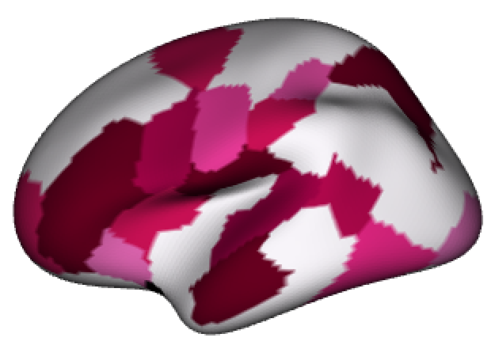
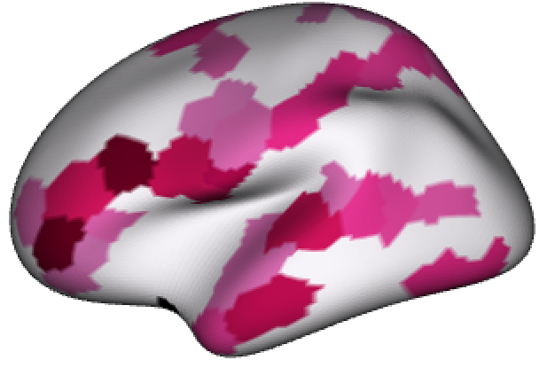
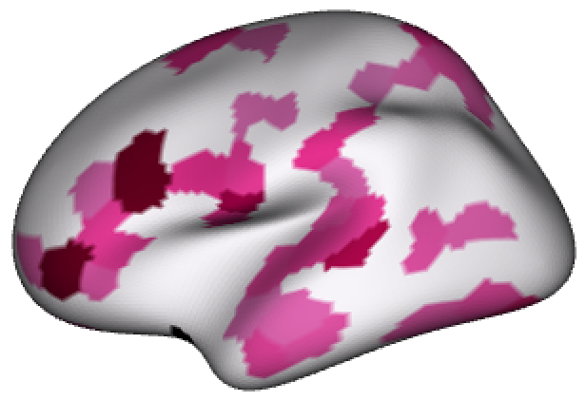
Statistical association persists across scales
Correlation between Age and MAE (for 5-time steps ahead)
  Plots of –log (FDR Corrected p-value) on brain surface
  for FDR Corrected p-value < 0.005
Transference of associations between regional MAE and Age for 314 resolution atlas across spatial scales
114 resolution
314 resolution
414 resolution
Notes:
We also investigated whether a downstream statistical association persists across scales.
Here, we examine relationships between region-wise prediction error and age of the individuals across the dataset. The anatomical maps display negative log-transformed FDR-corrected p-values for associations passing the threshold of 0.005, i.e., the time series prediction errors for these regions were statistically significantly associated with age.
The results suggest that age-related associations can remain detectable after transfer from 314 resolution data to other resolutions.

Slide 24
Conclusions
STVNNs are scale-free across space
Transference theory bounds differences across spatial resolutions
Experiments demonstrate transfer of performance for brain activity
  prediction (training at 314 regions and evaluating at 114, 414, and 614)
Associations between prediction error and age persist across spatial scales, motivating further investigation of
  forecasting errors as biomarkers
  information comparison between finer and coarser spatial scales

