Slide 1

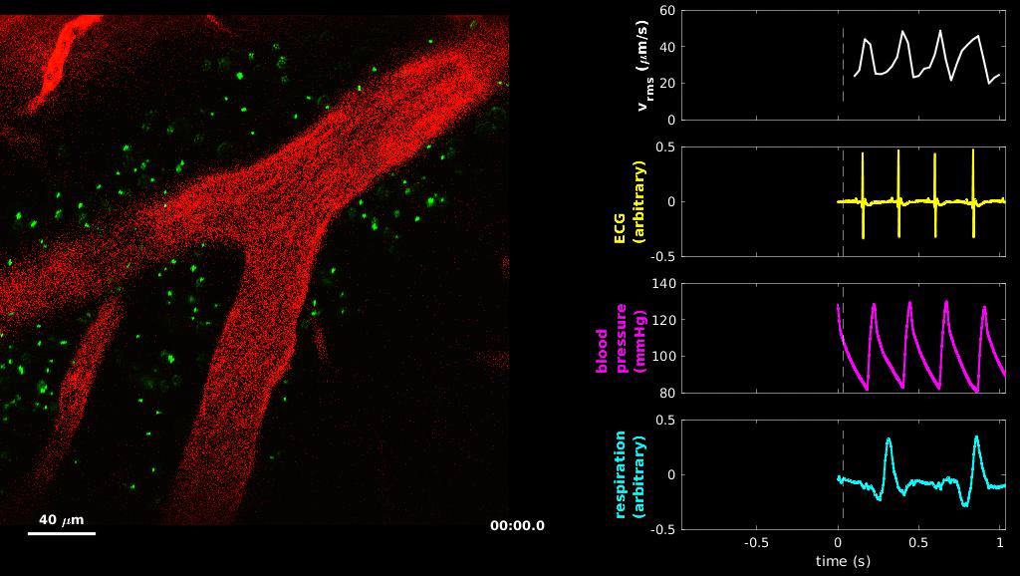
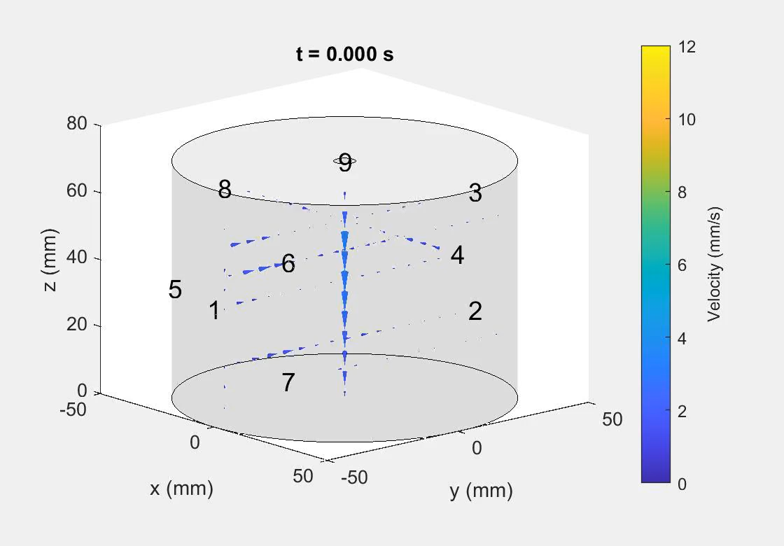
MixingLab
Prof. Douglas H. Kelley
hajim.rochester.edu/me/sites/kelley/
Fluid dynamics of brain cerebrospinal fluid with application to Alzheimer’s, stroke, traumatic brain injury.
Above: Automated tracking of tracer particles in the brain of a live mouse quantifies cerebrospinal fluid flow.
Liquid metal fluid dynamics
with application to energy storage and metals manufacture.
Above: Ultrasound velocity measurements in liquid gallium show flow structures in a laboratory liquid metal battery model.

