Slide 1
Optics 310 and 320
Fall 2017
Professor Wayne H. Knox
August 30 Introduction
Components of the course(s)

Slide 2
OPT310 Optical Engineering Senior Design
OPT320 Optics Senior Thesis
OPT310/311 Required course for Optical Engineering Degree
OPT320/321 Required course for Optics Degree
Hopefully you know by now which one you are in !
If not – let’s talk
MWF 11:50-12:40 pm ; GAV 301
WHK in office G507 or lab generally after class
Blackboard Course web sites regularly updated
Grading: 50% two assignments, 50% final specifications and planning document and presentation (310) or thesis proposal (320)
(no final exam)

Slide 3
The Plan…
OPT310 Fall
OPT320 Fall
Learn about potential projects from customers
Discuss research interests and career goals with WHK
Learn about patents and Intellectual Property
Learn about patents and Intellectual Property
Write a proposal to form and join a Project Team
Make appointments to meet with five Professors
Learn about IP War Stories and Professional Ethics
Review results and discuss with WHK
Meet with customers and develop specifications
Learn about IP War Stories and Professional Ethics
Write up your specifications and plan, BOM, review
Decide which research group to join
Present it to the class with needs specified
Work with Professor and group to develop a Proposal
Present your Proposal to the class
OPT311 Spring
OPT321 Spring
Execute your plan in Project Teams
Execute your Research plan, midterm review
Regular Project Reviews in class and with Customers
Present final project in class (PPT) and in poster
Present final project in class (PPT) and in poster

Slide 4
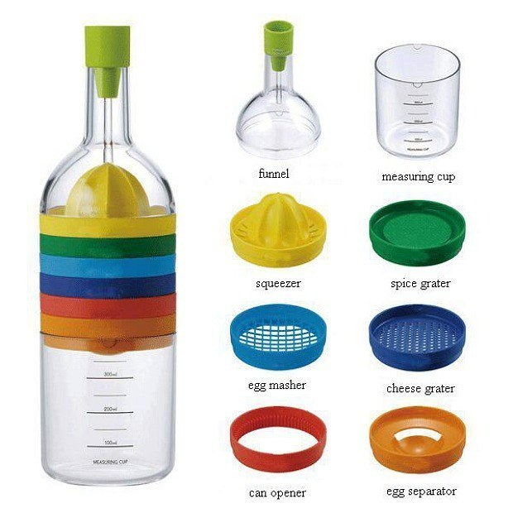
An example of great design…
Somebody really thought about this
I would love it and use it !!
http://www.buzzfeed.com/alannaokun/ingenious-products-that-will-save-you-so-much-space#3h3gqe7

Slide 5
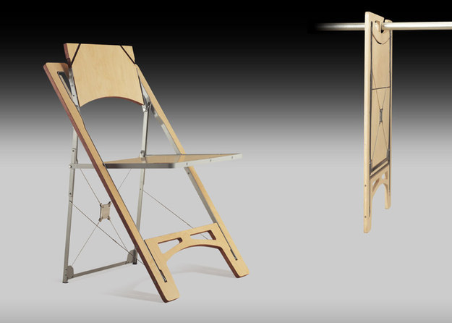
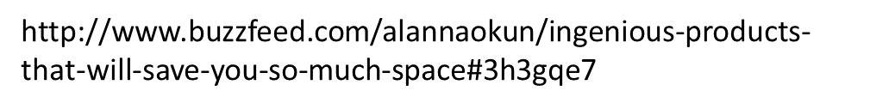
Example of great design – but does not look too comfortable
The design may be beautiful, but what does the customer think about it ?
“The Voice of the Customer”

Slide 6
Voice Of the Customer (VOC)
The “voice of the customer” is a process used to capture the requirements/feedback from the customer (internal or external) to provide the customers with the best in class service/product quality. This process is all about being proactive and constantly innovative to capture the changing requirements of the customers with time.
The “voice of the customer” is the term used to describe the stated and unstated needs or requirements of the customer. The voice of the customer can be captured in a variety of ways: Direct discussion or interviews, surveys, focus groups, customer specifications, observation, warranty data, field reports, complaint logs, etc.
This data is used to identify the quality attributes needed for a supplied component or material to incorporate in the process or product.
Related Articles and Dictionary Terms
QFD
Know Your Customer
Voice of the Customer: Have You Asked Enough Questions?
Turning Customer Data into Critical-to-Satisfaction Data
Customer Requirement

Slide 7

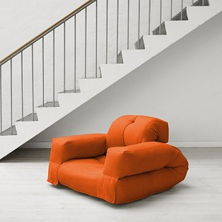
Another great design ? Or ugly !!
Looks like it works, but what does the customer think ?

Slide 8
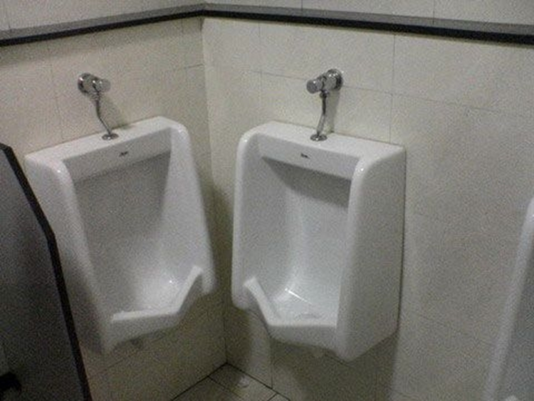
A few examples of design mistakes
I would not know how to use this…
Likely – there was no design…
Likely – there was no design review…
ALSO – 2007 Goergen building waterless urinals – great, or mistake ?

Slide 9
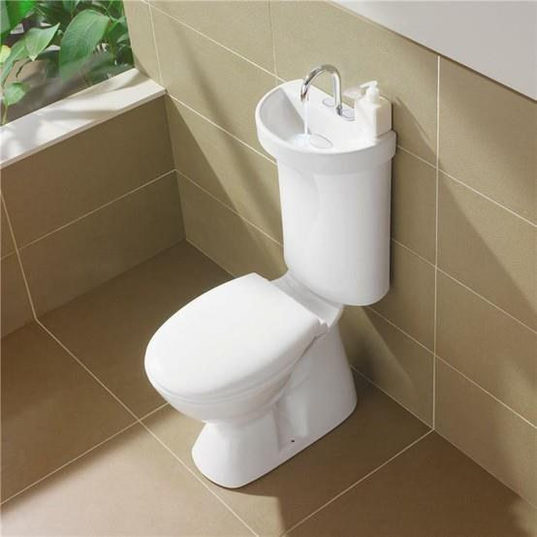
??

Slide 10
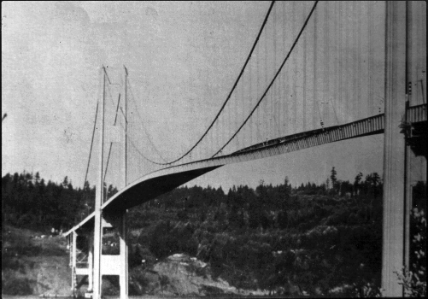
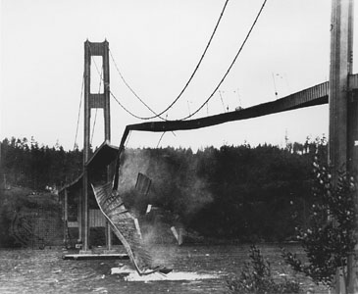
Engineering Design Giant Mistakes…
Tacoma Narrows Bridge (1940) - Wikipedia, the free encyclopedia
en.wikipedia.org501 × 350Search by image
The original Tacoma Narrows Bridge roadway twisted and vibrated violently under 40-mile-per-hour (64 km/h) winds on the day of the collapse

Slide 11
2013-2014 Senior Design Projects (Prof. Tom Brown)
SmartPhone Spectrometer (Per Adamson)
Portable Pathogen Detector (UR Chemistry)
3D Display (RMSC)
16-inch Ritchey-Cretien Telescope (Hopkins Centeer)
High Speed Polygon Scanner (Xerox)
Keratoprosthesis Metrology (Harvard Medical School+URMC)

Slide 12
2014-2015 projects (WHK)
Pathogen Detection V.2 (UR Chem.)
Instrument to measure Dominant Eye/etc. (Flaum Eye Institute)
Acoustic Zoom Lens for Photoacoustic Imaging in Prostate (URMC Urology)
Large Solar Concentrators (WHK)
Optics Display Prototypes for RMSC on 2015 Year of Light (RMSC)
Lens Design Optimization – Cost reduction via the Estimator (Optimax)
Illumination system for high speed Projectile Imaging (Sydor Instruments)
Optical measurement of nanoroughness/optical quality of flats (Sydor)

Slide 13
2015-2016 projects
Pathogen Detection V.3 (UR Chem. With MechE and VhemE)
Illumination system Design/fab for Photoacoustic Imaging of Thyroid Cancer (URMC Urology)
Large Solar Concentrators V.2 (WHK) + Mech E
Measurement system design for large AR VUV curved optics (Optimax) + Mech E
Brewster Angle Rayleigh Scatterometer for (Sydor Instruments)
Color Calibration System for Art History and (Kruschwitz+RIT)
Laser scanner for 3D Atomic Vapor Display (Broadbent/Physics)
Off-axis Telescope Design (Zavislan)
Silicon Nanofabricated Optical MidInfrared Filter Design/RIE Fabrication(Materion)
Flexible Vision Magnifier for Macular Degeneration (Yoon URMC Ophthalmology)

Slide 14
2016-2017 projects:
3D Imaging for product inspection - Navitar
Digital Cloaking system demonstration – UR Ventures
Lithography system multispectral mask aligner lens design – ASML
Historical Manuscript Imaging system – UR Library/English Dept
Rochester Museum and Science Center – Stress Birefringence Exhibit
Scratch-Dig Optical Inspection System – Optimax
Retinal Eye Tracker for Traumatic Brain Injury Screening – Startup Co.
Periscope for Community Art Project – Mesh Studios

Slide 15
2017-2018 Potential projects include:
Endoscope system (customer is MD)
TB Skin response imager (customer is nurse)
Automated eye prescription (customer is DigitEyez startup)
3D imaging medical phantoms with IR light (customer is URMC)
Prototyping a Fall Senior Design Challenge (customer is Per Adamson)
Photoacoustic Imaging System for Thyroid/Prostate Cancer (URMC)
Multispectral Document Imaging (customer is English Prof.)
Lithography Optical System Design (ASML)
AR/VR goggles (Vuzix)
TBD (Honeywell Aerospace)
TBD (Photon Gear)
TBD (Optics faculty)
TBD (Sydor Optics)

Slide 16
Hajim School Design Day May 3 (?tbc), 2017
Let’s show up with great projects !
What’s it all about ?
http://www.hajim.rochester.edu/

Slide 17
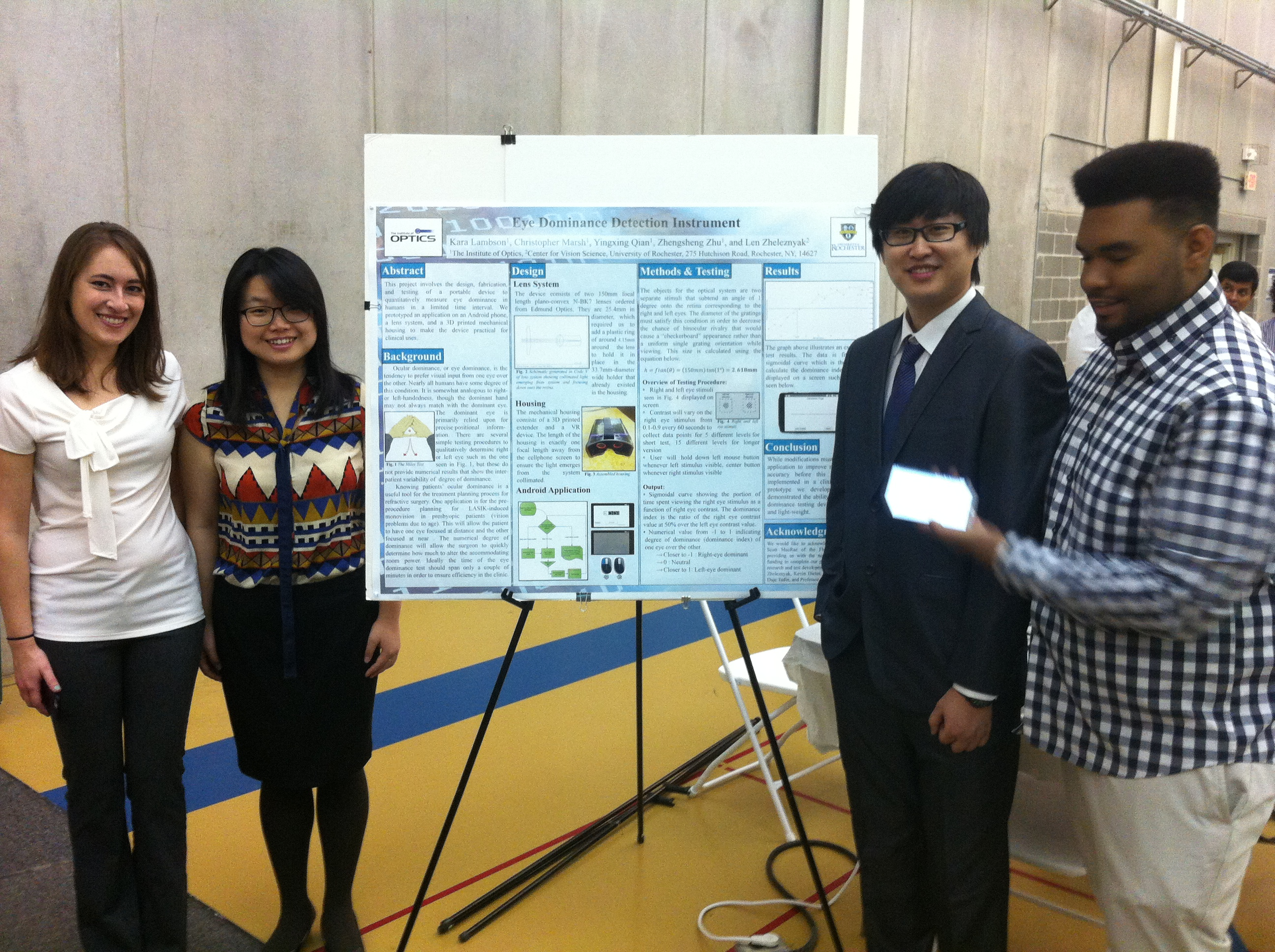
Hajim School Design Day – show off your demo !

Slide 18
90 second “elevator pitch”
Rehearse in class
Critical review
Present at Industrial Associates Spring Meeting
Clips ! (before vs after)

Slide 19
How we will do this: OPT310
We will learn how to interview customers and determine their product requirements (what do they really want ???)
Then you will write me a proposal containing:
  Formal cover letter ‘applying for the job’
  Your one-page CV/resume in a specific format
  A two page essay on which projects are your first, second and third choices, including why you are interested, and what your particular qualifications are
I will organize the teams trying to reach optimum placements
You will meet with your customers several times over the semester
You will develop your Product Requirements Document and we will review it in class.
Your Final PRD will represent your plans for the Spring semester

Slide 20
How we will do this: OPT320
Discuss with WHK your research interests
Determine which five professors you want to interview with
Interview with five professors/research groups
Then you will write me a proposal containing:
  Formal cover letter ‘applying for the job’
  Your one-page CV/resume in a specific format
  A two page essay on the results of your five interviews, what your choice is, why you are interested, and what your particular qualifications are for the research
Work with the professor and research team to develop a ‘NSF style’ proposal (10-12 pages long)
Your Final Proposal will detail your plans for the Spring semester

Slide 21
Examples of what NOT to put on your CV

Slide 22
Professional Ethics Component
SPIE CODE OF ETHICS
The Mission/Vision Statement of SPIE, the International Society for Optics and Photonics states that SPIE
partners with researchers, educators, and industry to advance light-based research and technologies for
the betterment of the human condition. It is the purpose of this statement to advance this vision by
presenting ethical guidelines for society members, collaborators, and participants to abide by in their
professional lives.
PROFESSIONAL BEHAVIOR
1. Discrimination based on race, religion, gender, age, disability, or sexual orientation is not
acceptable.
2. Individual and public safety and welfare should be considered paramount in performance of
professional duties.
3. Real and potential conflict of interest should be avoided and disclosed to all impacted parties
when it cannot be avoided.
4. Technical knowledge and skills should be kept up-to-date and work should be performed in areas
of competency.
5. Public statements should be realistic and issued in an objective and truthful manner based on
available data.
6. Professional confidentiality should be maintained.
7. Accomplishments, publications, professional honors and titles should be accurately reported.
GUIDELINES FOR ETHICAL PUBLISHING*
RESEARCH RESULTS
The results of research should be recorded and maintained in a form that allows analysis and review.
Research data should be immediately available to scientific collaborators. Following publication, the data
should be retained for a reasonable period in order to be available promptly and completely for
appropriate scientific review. Exceptions may be appropriate in certain circumstances in order to preserve

Slide 23
Patent component common for OPT310+320
A recent patent is assigned to small teams
You will read and analyze the patent
(The most excellent) UR Patent lawyer Reid Cunningham will explain Patents 101 to you
You will present the results of your analysis in class
Themes in the past:
* Recent patents containing “Laser pointer”
* Recent patents containing “Laser scanner”
* Recent patents in “3D Imaging systems”
This is a very valuable part of your OPT310+320 experience

Slide 24
Hopkins Center Software Update 8/29:
431 imaging is completed, including addition of
- zemax optic studio 16.5
- lumerical mode 7.10
- lumerical fdtd 8.18
- optilayer 11.65f
- codev 11
- light tools 8.5.0-2
- fred 16.42.1

Slide 25
Expectations
I expect that you will
  Come to class
    (if you need to miss class let me know why)
  Participate in class
    Listen carefully
    Ask lots of questions
    Take notes
    DON’T PLAY WITH YOUR CELLPHONE 100%
  Be a good Team Player
    Help your Team
    As well as other Teams when needed
  Take this class seriously
    It is your Capstone Experience
ATTENDANCE POLICY:
ATTENDANCE WILL BE RECORDED FOR EACH CLASS. AT THE END OF THE SEMESTER WHK WILL DETERMINE AN APPROPRIATE GRADE PENALTY FOR UNEXCUSED ABSENCES. EXCUSED ABSENCES = DOCTOR’S NOTE ETC.

Slide 26
The Order of the Engineer
Those students graduating with a degree BS in Optical Engineering (ABET Accredited now) will be invited to the Order of the Engineer ceremony on graduation weekend
You will sign the Obligation of an Engineer and be given a simple stainless steel ring
We will talk about this a lot more throughout the semester

Slide 27
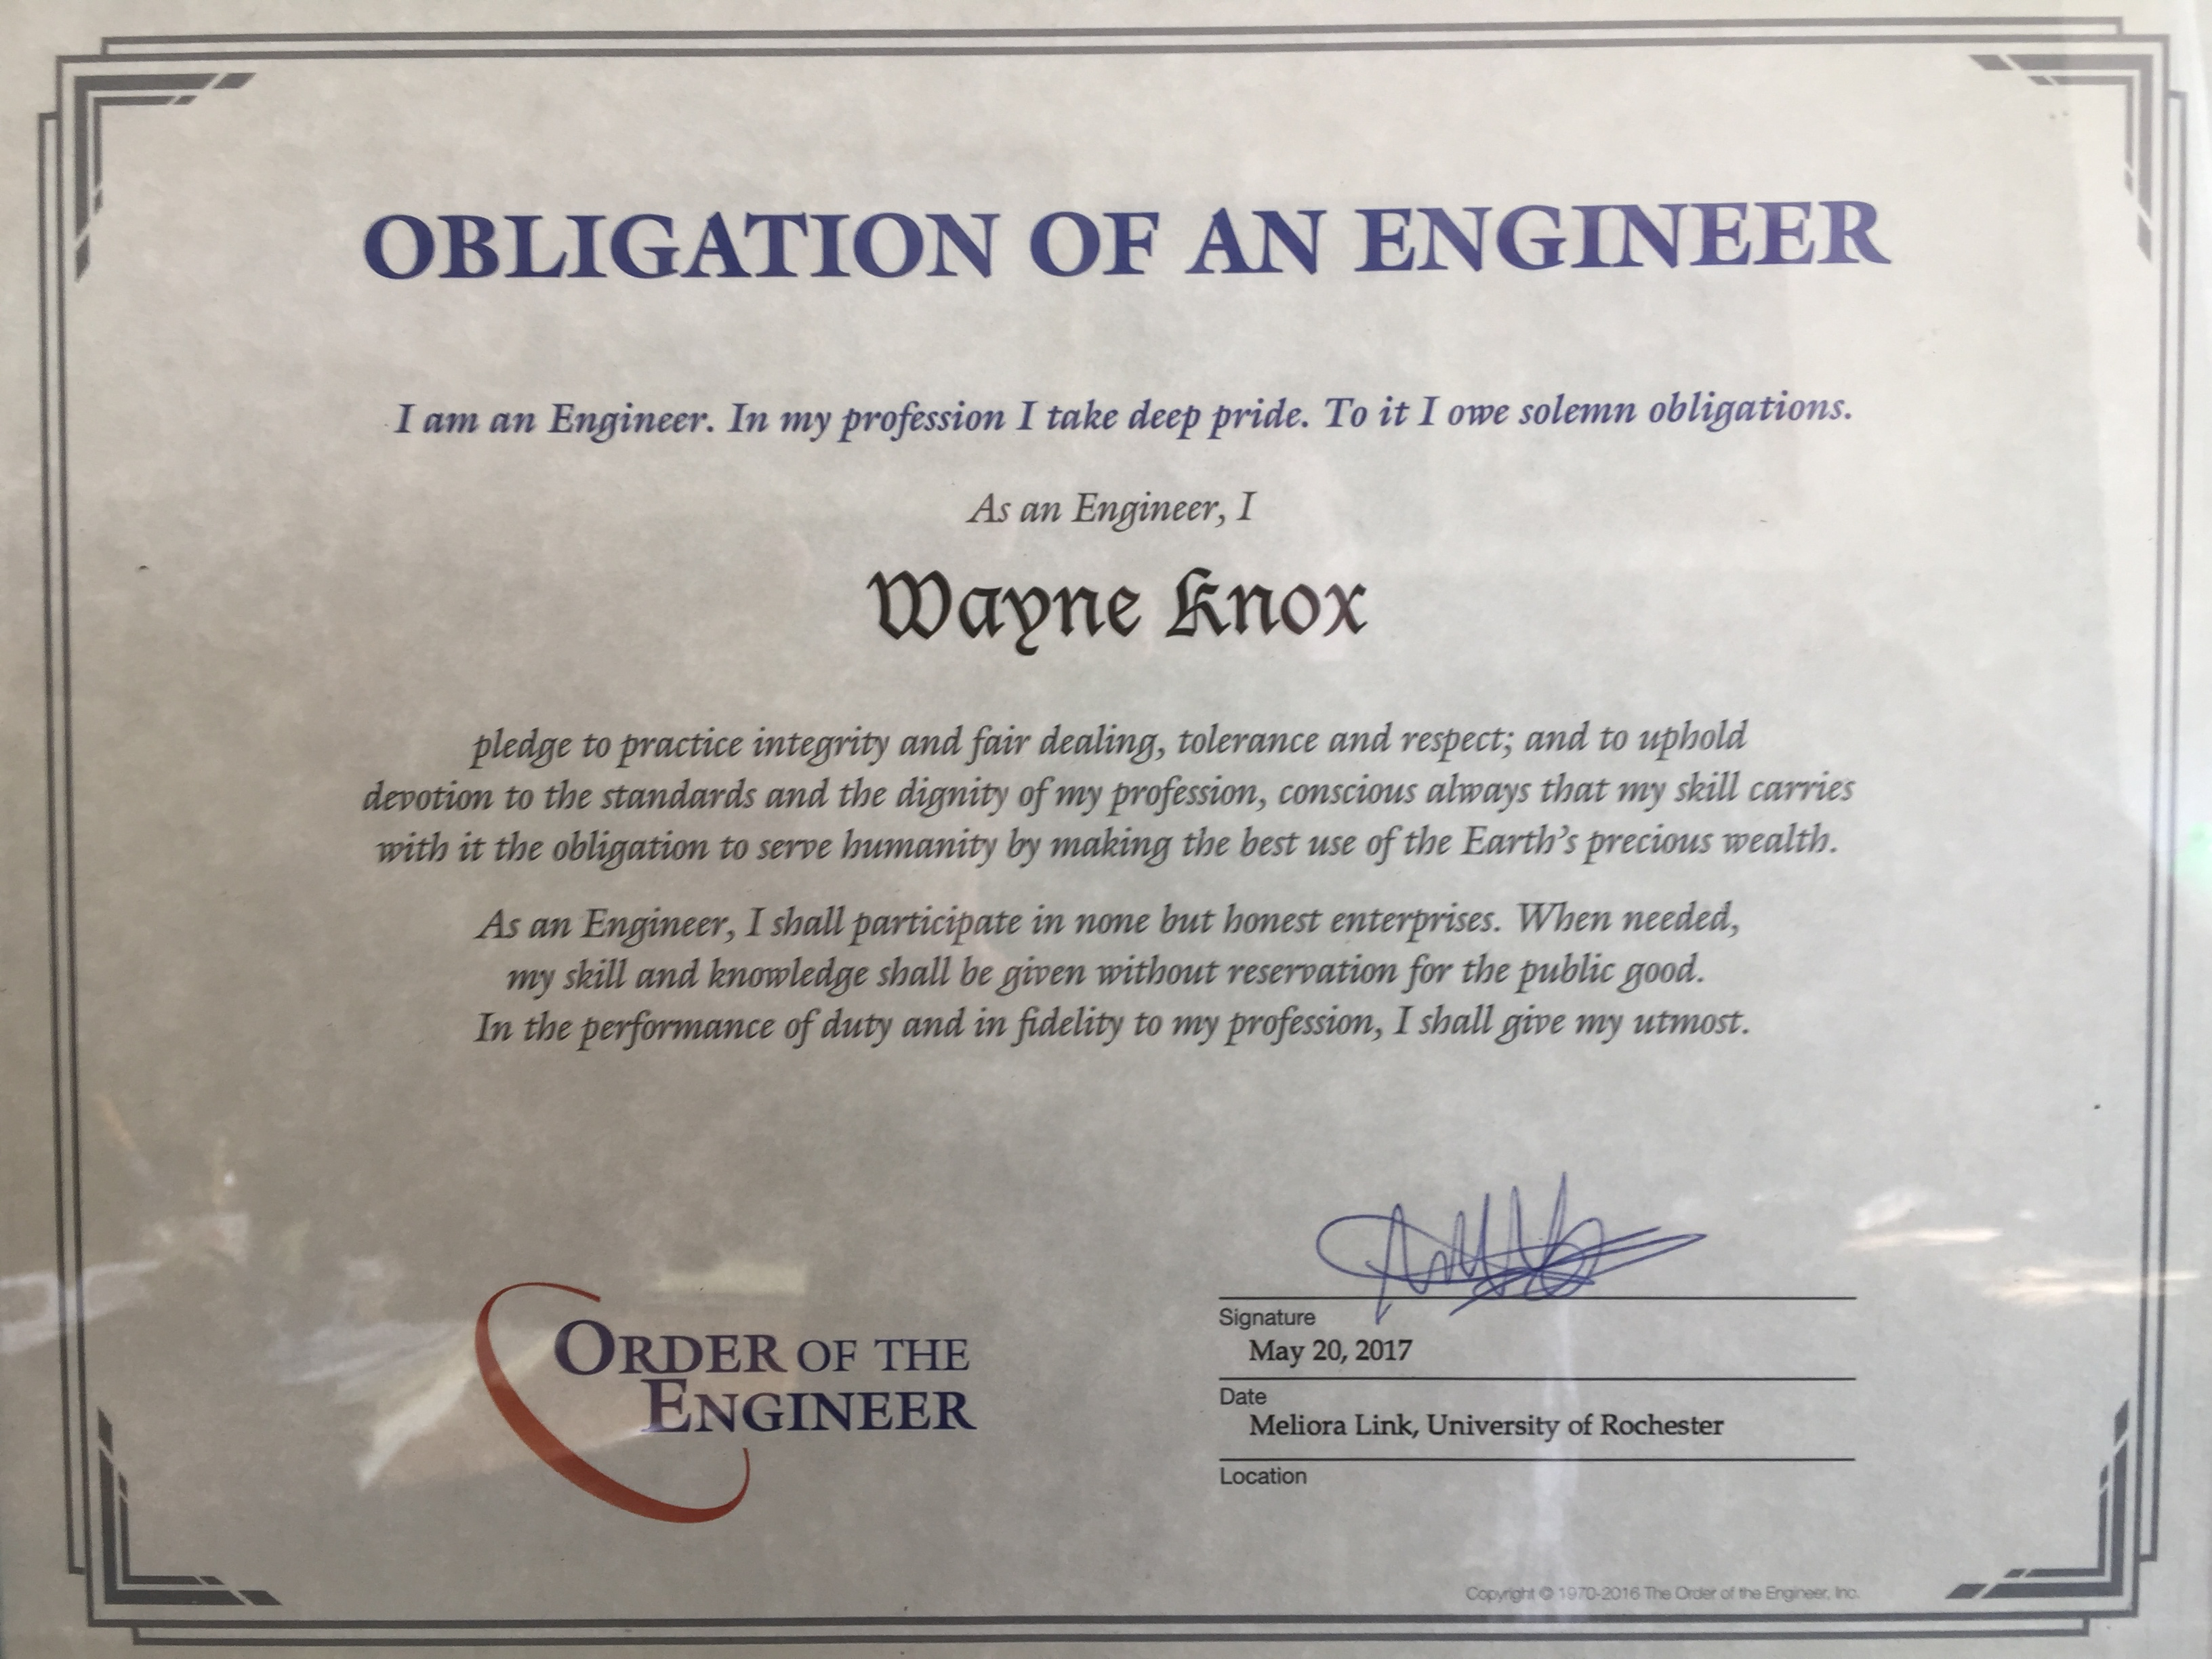

Slide 28
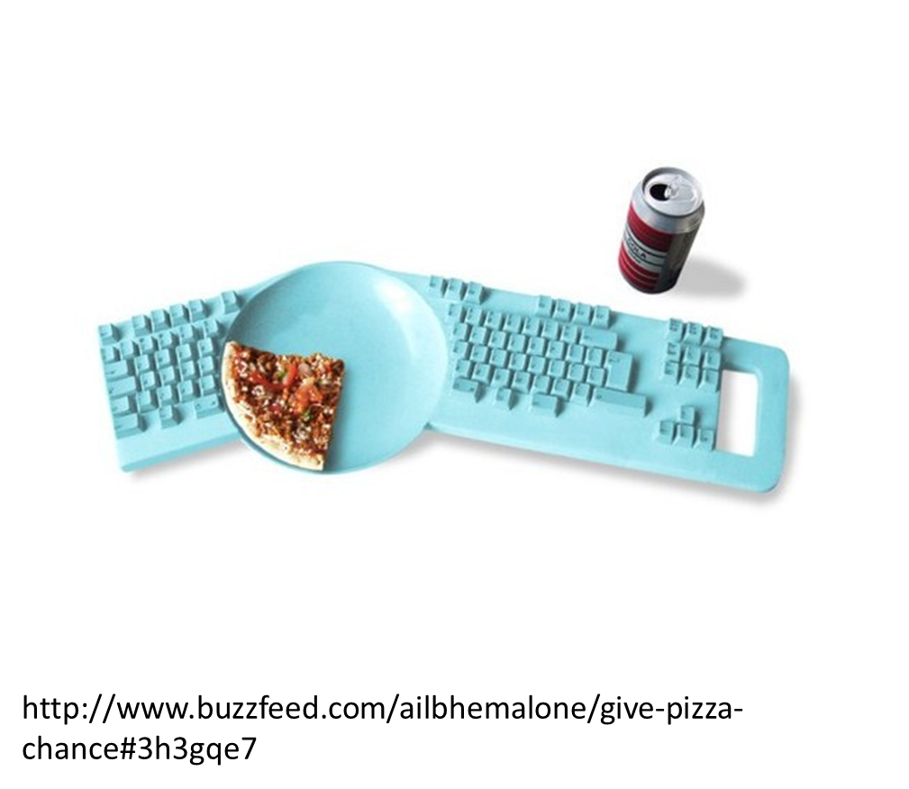
Stupid Design Ideas (or clever ?)

