Slide 1
GIDS1 Project
Final Presentation – April 25, 2022
Team 7:
Sung Beom Park, Joseph Smith, Jiecheng Gu, Charlotte Ding

Slide 2
Outline
Introduction & Logistics
Project Vision & Goals
Schedule
Data Analysis & Data Visualization
Statistical Tests
Predictive Model
Results & Conclusions
Challenges & Next Steps
Acknowledgments

Slide 3
Introduction - Members
Sung Beom Park
Joseph Smith
Jiecheng Gu
Charlotte Ding

Slide 4
Introduction - Vision
Understand the applicant pool better
Discover the programs that are our main competition
Predict which applications will accept our offer
Help raise the accepted yield of GIDS!
Notes:
Using the University of Rochester’s Applications data, the National Student Clearinghouse data (which is the additional data set that was provided for this project and it contains data on which university and programs a student is enrolled in) and the School Rankings data, we want to understand the applicant pool and application cycle which will help raise the accepted yield of the Data Science master’s program here at U of R.

Slide 5
Introduction - Goals
Pre-process the provided data, deal with missing values, merge datasets
Exploratory Data Analysis
Create meaningful visualizations to answer the most important questions
Using the merged data, build classification models to predict whether an applicant will accept the offer
Perform statistical tests to find meaningful information

Slide 6
Introduction - Progress
Data pre-processing
EDA
Classification models
Statistical tests
Improve models & get new visuals

Slide 7
Schedule / Milestones
Milestone 1: Analyzed dataset & completed project charter (Feb. 28, 2022) ✅
Milestone 2: Performed data pre-processing & EDA (Mar. 16, 2022) ✅
Milestone 3: Built preliminary classification models (Mar. 26, 2022) ✅
Milestone 4: Improve upon the models from Milestone 3 (Apr. 6, 2022) ✅
Milestone 5: Model Evaluations & further improvements (Apr. 15, 2022) ✅
Milestone 6: Completed final presentation (Apr. 20, 2022) ✅
Milestone 7: Improvement & Final report

Slide 8
Description of Data: GIDS Applicants
3721 rows
217 columns
Notes:
The main dataset is the applicants data to the Goergen Institute of Data Science as seen here. It has 3721 rows and 217 columns.
It contains all the specific information about the particular student, such as the entry term for the program, degree, time status, tuition percent, age, race, sex, etc.

Slide 9
Description of Data: Clearinghouse
Years of data available:
2013 - 2018
2020
2021
Notes:
The Clearinghouse data as mentioned earlier, is the additional data set that was provided for this project and it contains data on which university and programs a student is enrolled in. The reference id that is contained in both this data and the applicants data from the previous slide was what was used to match and merge the data together.
The clearinghouse data contains the information of the institution and the program the student ended up attending.

Slide 10
Data Cleaning - Clearinghouse
Drop unnecessary columns
Remove duplicates
Fix error with Ref ID
Format colleges to match ranking data
Over 100 handpicked edits to consider
Merge 13-18, 20, 21
Reformat dates to standard format

Slide 11
Data Cleaning - GIDS Applicants
Drop unnecessary columns
Remove duplicates
Fix College formatting
Same rules as clearing house
International schools are too plentiful to draw meaning here
Define decision types numerically
General prep for further ML and descriptive analytic purposes

Slide 12
Exploratory Analysis -
Data Visualization

Slide 13
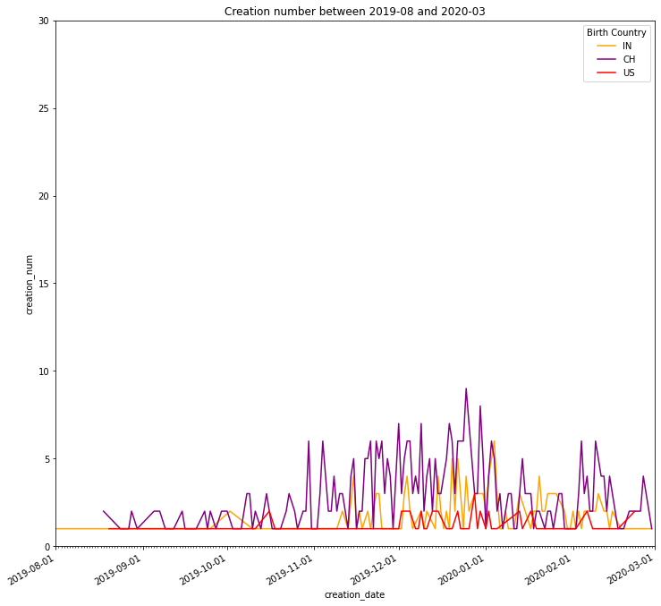
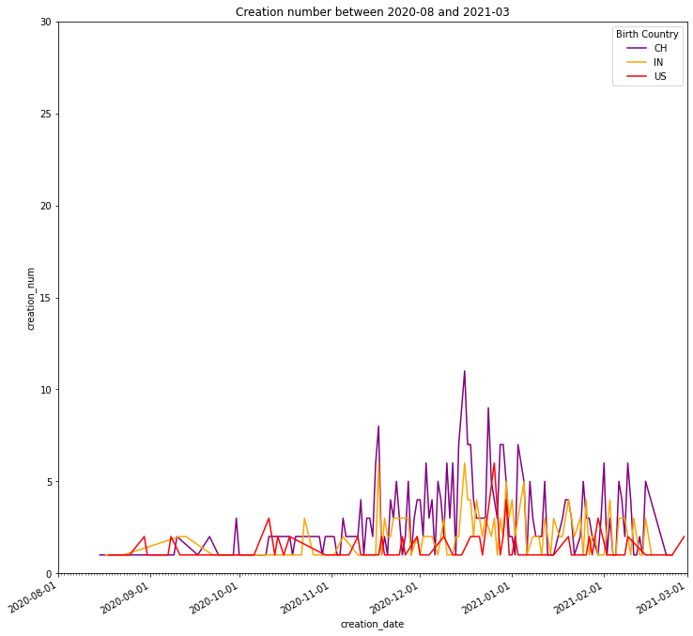
Creation / Day

Slide 14
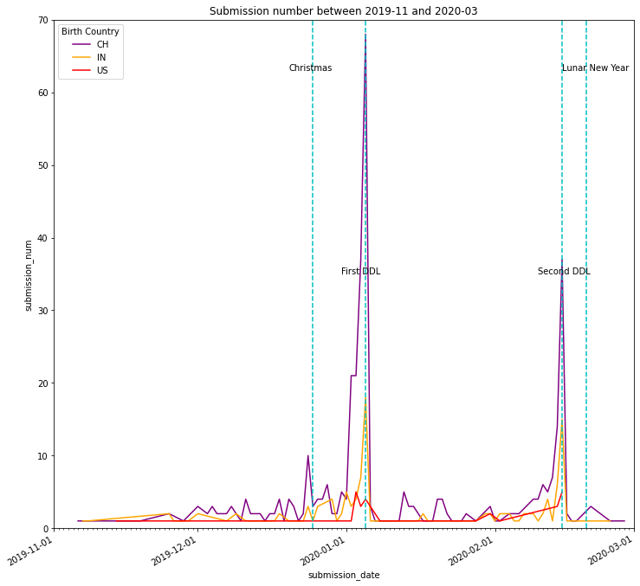
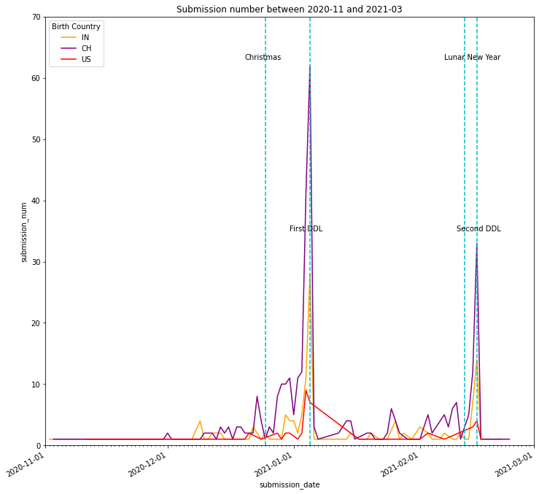
Submission / Day

Slide 15
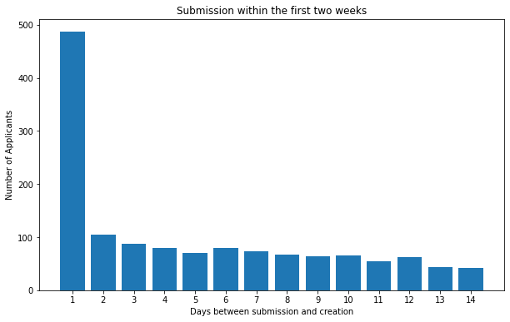
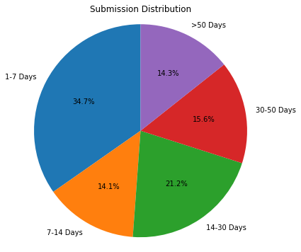
How Quickly do Applicants Submit their Application?
Nearly 50% applicants submit their application within two weeks
Nearly 86% applicants submit their application within 50 days

Slide 16
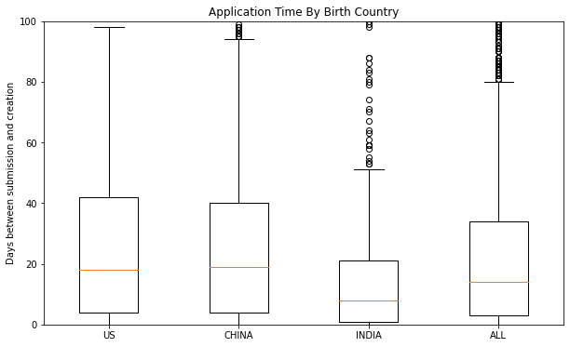
How Quickly do Applicants Submit their Application?
American applicants tend to procrastinate
Indian applicants tend to finish their application in a shorter time
Country | Mean (days) | Median (days)
ALL | 24 | 14
US | 30 | 18
CH | 26 | 19
IN | 15 | 8

Slide 17
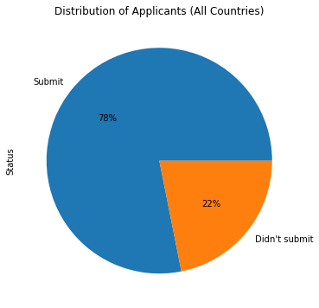
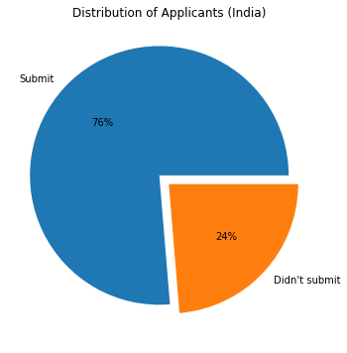
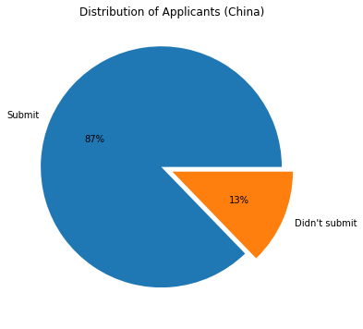
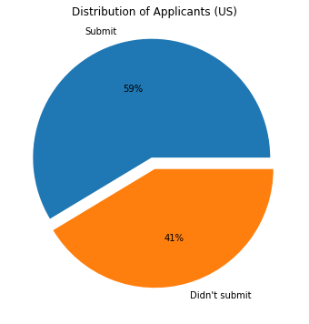
What about People who do not Finish Applications?
22% people didn’t finish their application
American applicants are most likely not to finish applications among people from three major countries - 41%

Slide 18
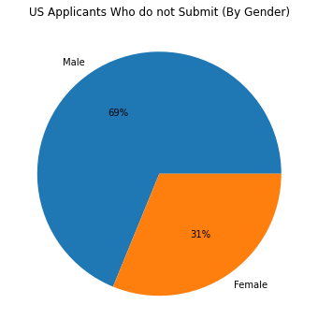
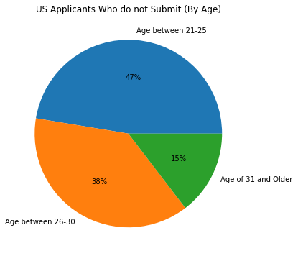
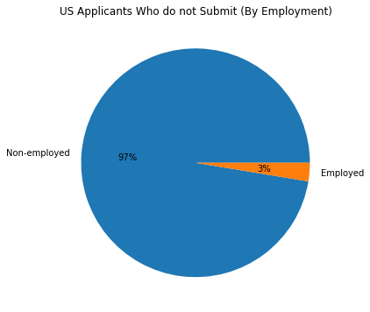
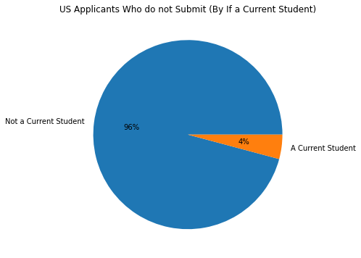
Applicants from US Who do not Finish Application

Slide 19
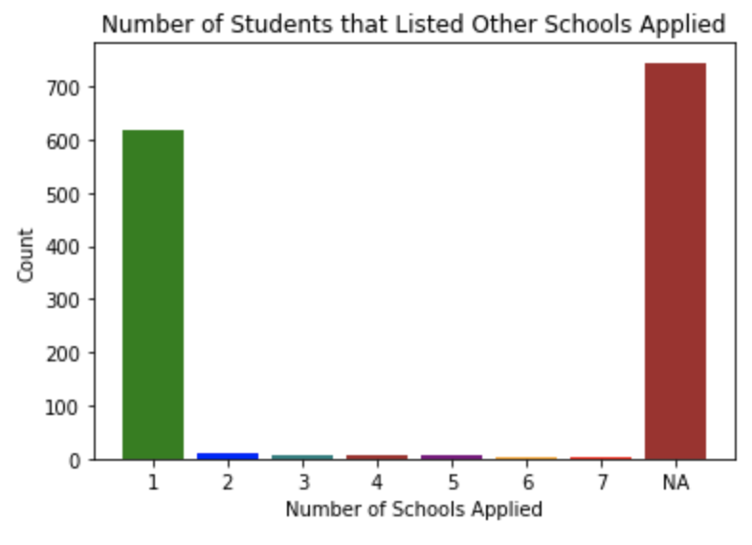
How many schools did they apply to?

Slide 20
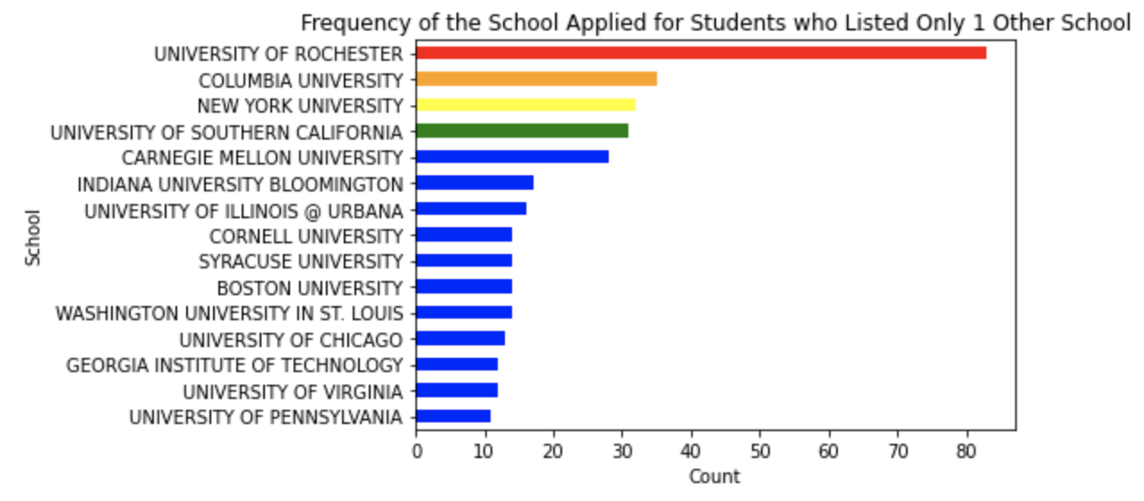
Let’s Look at those ‘1 Other School’ the Students did List
Other than U of R, the most frequently listed schools were: Columbia, NYU, USC, and Carnegie Mellon

Slide 21
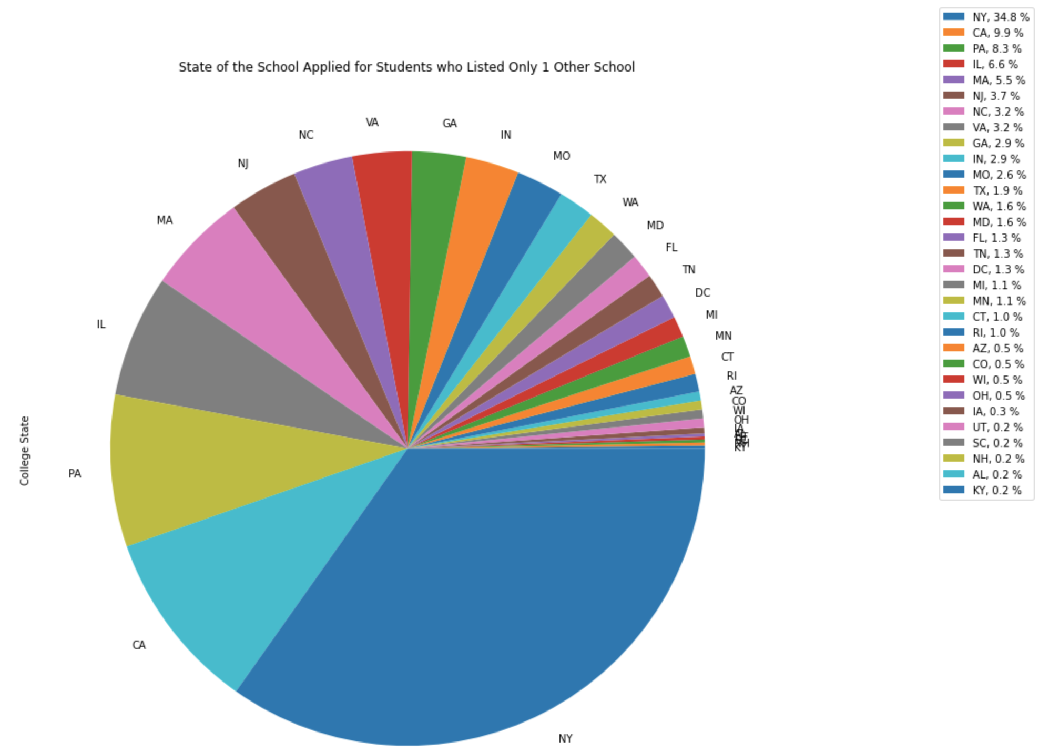
Other than the state of NY, most frequently applied to states were:
CA, PA, IL, and MA

Slide 22
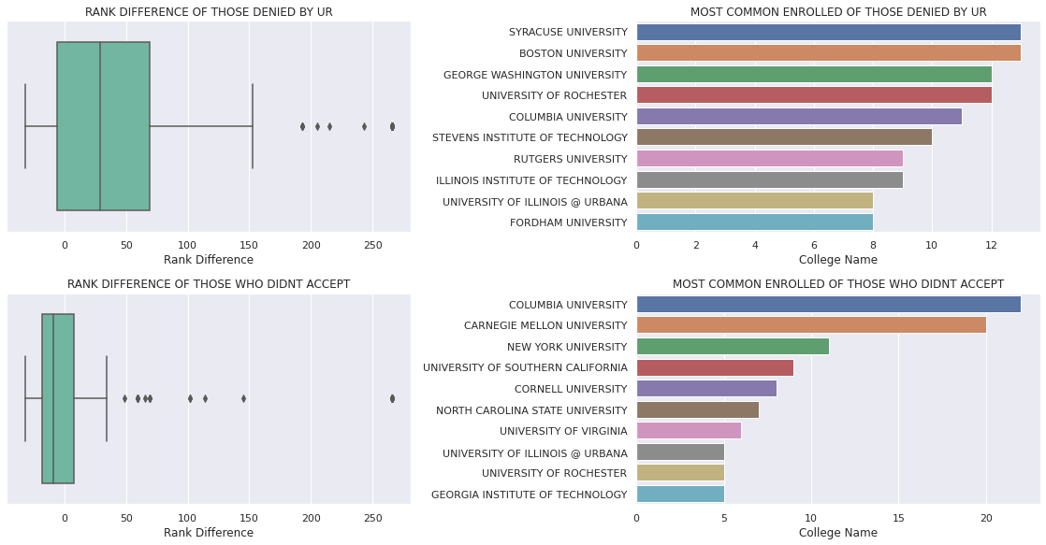
Rank Difference by Decision & T-Test
T statistic = 3.66607 p-value = 0.00028

Slide 23
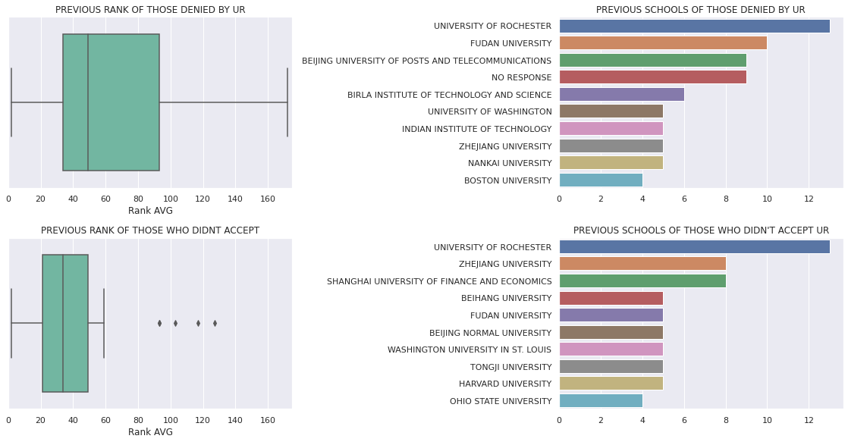
Previous Rank by Decision & T-Test
T statistic = 3.49582 p-value = 0.00072

Slide 24
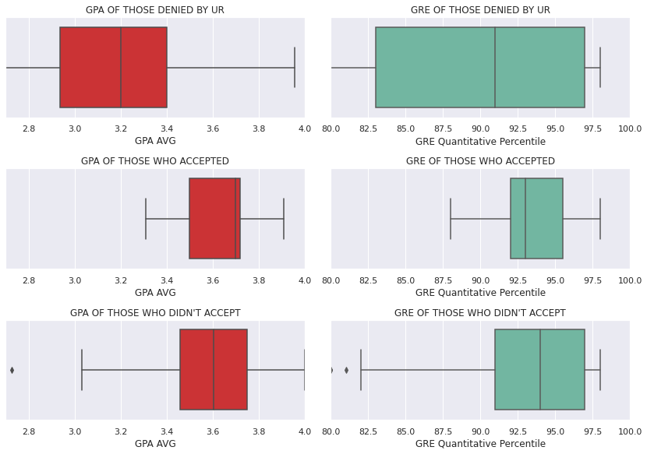
GPA & GRE by Decision
Got Denied vs. Didn’t Accept
GPA:
T statistic = -12.0666
p-value = 7.48e-29
GRE:
T statistic = -3.5295
p-value = 0.00047
Accepted vs. Didn’t Accept
GPA:
T statistic = 0.47724
p-value = 0.63378
GRE:
T statistic =-0.49467
p-value = 0.62149

Slide 25
Data Modelling -
Clustering & Classification

Slide 26
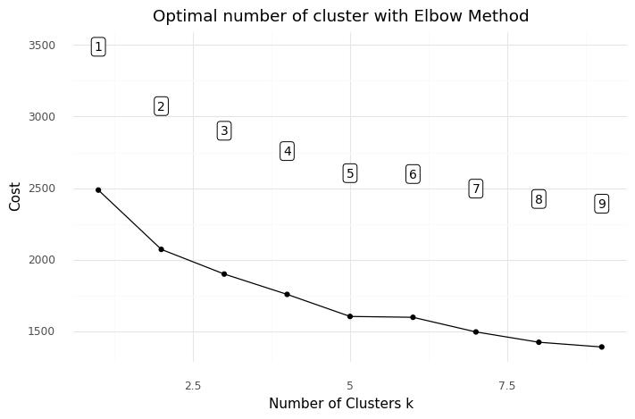
Data Modelling - Clustering
Method: K-modes clustering on admitted students
Features (binned): Tuition Scholarship Percentage, Age at App. Submission, Completion Time, GPA, Birth Country
Notes:
tuition = {'No tuition':0, '20% - 30% tuition':1, '40% - 45% tuition':2, '50% tuition':3}
age = {'18-22':0, '23-25':1, '26-30':2, '>30':3}
time = {'1-7 days':0, '8-14 days':1, '15-30 days':2, '31-49 days':3, '>= 50 days':4}
gpa = {'<3.0':0, '3.0-3.5':1, '3.5-3.6':2, '3.6-3.7':3, '>3.7':4}
country = {'US':0, 'IN':1, 'CH':2, 'OTHERS':3}
sex = {'M': 1, 'F': 0}

Slide 27
Data Modelling - Clustering
Group 2: Long completion time + high GPA -> low accept rate and high melt rate
Group 6: Older applicants -> high accept rate and high melt rate
Group 7: Higher scholarship -> high accept rate and low melt rate
Group | Tuition percentage | Age | Time (days) | GPA (4.0 scale) | Country | Rate (%) |  | Count
 |  |  |  |  |  | Accept | Melt
1 | 40% - 45% | 18-22 | 8-14 | 3.0-3.5 | CH | 49.2 | 36.5 | 128
2 | 40% - 45% | 18-22 | >=50 | >3.7 |  | 26.6 | 54.2 | 222
3 | 20% - 30% | 18-22 | 15-30 | 3.5-3.6 |  | 33.3 | 31.3 | 153
4 | 20% - 30% | 18-22 | 1-7 | 3.6-3.7 |  | 28.0 | 43.2 | 132
5 | 20% - 30% | 18-22 | 31-49 | 3.0-3.5 | US | 35.5 | 45.5 | 155
6 | 40% - 45% | 23-25 | 1-7 | 3.5-3.6 |  | 58 | 58.6 | 50
7 | >45% | 18-22 | 1-7 | >3.7 | IN | 45.9 | 23.5 | 148
Notes:
We listed centroids of each cluster and calculated the accept rate and melt rate for each group.

Slide 28
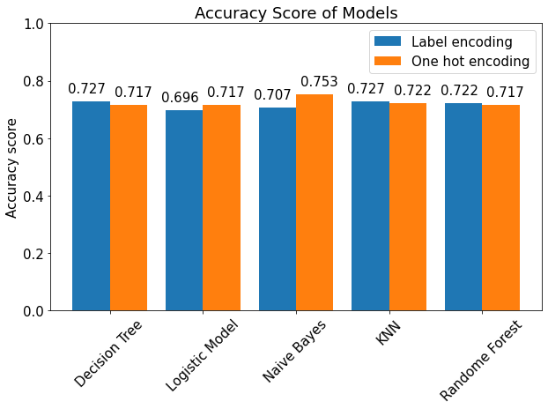
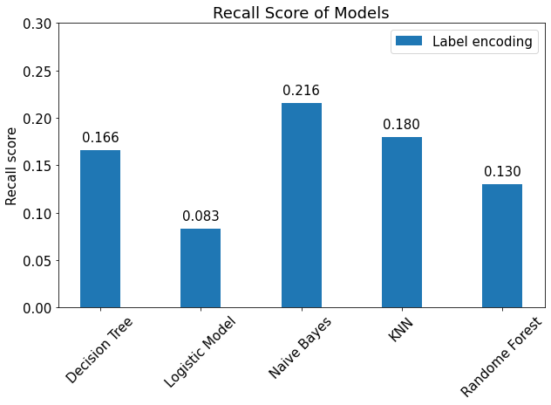
Data Modelling - Classification
Goal: use classification models to predict if admitted applicants would accept the offer or not
Best Model: Naive Bayes Model using one hot encoding (Accuracy: 0.753)
Problem: Recall score is low
Notes:
In addition to the clustering, we also used

Slide 29
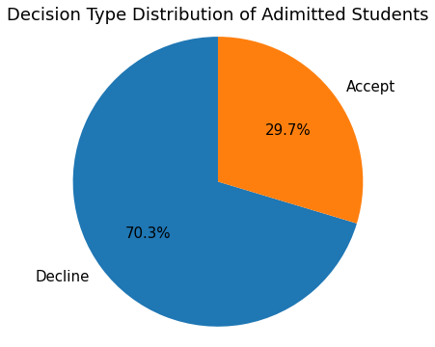
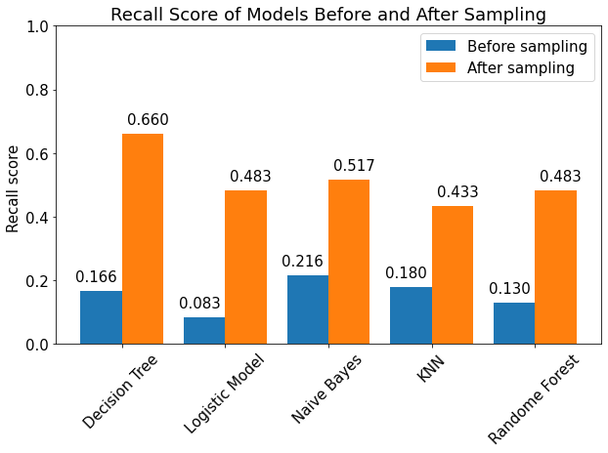
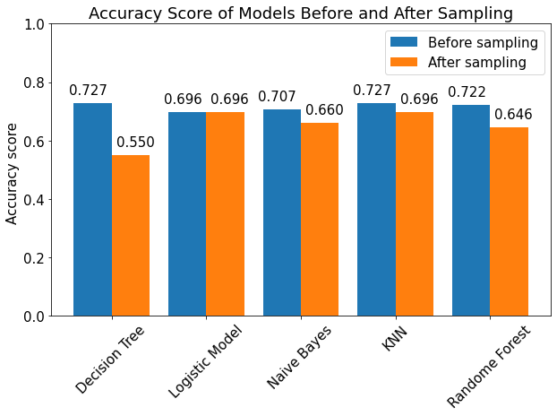
Model Improvement
Reason: Class imbalance
Sampling method: SMOTEENN (combining over- and under-sampling using SMOTE and Edited Nearest Neighbours)
Results: Recall score increased, but accuracy score declined

Slide 30
Data Modelling - Feature Analysis
Features that have a positive impact on accept rate: Tuition Scholarship Percentage, Age at App Submission
Features that have a negative impact on accept rate: Completion time, GPA, Birth Country (international students)
Results of Logistic Model
Variable | Coefficient
Tuition Scholarship Percentage | 0.1293
Age at App Submission | 0.3001
Completion Time | -0.1018
GPA | -0.3260
Birth Country (US:0, IN:1, CH:2, OTHERS:3) | -0.1476

Slide 31
Conclusions & Insights
There are submission peaks before two deadlines -> Remind people to submit their application before deadlines
American applicants tend to procrastinate and not submit their application -> Urge Americans to submit their application
Long completion time (>50 days) probably leads to a low accept rate

Slide 32
Challenges & Next Steps
Challenges:
Class imbalance in the dataset (accept vs. decline)
Next Steps:
More visualizations
Final Report

Slide 33
Acknowledgment
Huge thank you to Lisa, Gretchen, and Professor Anand!!!

Slide 34
Thank You So Much!
😁 😁 😁

