Slide 1
URMC Rehab Senior Design Team
Jose Corredor, Keagan Hemsley, Gabriel Lundy, Joseph Moore

Slide 2
Problem Definition
Problem Statement: Patients with extensive damage to their hand or neurological problems that affect hand muscle control (such as patients who have experienced a stroke) need an assistive device that aids in opening their hand from a closed position and measures their range of motion by measuring the angles of their joints. Making a hand exoskeleton to improve the rehabilitation process will allow patients to open one finger, for pointing or touching, or multiple fingers to grasp something.
Specs | Value | Units | Description | Method of Evaluation
1 | 1 | lbf | The device must have an overall weight of one pound or less. | Scale
2 | 180 | deg | The device must have a maximum range of motion of 180 degrees per joint, where 180 degrees signifies the hand being completely open. | Goniometer
3 | 2 | deg | The device must have a joint angle measurement resolution of 2 degrees or better. | Encoder or High-resolution protractor
4 | 6 | lbf | The device must apply a maximum force of 6 pounds to the fingers to aid in finger flexion. | Spring Scale
5 | 1 | hrs | The device must have a battery life of 1 hour under continuous use. | Timer
6 | 1 | large | The device must fit a glove size large (male) under the guidelines of the universal glove sizing chart (https://www.palmflex.com/glove-sizing.html). | Ruler/Caliper
7 | 30 | deg | Stretch goal: The device must have a maximum angle of abduction of 30 degrees. | Protractor
8 | 3 | lbf | Stretch goal: The device must apply a maximum force of three pounds to aid in abduction of the fingers. | Spring Scale
Requirements | Description
1 | The device must measure the range of motion of the fingers.
2 | The device must fit an adult hand.
3 | The device must aid an individual or multiple fingers in extension.
4 | The device must exert an adjustable force to aid in extension.
5 | The device must prevent the hyperextension of finger joints.
6 | The device must be portable.
7 | Stretch goal: The device must aid in the abduction of the fingers

Slide 3
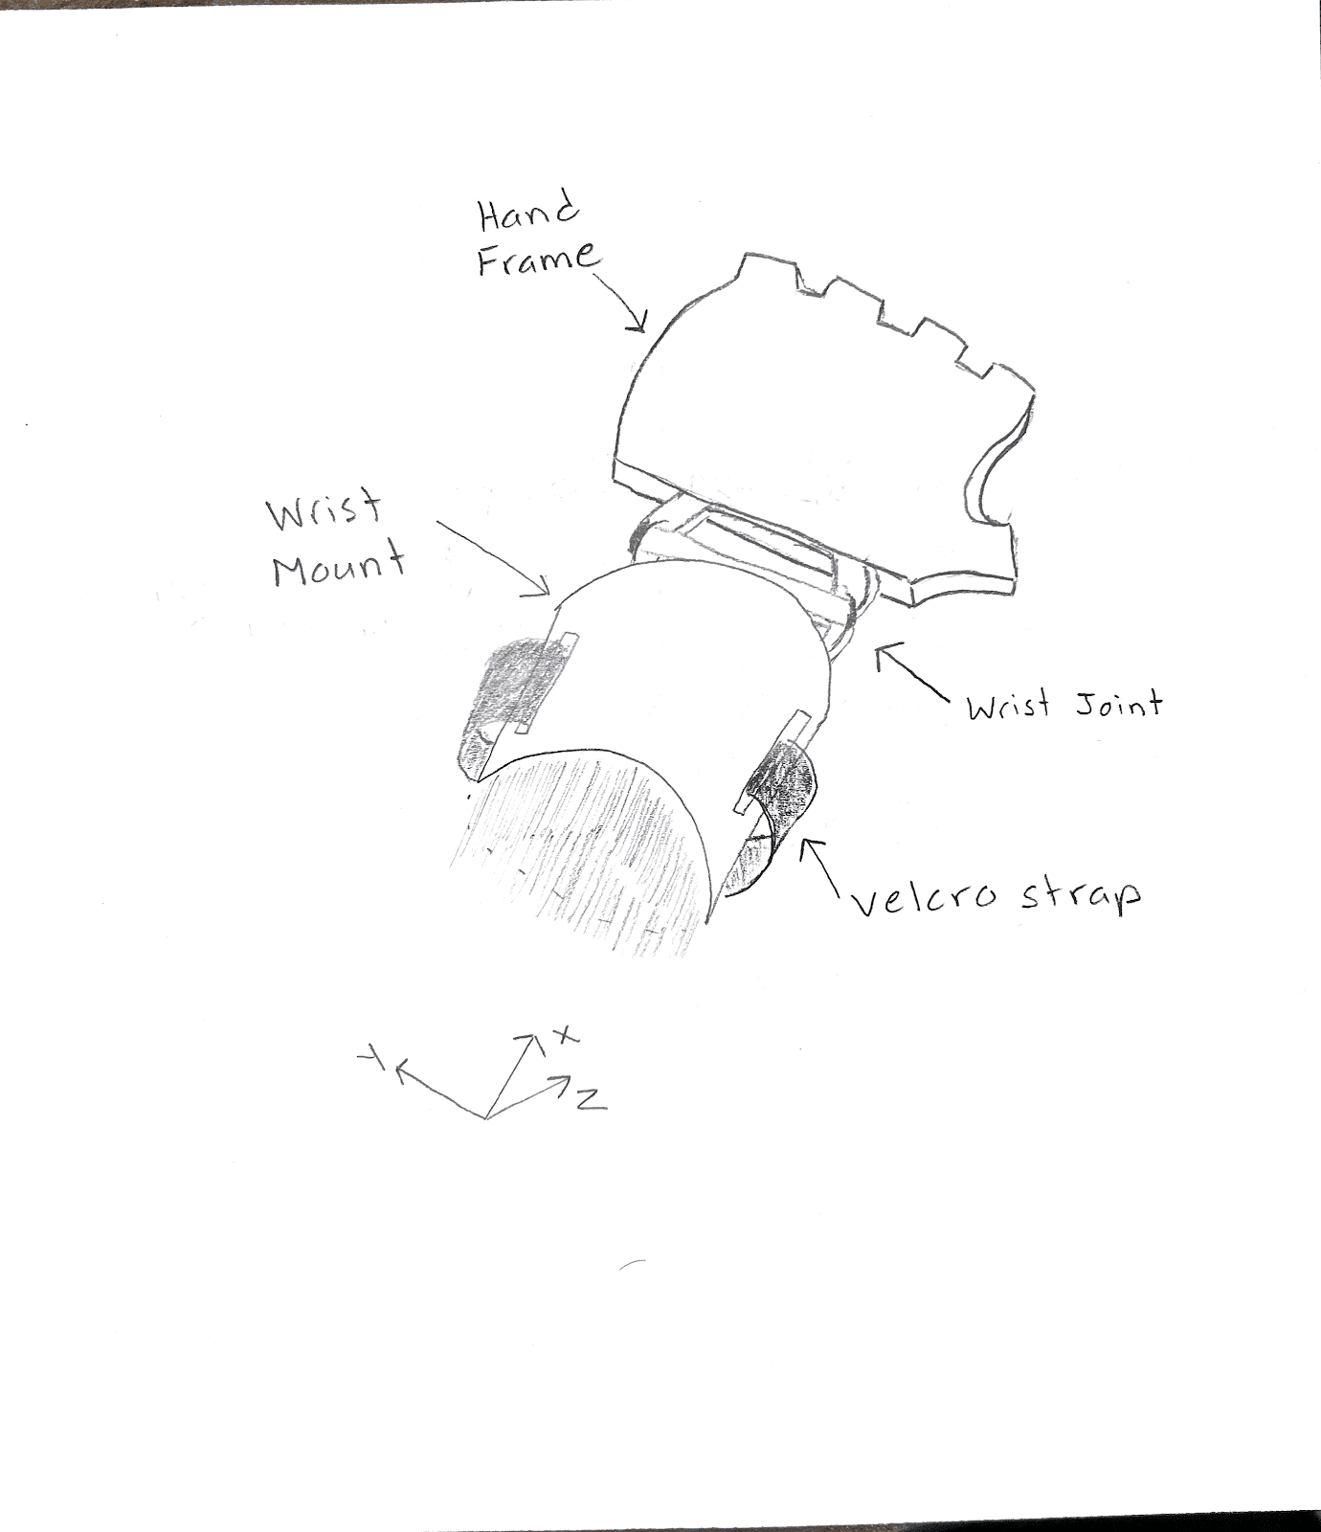
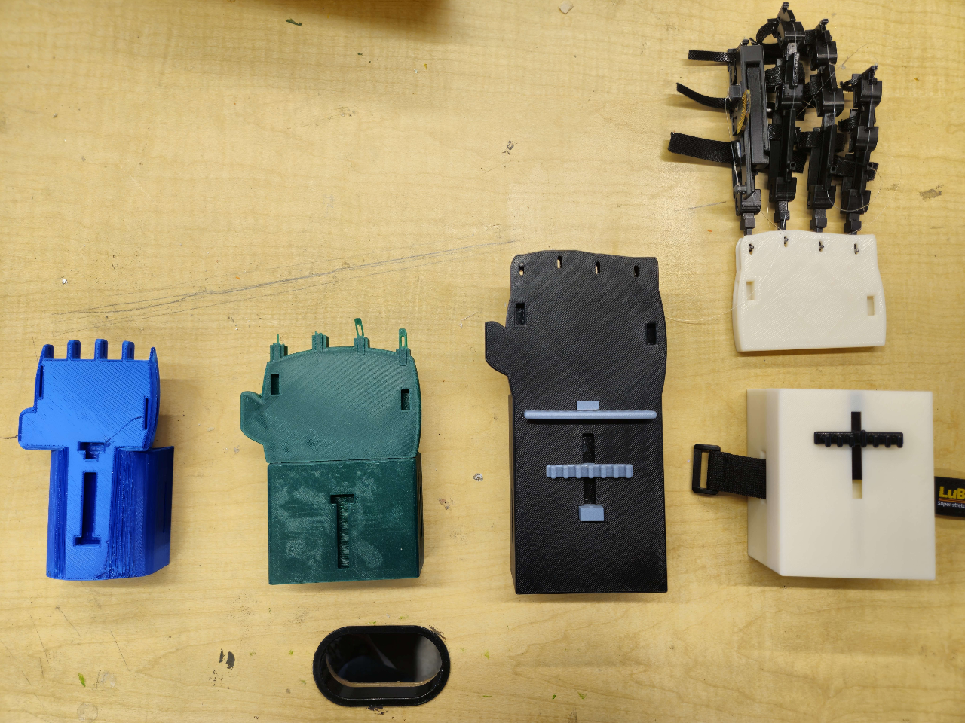
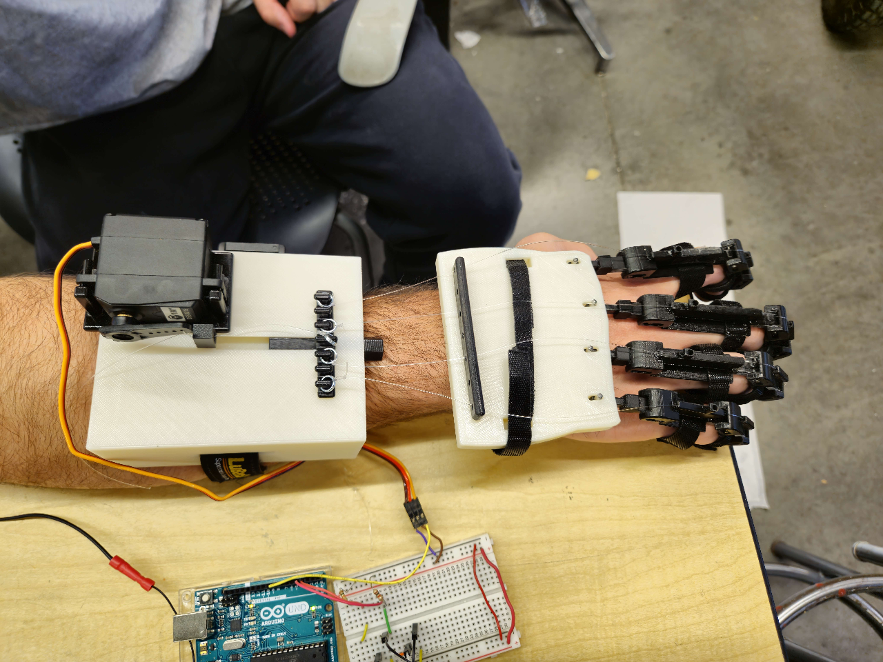
Hand Frame Design
Initial Design:
Wanted to create a design that would allow for different parts to be able to be mounted on the frame while also supporting the finger modules that would aid in finger extension.
Iterations:
Each iteration gave important feedback towards what design aspects were useful and what needed to be improved.
Found out through early iterations that effectively modeling the human wrist and hand are very difficult.
Final Design:
The final design incorporated key components of previous design concepts.
One of the major changes to the final design included the separation of the wrist mount and the hand frame to allow the wrist joint to move freely.

Slide 4
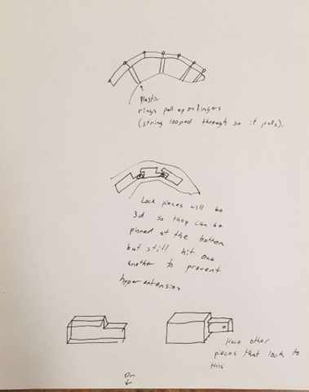
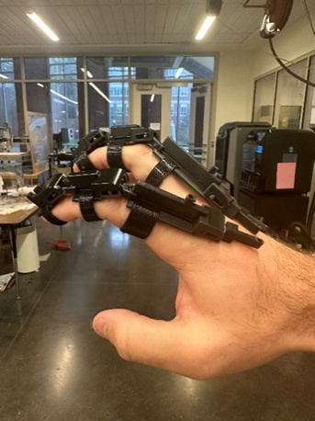
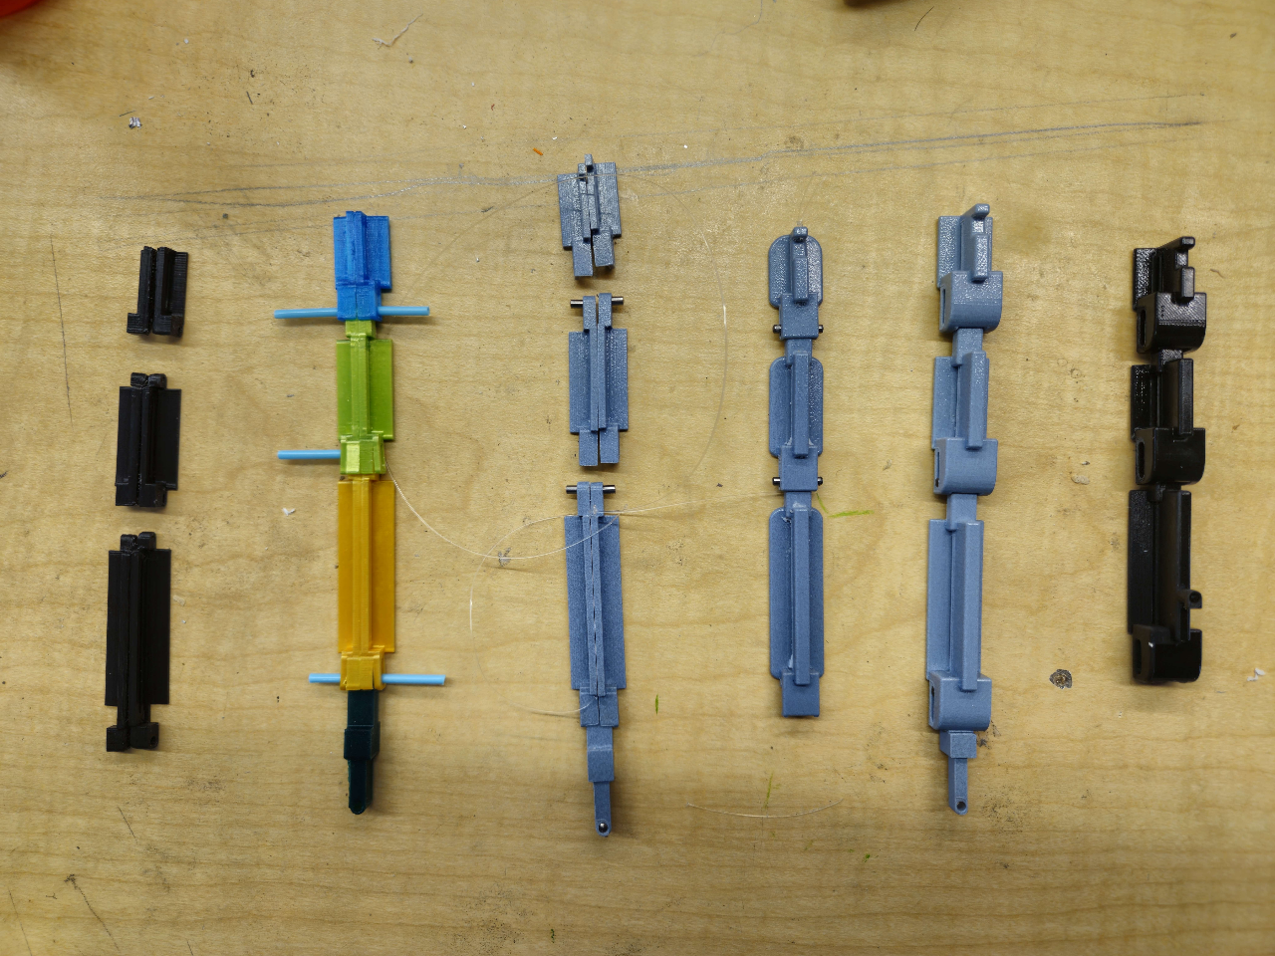
Finger Module Design
Initial Design:
Th initial concept of the fingers was chosen based on its ability to hinge at each knuckle.
We needed to ensure that each finger joint would not hyperextend to ensure the safety of the user
Iterations:
Early iterations helped us see our concept in physical form and identify the changes that need to be made.
Designed a joint at the knuckle connecting the fingers to the hand to allow for the fingers to abduct.
As iterations moved forward, we began using the more precise 3D printer so each crucial dimension was as accurate as possible.
Final Design:
Able to incorporate a sliding joint at each knuckle that would allow the modules to be properly sized to the finger when in flexion and extension.

Slide 5
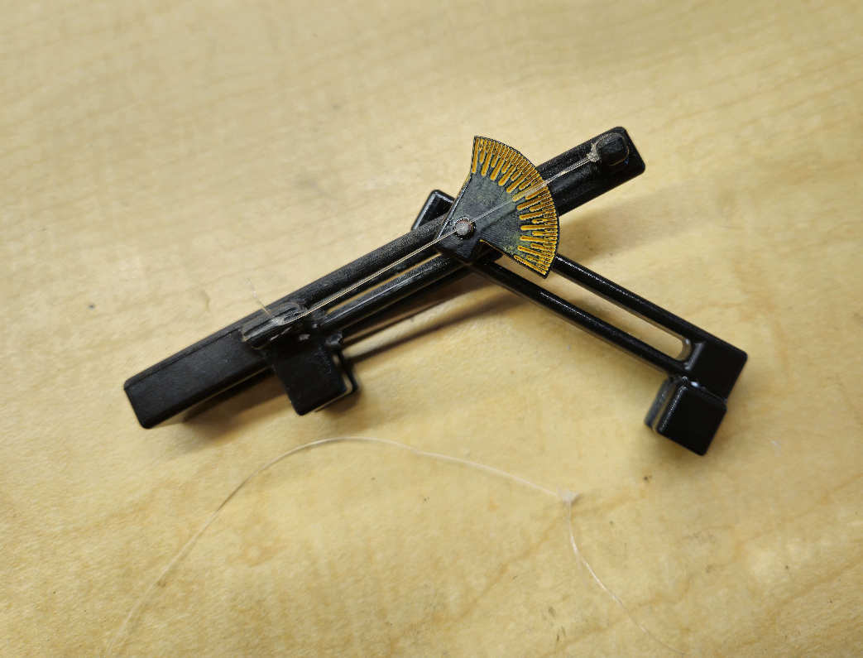
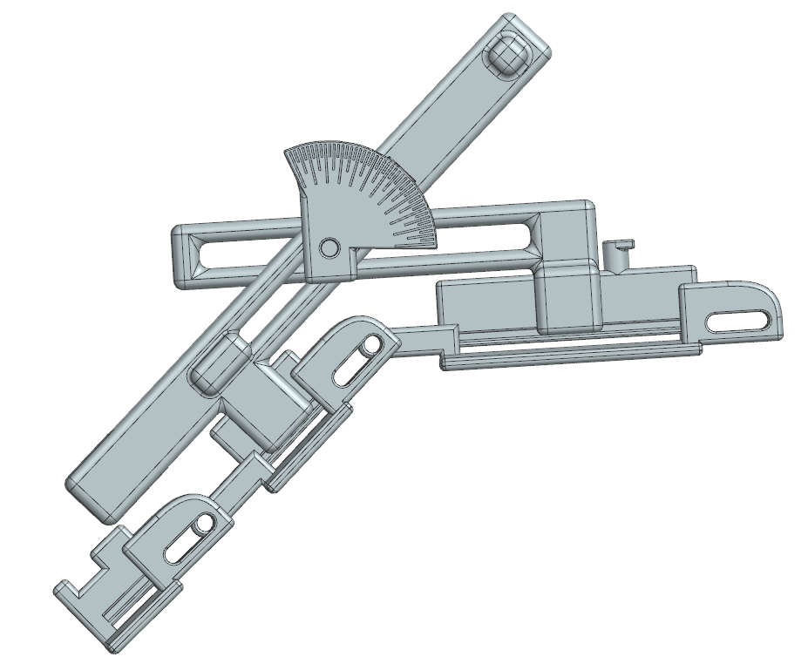
Goniometer and Abduction Design
Initial Design:
Thought of making a detachable plastic goniometer that would mount to the side of a finger and would have a pointer spin around the dial to display the angle
Believed that placing two plastic parts between the fingers in a V formation, connected by a pin, would allow for abduction of the fingers
Iterations:
The goniometer underwent no iteration
Abduction pieces were redesigned to be thicker as it was believed the parts would break
Final Design:
The final goniometer design functioned as intended, however, would benefit from a bigger dial to be more accurate and legible
The final abduction design functioned in CAD but failed in practice and was not used on the final prototype. It is believed that making the parts longer, as well as possibly mounting them on the side of the finger modules, would solve the problems.

Slide 6
Final Design

Slide 7
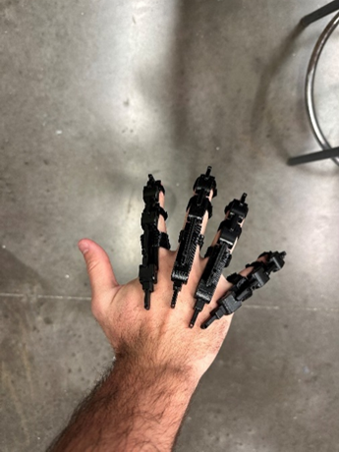
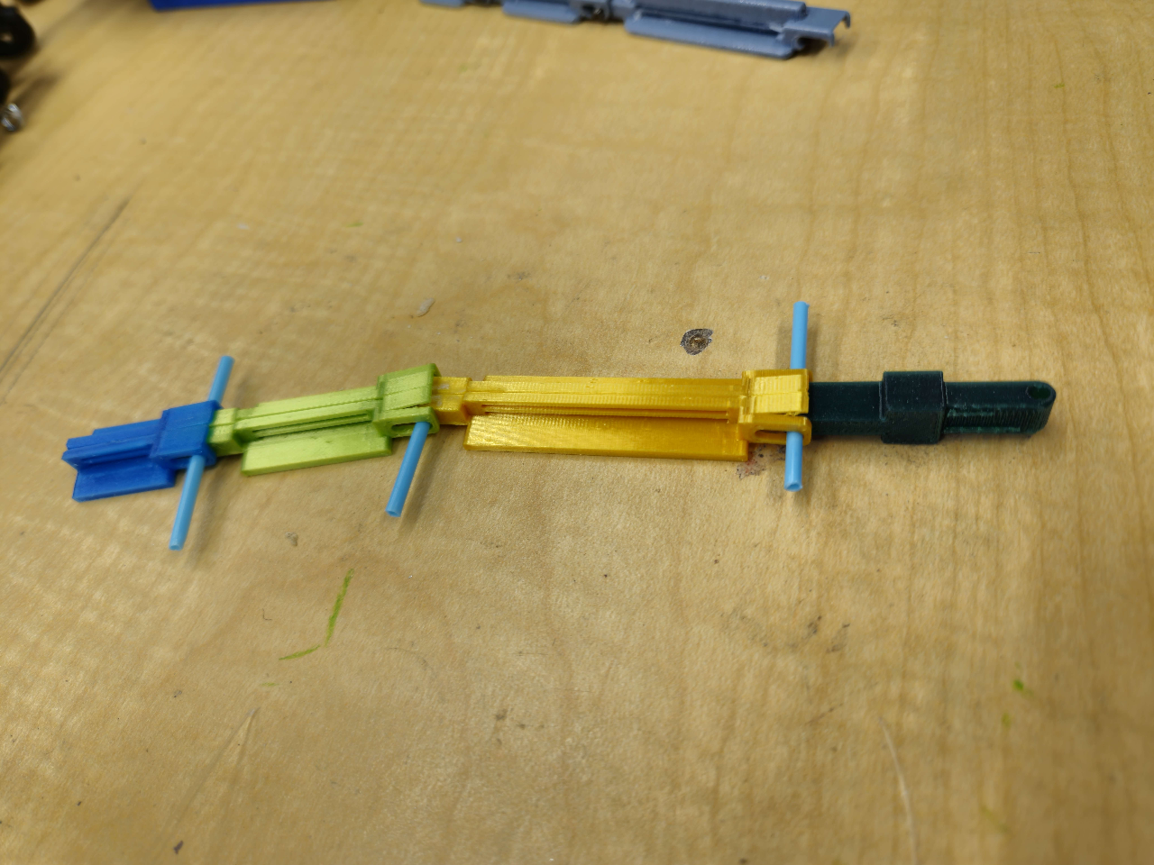
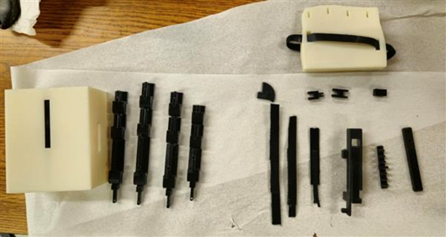
Manufacturing
3D Printing:
This was our main source of manufacturing.
Early prototypes were printed using the Prusa Printers in Hopeman which were sloppy but gave us a rough outline of each design concept.
In later iterations we were able to use the Stratsys J35 Printer in Rettner that allowed for much finer details to be accurately printed.
Manual Assembly:
Once each part was printed we manually assembled the parts together using pins where needed and gluing the parts in the respected areas.
The assembly process progressed from constructing the finger modules together and then gluing each miscellaneous part to the hand frame.
The manual assembly took roughly 3 hours once all parts were printed.

Slide 8
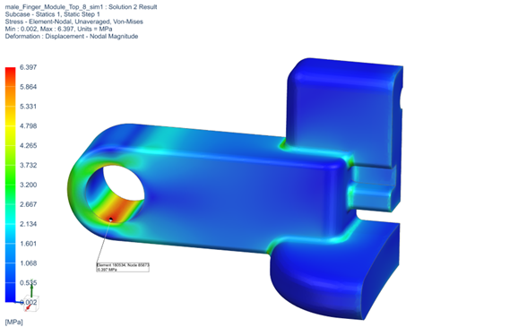
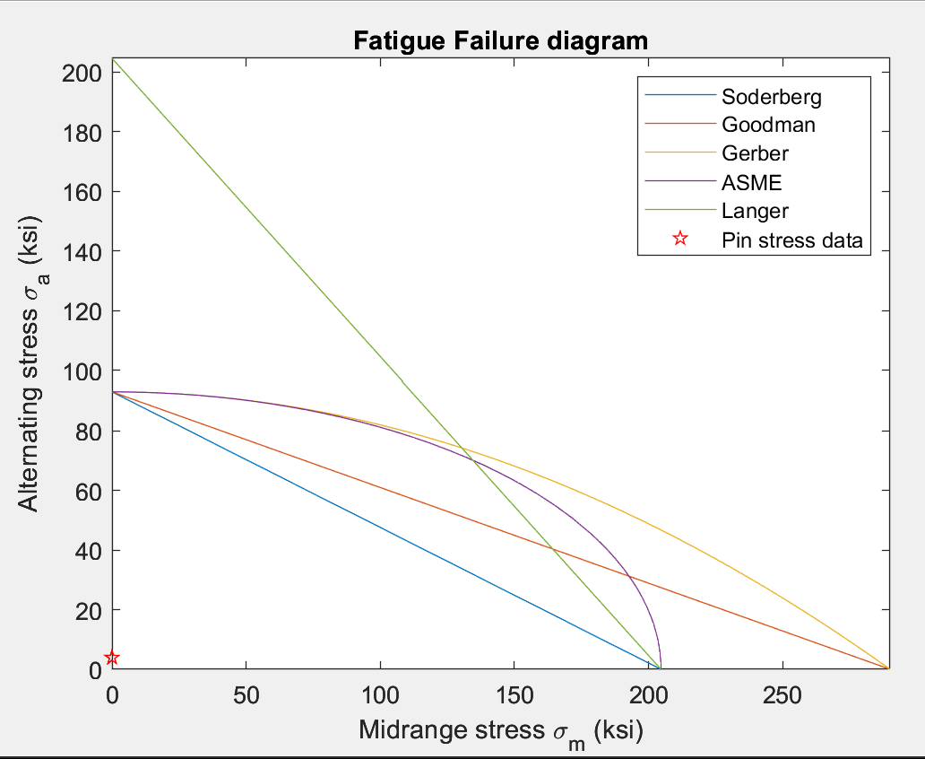
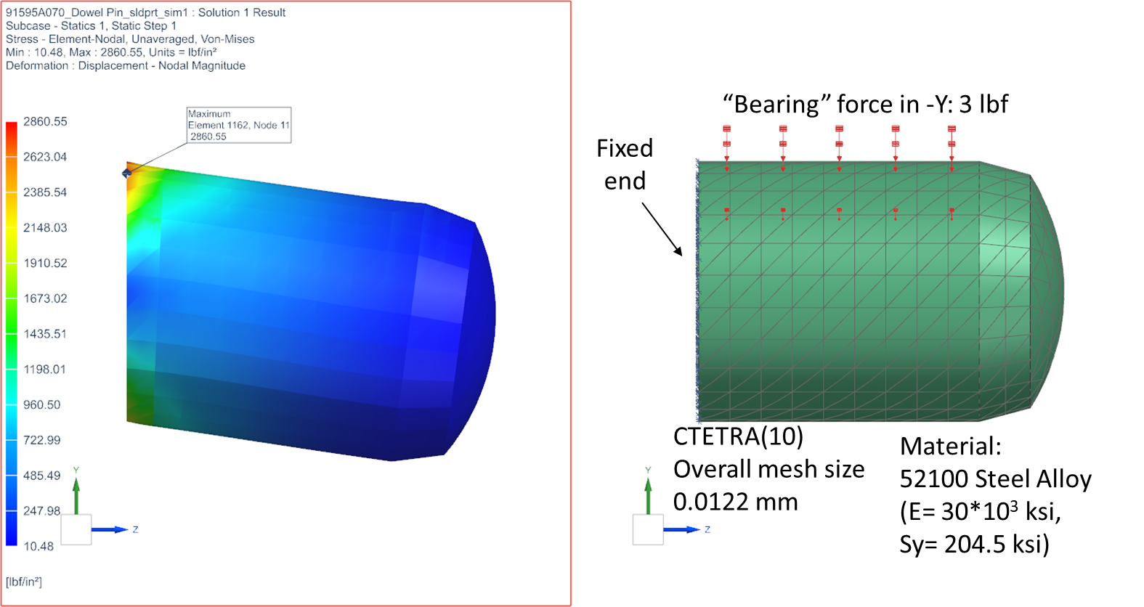
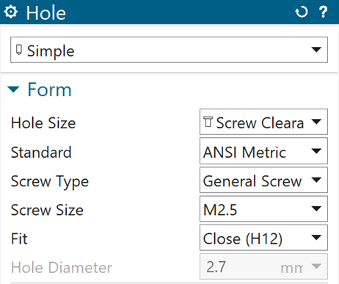
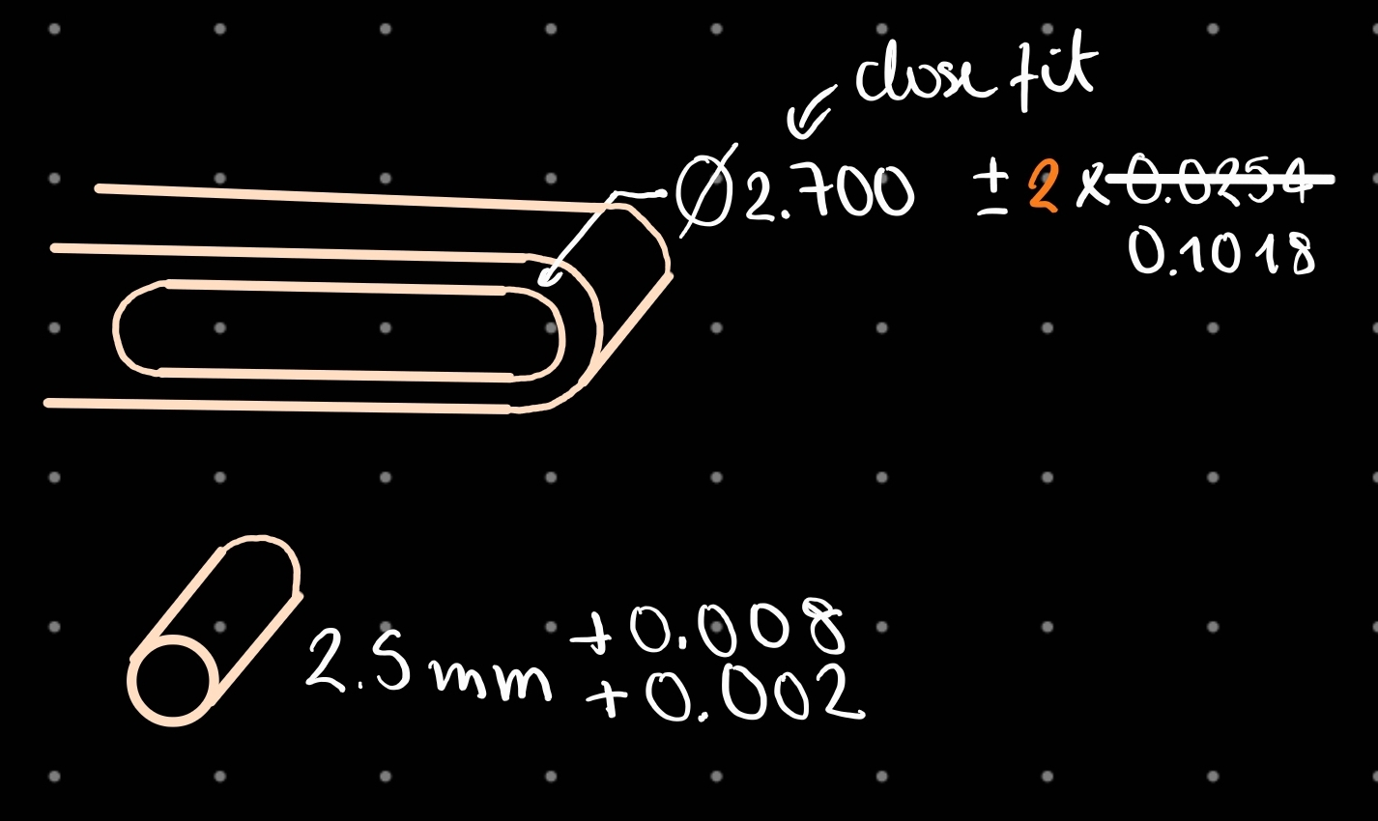
Mechanical Analysis
Four main mechanical analyses were performed:
Tolerance
Fatigue
Structural integrity (FEA) of system
Finger modules
Pins cantilever analysis
Finger modules
Pin and
Hand frame
Key takeaways:
Negative tolerance zone at MMC on finger modules
Negative tolerance zone at nominal size for hand frame.
SOLUTION: Wear down plastic in sliding joints.

Slide 9
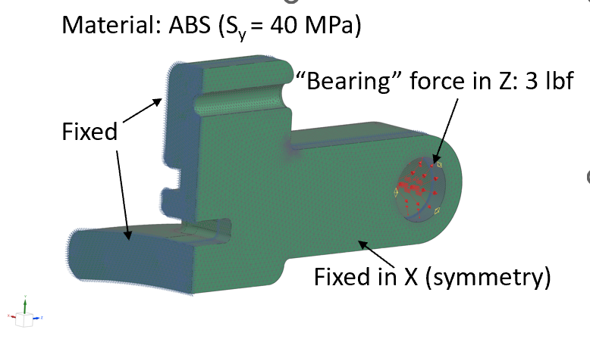
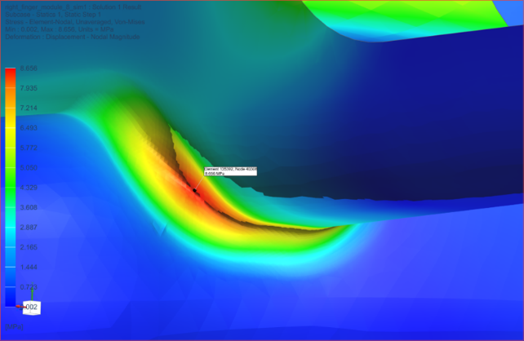
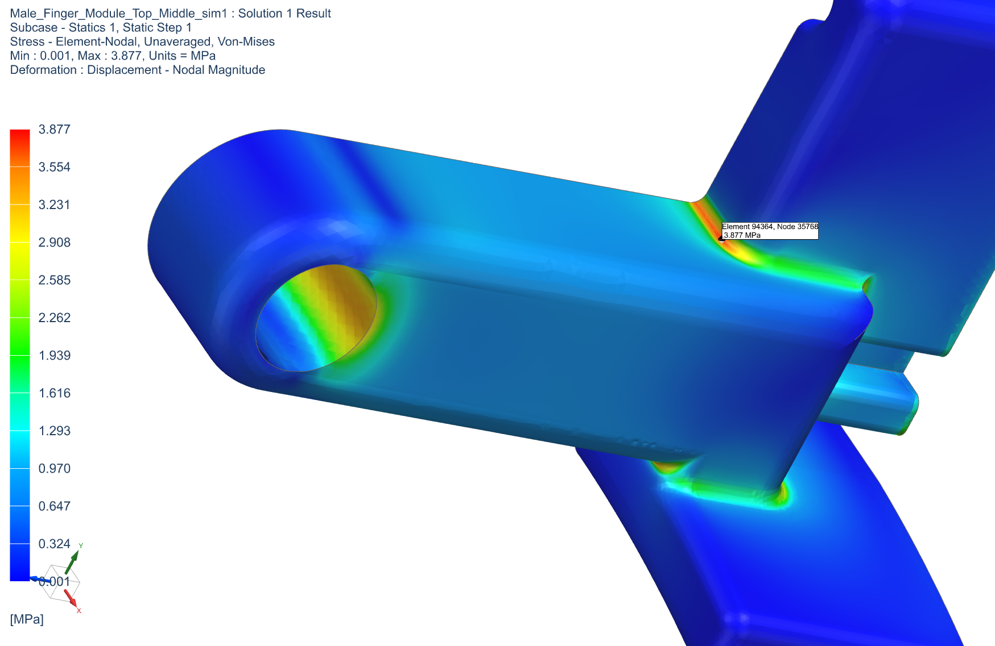
Mechanical Analysis
Structural integrity (FEA) of finger modules:
Goals:
Understand/replicate failure of former finger modules (V8).
Quantify improvement in design between iterations 8 and 9
Key takeaways:
Module V8 DID NOT FAIL (S_{y}=40 MPa), but highest stress zones validated.
Module V9 is 55.21% better in terms of stresses.
Highest VM: 8.656 MPa
VS
Highest VM: 3.877 MPa

Slide 10
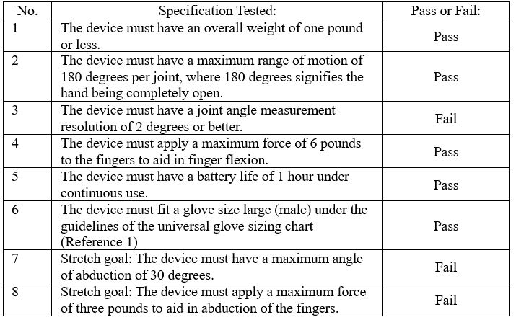
Testing and Validation

Slide 11
Future Improvements
Wrist Mount: Add padding, make lighter, lengthen slide cutout to improve range of motion.
Hand Frame: Ideally, elimination, as it is extremely difficult to make frame fit a hand or properly mold the frame to a hand to get a more precise fit.
Finger Modules: Bigger rounds, easier attachment to fingers, and complete overhaul to turn single sliding joint into double sliding joint (like the goniometer) to better fit multiple finger sizes, improve range of motion, and better prevent hyperextension.
Guide Rail: Slots in top to allow complete removal of fishing line if needed.
Hook: Eliminate backward facing hook on middle hook to allow servo motor to attach more securely.
Servo Motor Mount: Redesign to be stronger if current version begins to fail.
Circuit: Make smaller, add adjustment dial to control speed of motor.

Slide 12
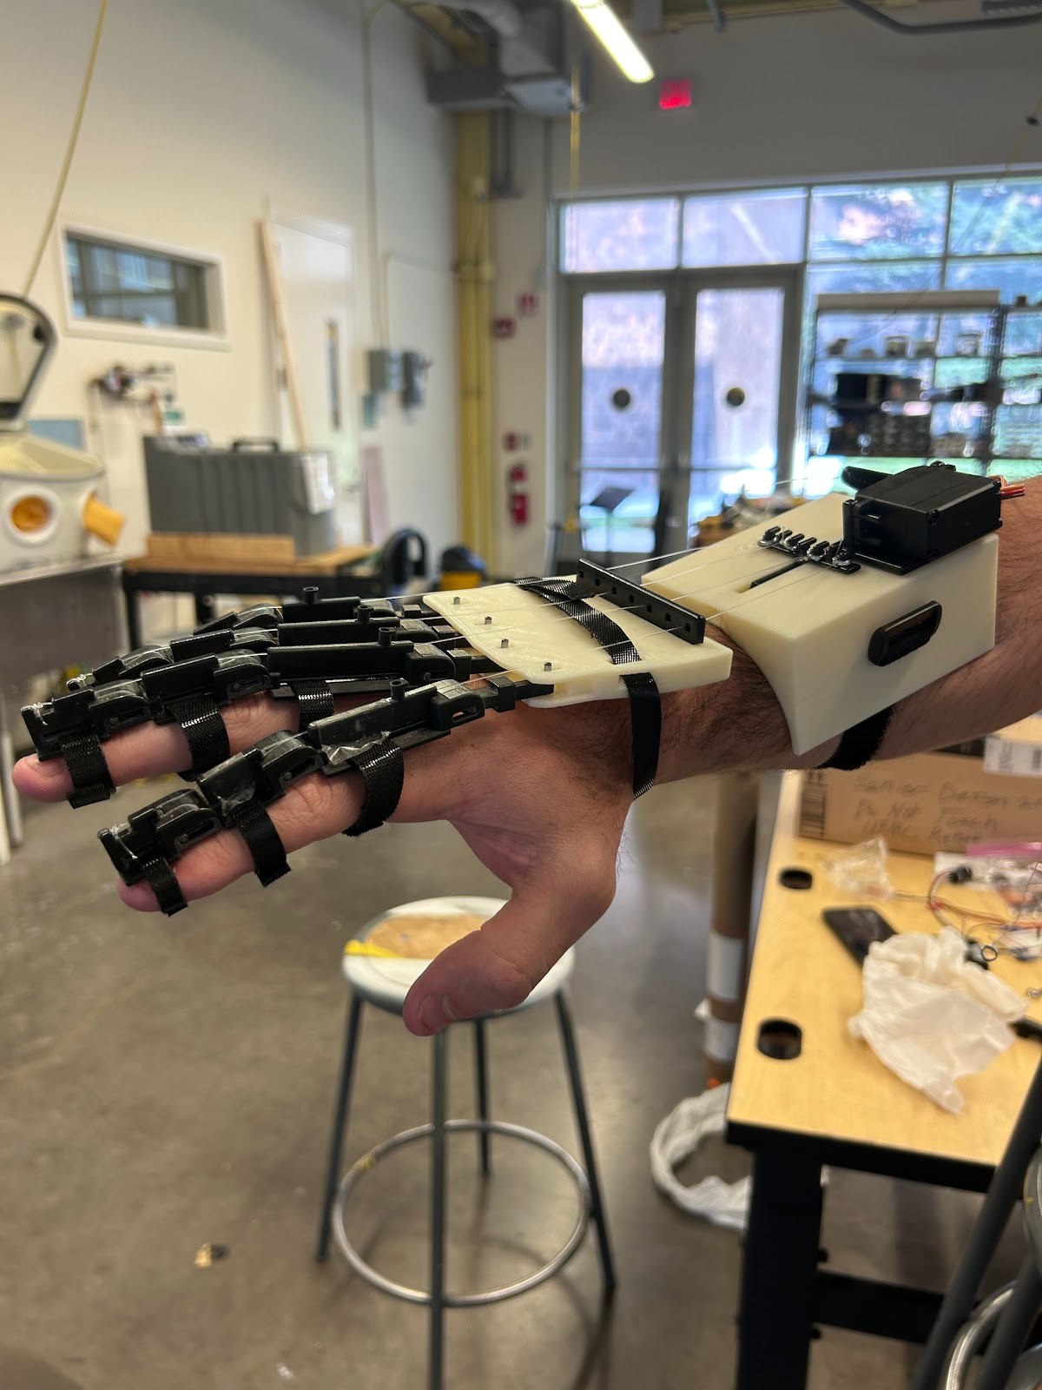
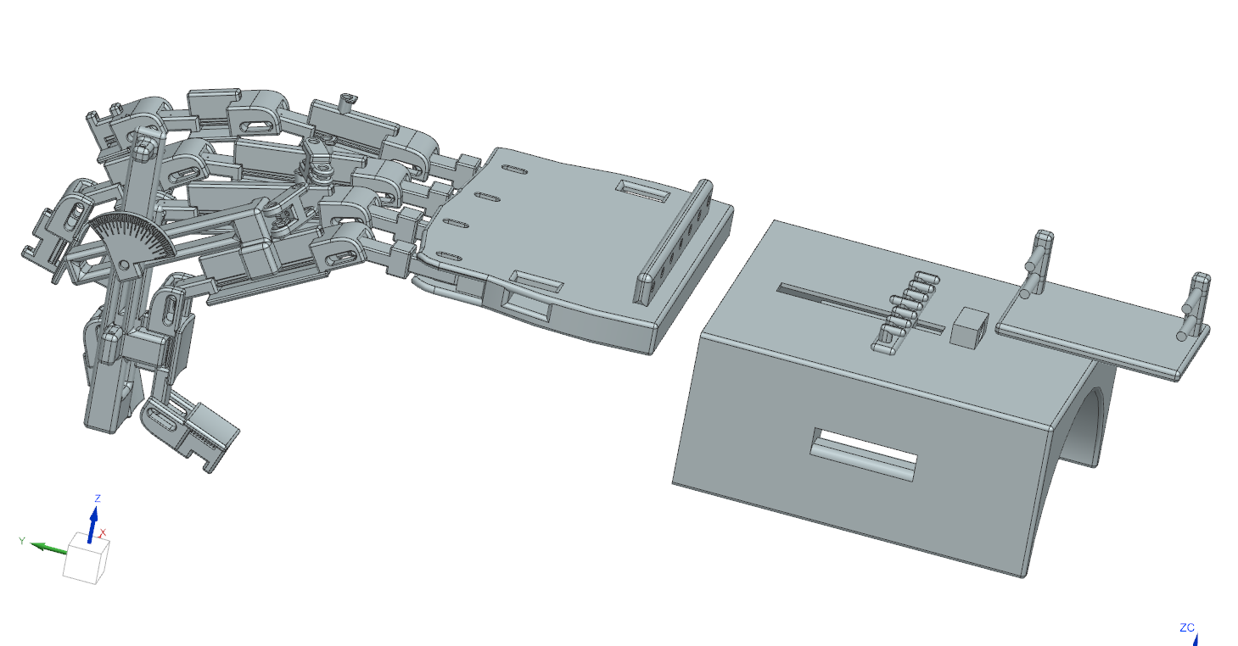
Conclusion
Special thank you to Professor Muir, Jim Alkins, and Monica Zaso for their help and expertise that we used to make this project possible!

